Slide 1
Bioengineering and Bioprinting: metrology to improve innovation
Jose Mauro Granjeiro
Senior Researcher,
Bioengineering Laboratory,
Directory of Life Sciences Applied Metrology, INMETRO
Florianópolis
2019

Slide 2

Team
UNICAMP, USP, UNESP, UFMG, UFRG, Centro Renato Archer, NYU, HU, PU, FP7
Inmetro
UFRJ:
Embryology and Histology
Chemical School
Pharmaceutical School
Engineering School / Coppe
UFF
National Institute of
Techcnology (INT)
Brazilian Center of
Physic Research
Military Institute of
Engineering

Slide 3
Team Networks – funding and cooperation
National Institute of Science and Technology on Regenerative Medicine (CNPq/Faperj - Brazil)
Nano Health Network (Rio de Janeiro - Faperj)
Rio de Janeiro Bioengineering Network

Slide 4
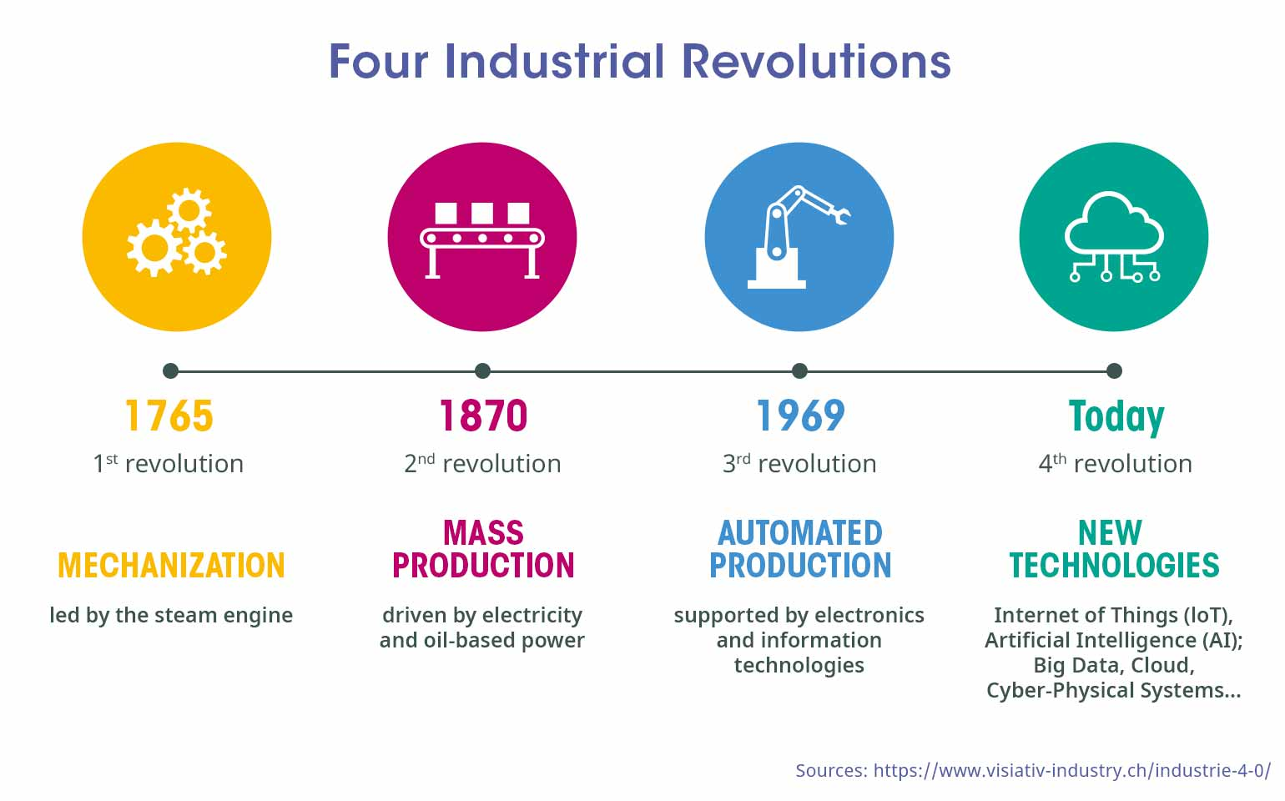
Context

Slide 5
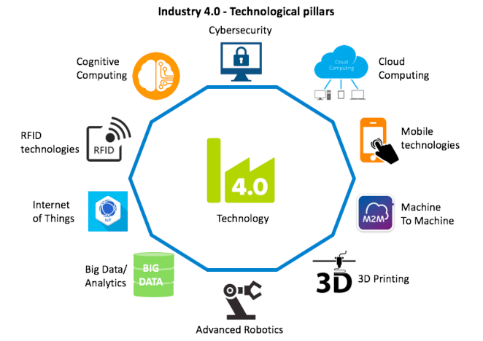
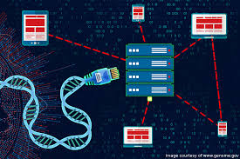
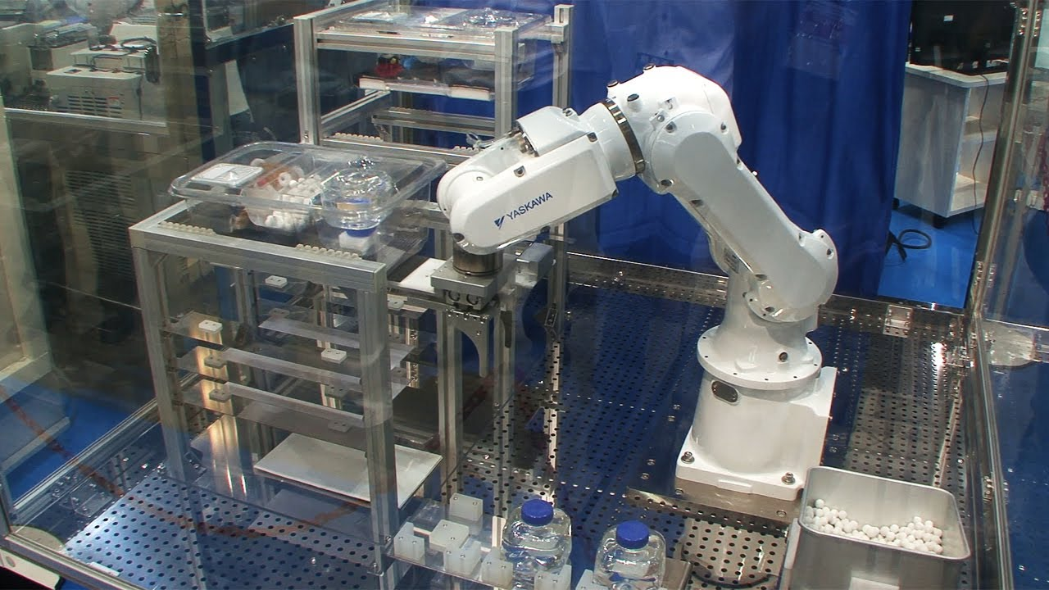
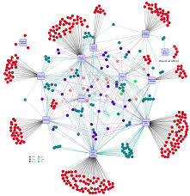
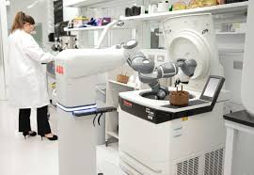
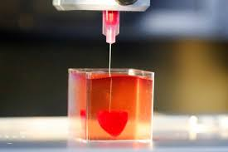
Industry 4.0 and Biotecnology

Slide 6
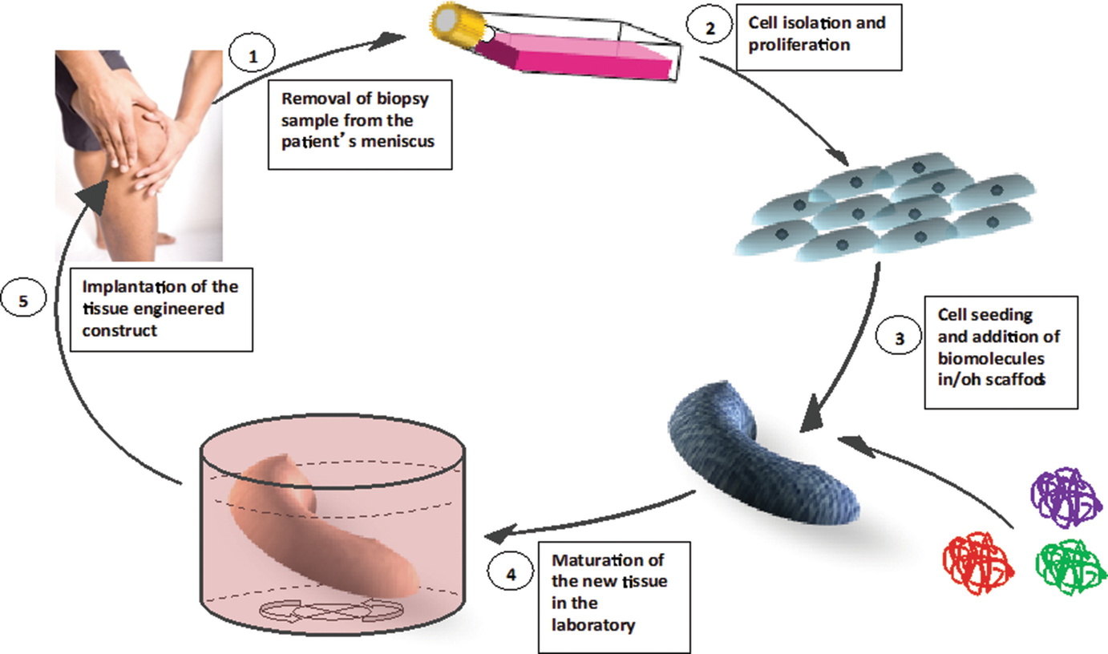
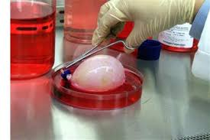
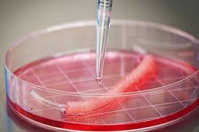
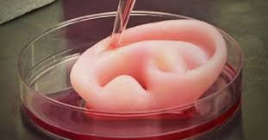
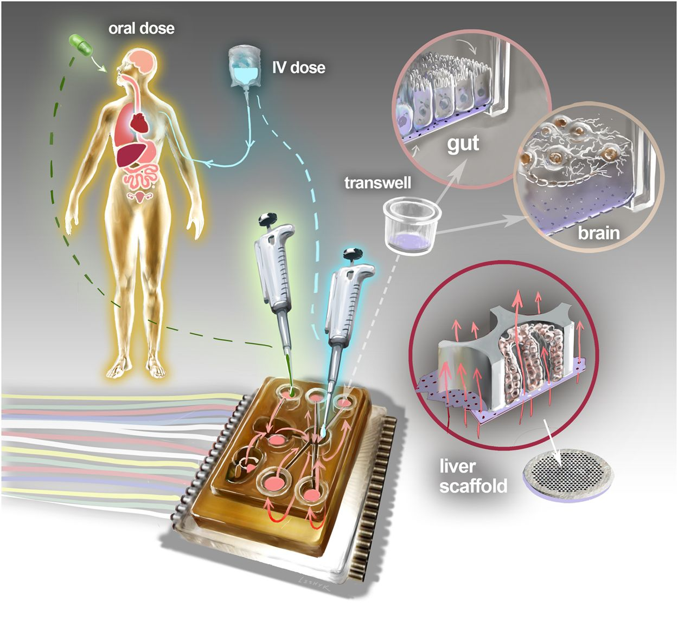
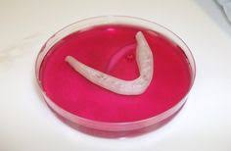
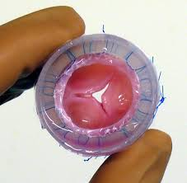
Biotecnologia: tecidos para a vida
Bioengineerd tissues
Regenerative Medicine
Bladder
Blood vessel
For what?
Ear
Mandible
Cardiac valve
Toxicology for XXI Century
(human on a chip)

Slide 7
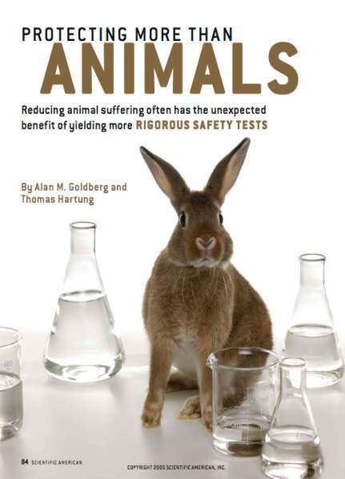


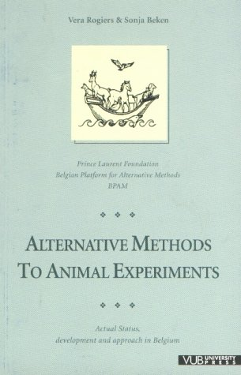




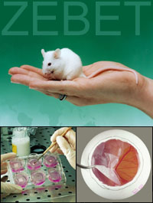






Alternative Methods to Animal tests
Ethical issues
Scientific issues
Better science
Less animals
Human relevance
Faster and cheaper results
3R
Replacement
Reduction
Refinement

Slide 8

Hughe challange
4Rs
Publish
Challenge
Quality
Reliability
Traceability
Bias
Funding
Private
Public

Slide 9
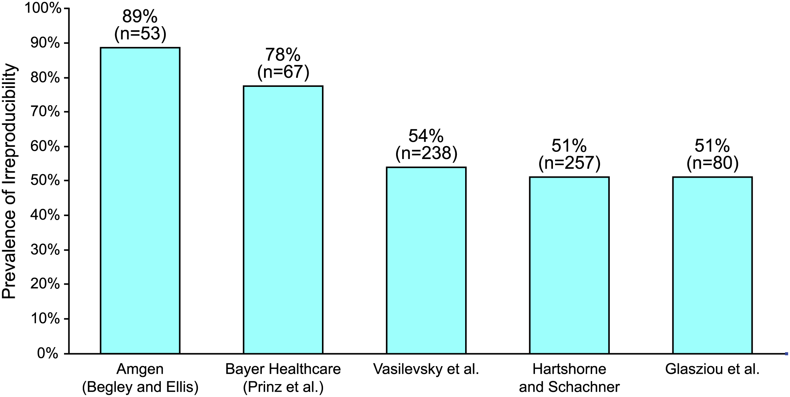
The Economics of Reproducibility in Preclinical Research
Leonard P. Freedman , Iain M. Cockburn, Timothy S. Simcoe. PLOS https://doi.org/10.1371/journal.pbio.1002165
Reliability….

Slide 10
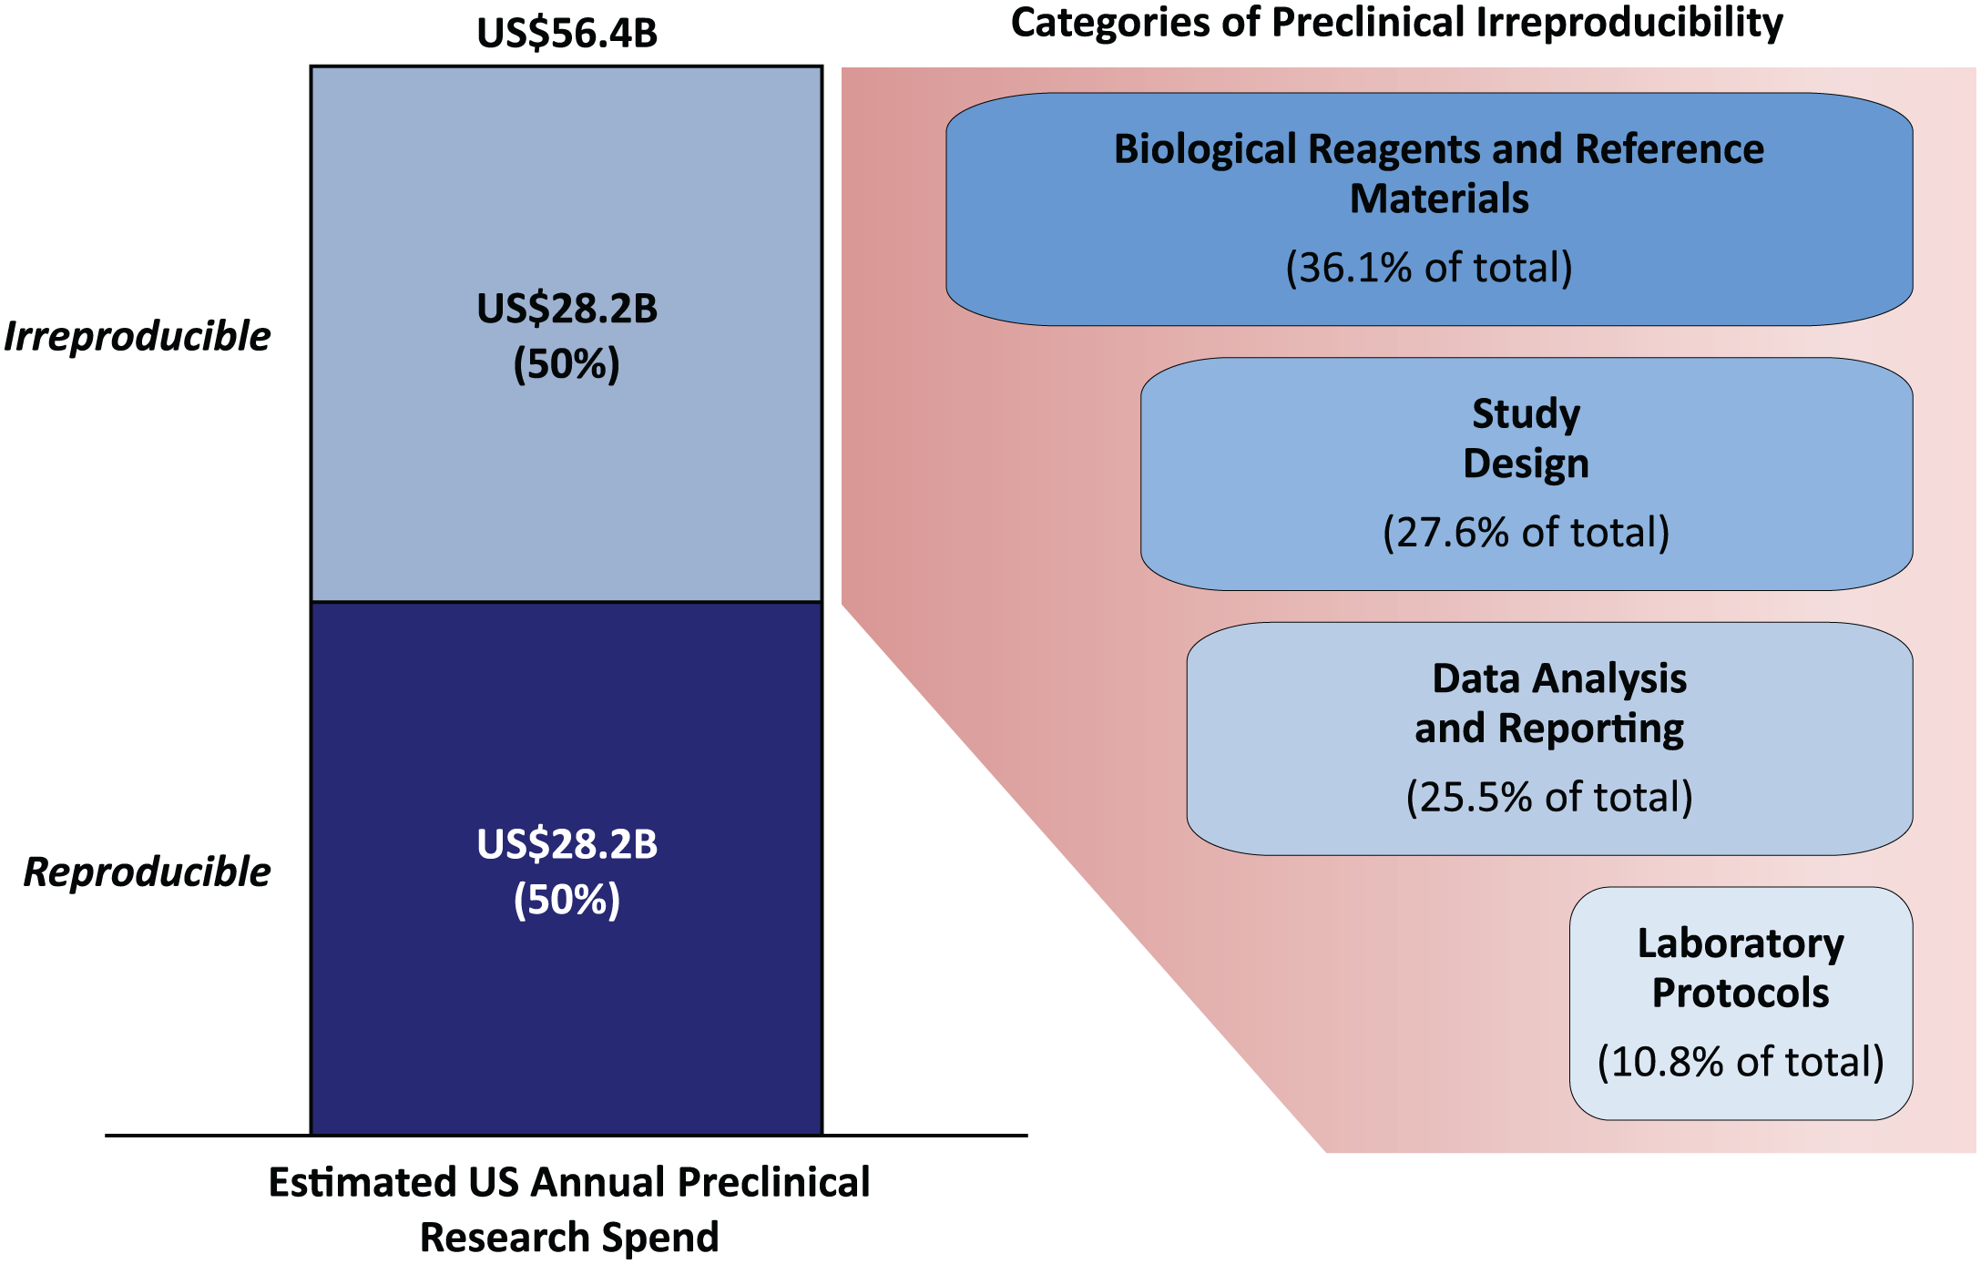

Irreproducibility cost
Quality
assurance !!!
Notes:
The treatment and assemsnet of toxic effects are onging.

Slide 11
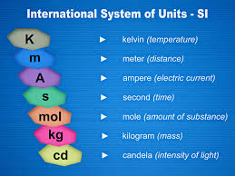
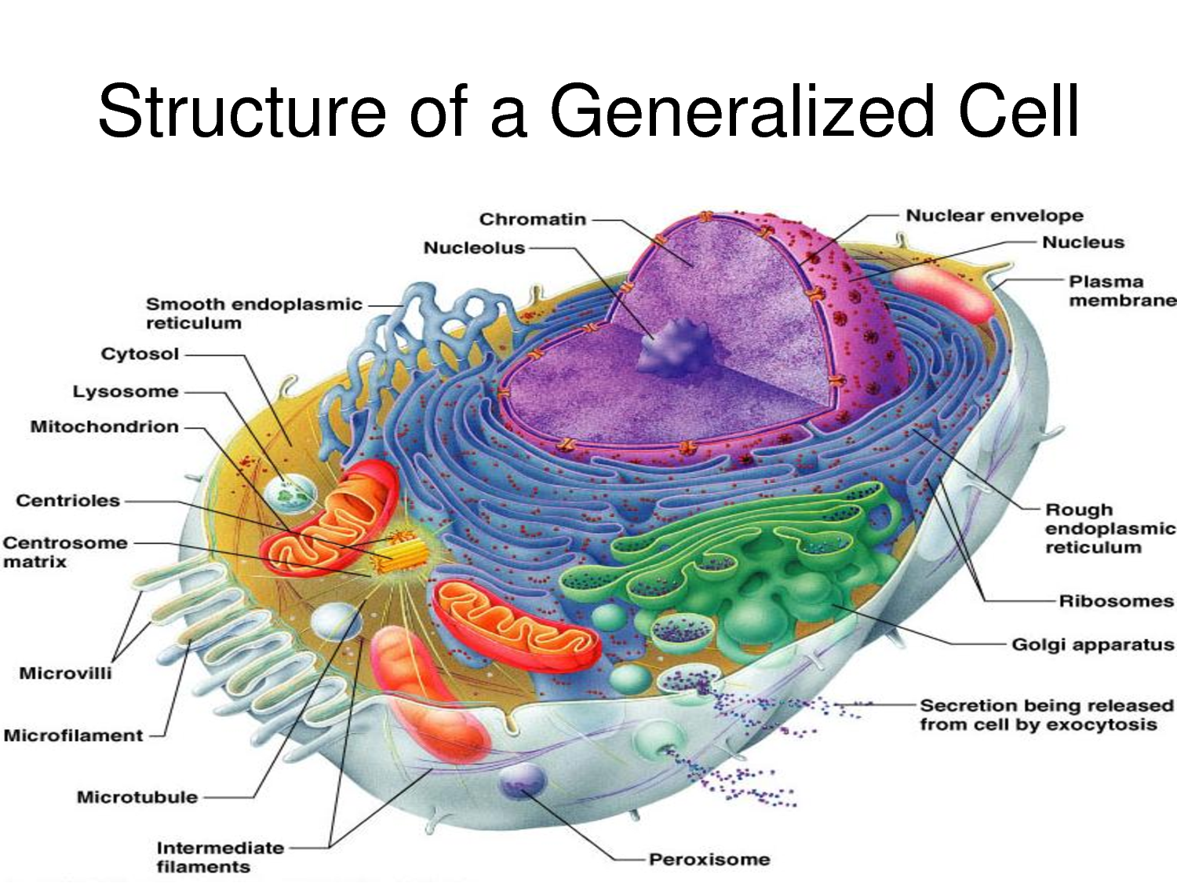
Metrology of cells, nucleic acids and proteins
Counting viable cells
Identification and quantification of amino acids and proteins
Identification and quantification of nucleic acids (DNA, RNA, microRNA)

Slide 12
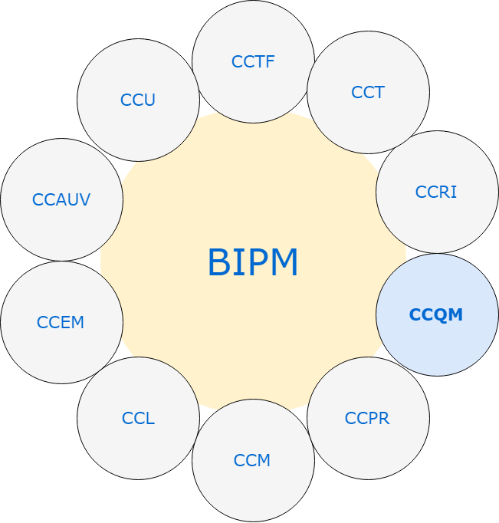
Biometrology – 2001 BSWG/BIPM)
Consultative Committees of the CIPM
isotopic
ratios
Time and frequency
surface
temperature
inorganic
units
electrochemistry
Ionizing
radiation
gas
Acoustics,
ultrasound
and vibration
organic
CIPM
proteins
PAWG
CAWG
NAWG
Amount of
substance
Quantification and Traceability
cells
Electricity
and magnetism
microbiology
nucleic acids
Photometry
and radiometry
Key
comparisons
Pilot Studies and KC
lenght
Strategic
planning
mass
mol

Slide 13
Life Sciences Applied Metrology
Dimav
Lamav Lamic Labio Lamac Lqbio
Microscopy
Optical,
electronic,
High througput
Microbiology
identification,
quantification,
preservation
Cell culture
Authentication
Tissue-equivalents
in vitro toxicology
Macromolecules
DNA, carbohydrate
and protein
analysis
Small biological
molecule
analysis
Bacterial and
yeast scale-up
Pharma
scale-up
Staff (researchers, technicians)
7 8 6 8 3

Slide 14
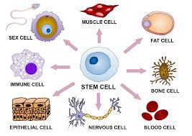
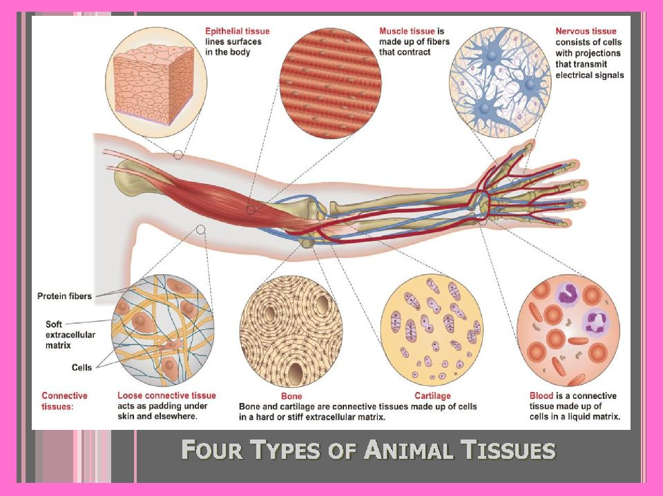
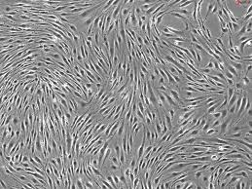
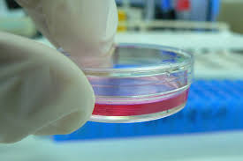
Human cells

Slide 15





Tissue Engineering - spheroids
Human cells
  Blood vessels
  Mucosa
    Gastric
    Respiratory
    Oral
    Intestine;
  Bone
  Cartilage

Slide 16
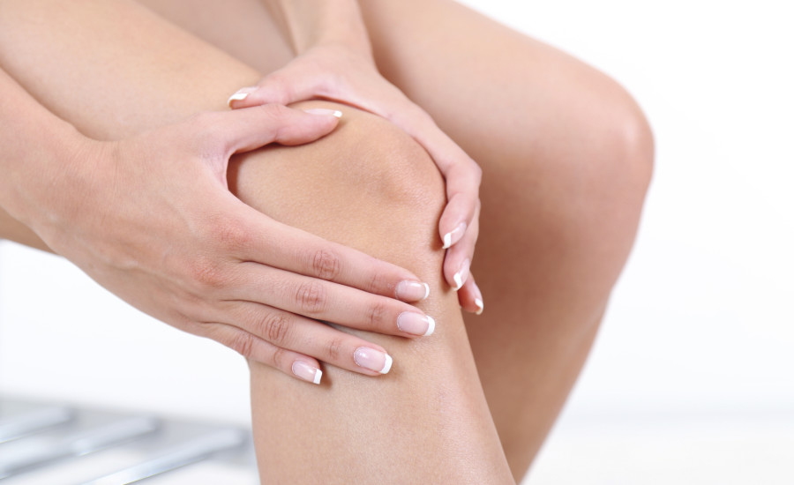



Social and Economic Impact
- In 2013, about $ 304 billion was spent on medical expenses and sick leave in the United States.
Life Quality
7.5% of leaves of work.
10.5% of sick leave applications.
6.2% early retirement.
https://www.vectorstock.com/royalty-free-vector/sad-people-black-icon-vector-19729271

Slide 17
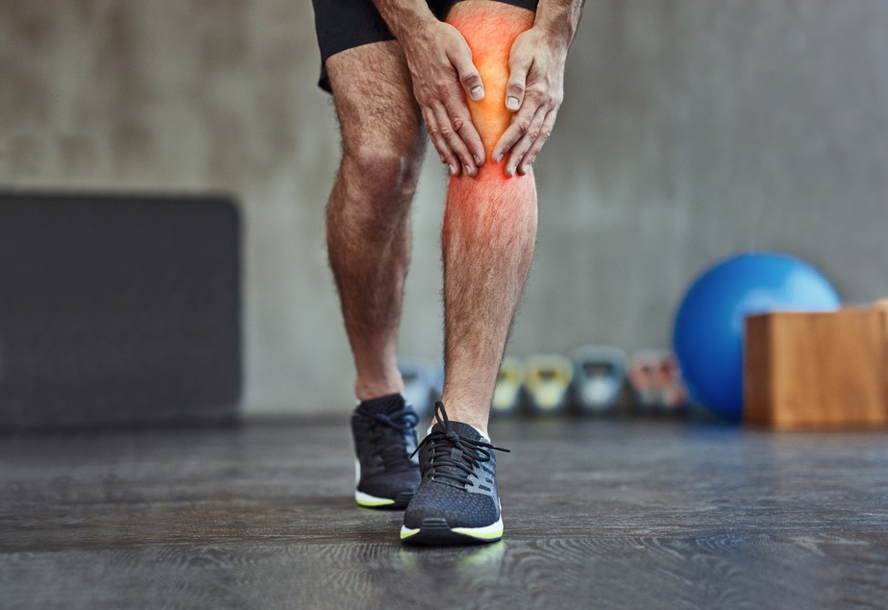
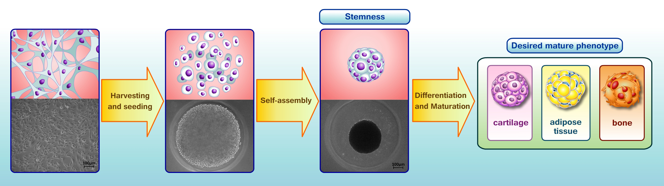
Tissue Engineering for bone and cartilage injury

Slide 18

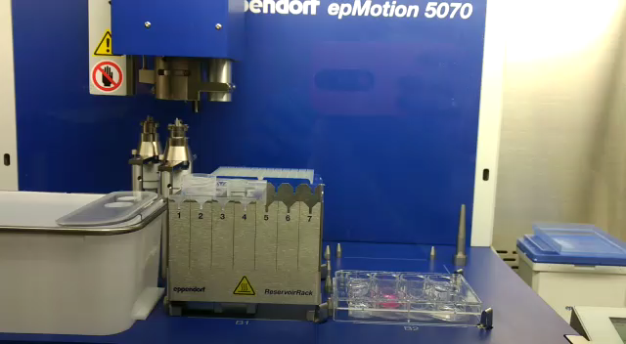
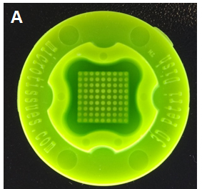
Human adipose tissue derived stem cells spheroids
Micro-molded non-adhesive
hydrogel
Stuart MP et al. Stem Cells International. 2017. https://doi.org/10.1155/2017/7053465
Notes:
In our research group, we form three dimensional spheroids from human adipose tissue derived stem cells due to their multilineage potential, as I explained before. For reach a three dimensional culture system scalable and reproducible we are using the mircomolded nonadhesive hydrogel capable to form eighty one spheroids per each well in culture plate. The cell seeding step was automatized using this platform

Slide 19
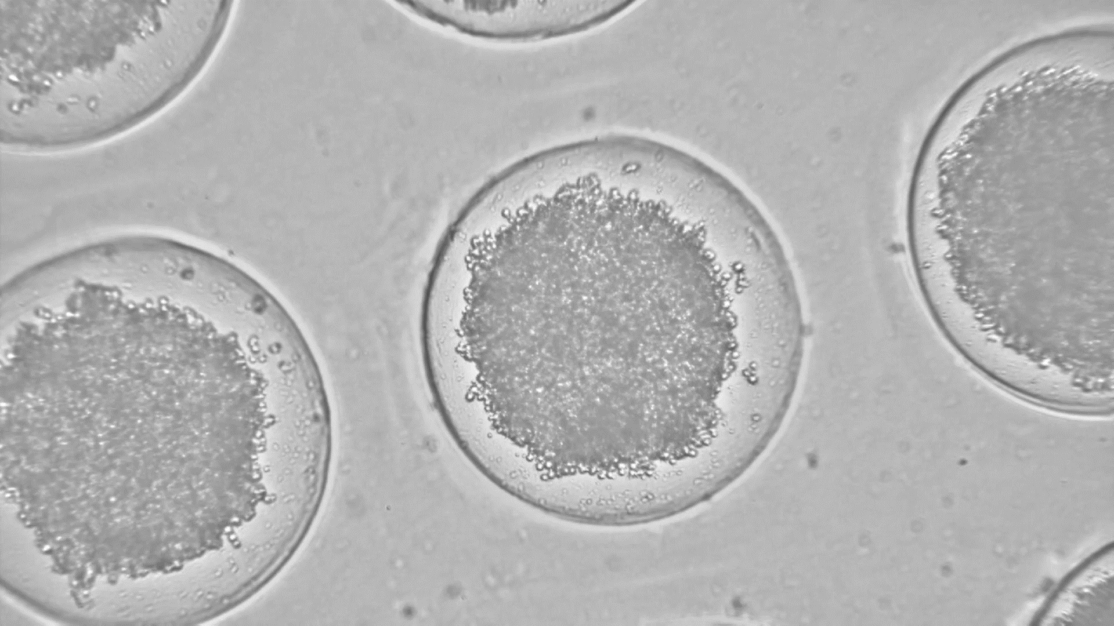

Slide 20
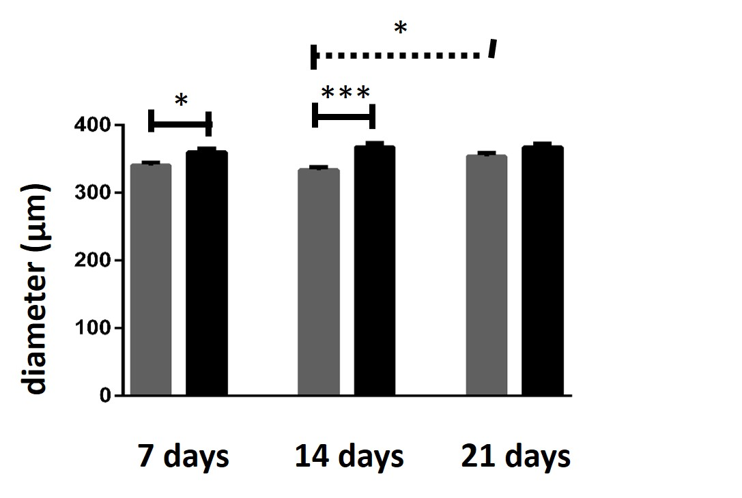
End points (analysis) of 3D spheroids
From spheroid culture supernatant
From spheroids
REPRODUCIBILITY
Diameter measurement (viability)
Eletronic microscopy (morphology)
Biomechanical assay
Histology/Specific targets (immunofluorescence, immunohistochemistry)
Molecular assays
(qPCR, transcriptome)
Flow cytometry
(viability, cell cycle and cell phenotype)
Biochemistry assays (viability)
Non-specif targets (secretome)
Specific targets (multiplex, CBA)
RASTREABILITY
***
**
TGF-β3 (pg/mL)
**
**
a 7 days 14 days 21 days
Notes:
For efficacy assessment of our three dimensional tissue construct derived from spheroids, we can divide the end points into two main groups: from spheroids and from spheroid culture supernatant. From spheroids we can perform analysis from intact spheroids such as eletronic microscopy and histology or from dissociated spheroids such as molecular assays and flow cytometry analysis. From spheroid culture supernatant we can perform analys to specific targets such as dosage of cytokines and growth factors or non-specific targest using omic tools.

Slide 21
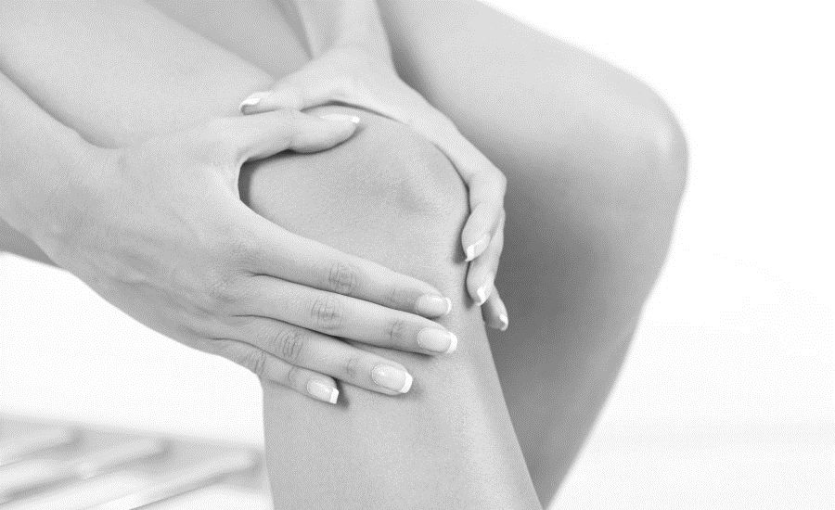
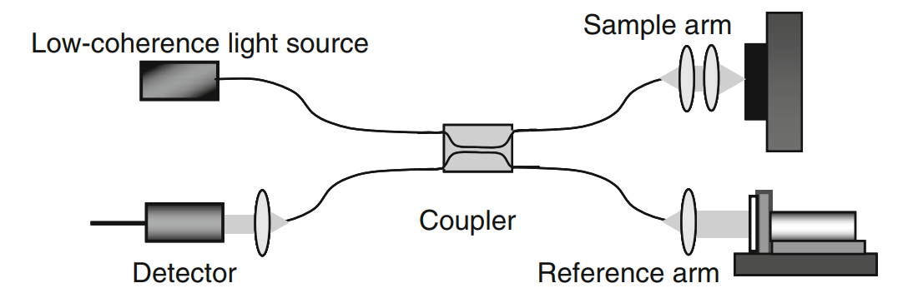
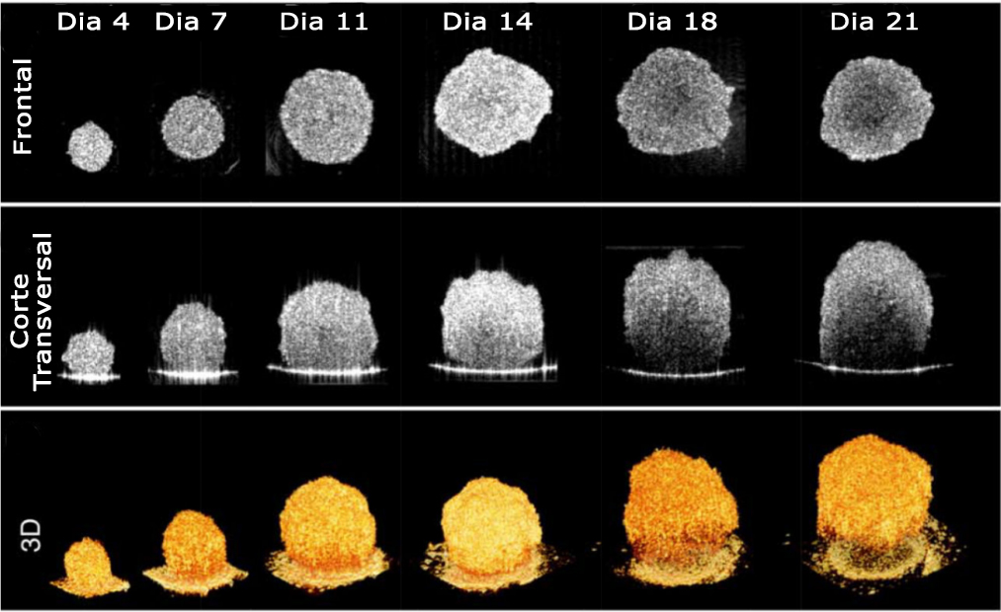
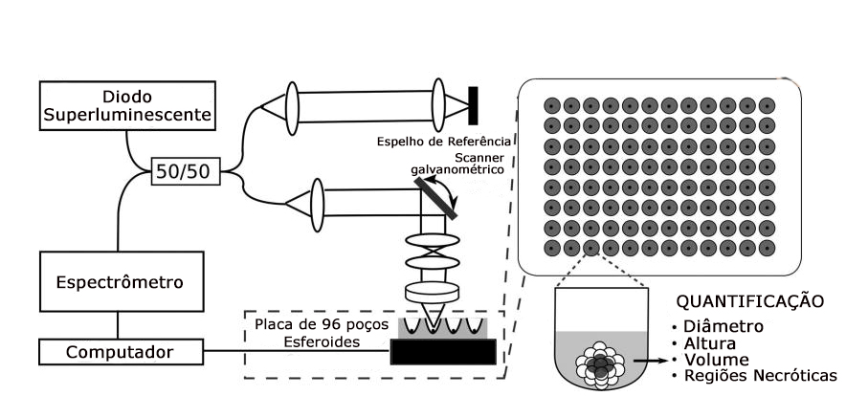
Optical Coherence Tomography - OCT (Huang et al, 2017)
OCT uses light waves to take cross-section images of tissue: Non-invasive, real time, quality control of spheroids
POPESCU et al, 2011
HUANG et al, 2007
HUANG et al, 2017

Slide 22
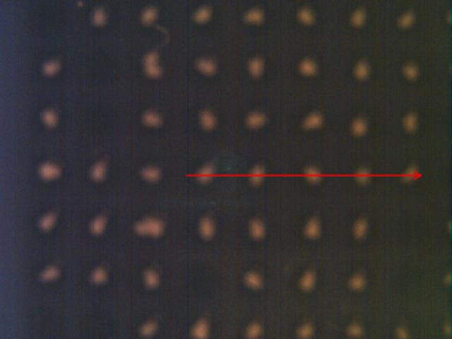
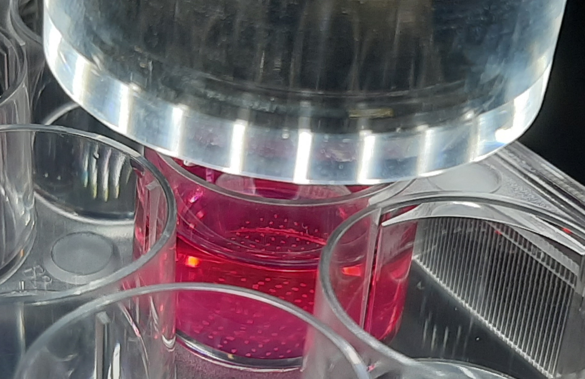
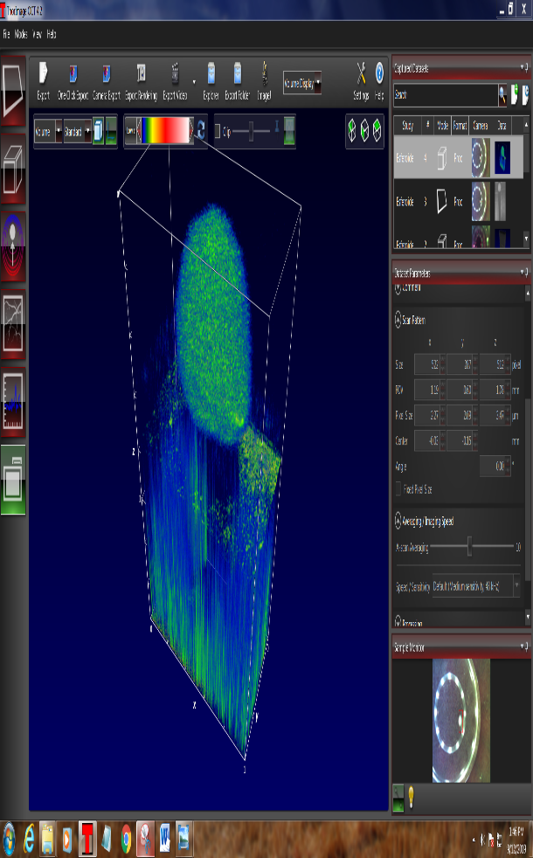
Preliminary Result

Slide 23
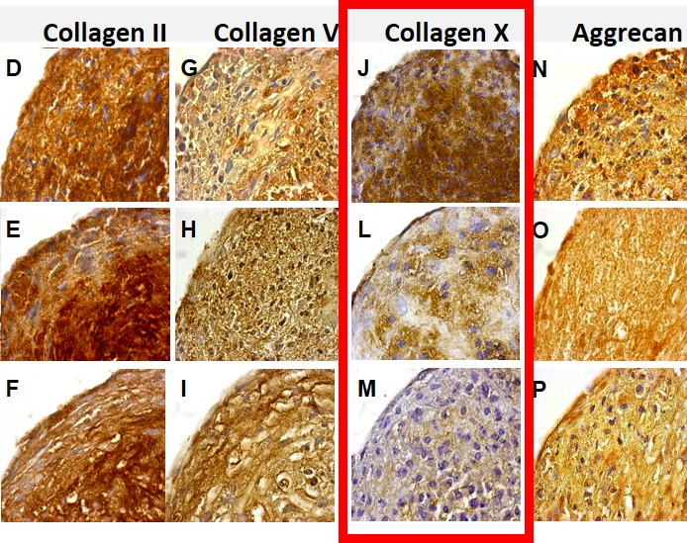

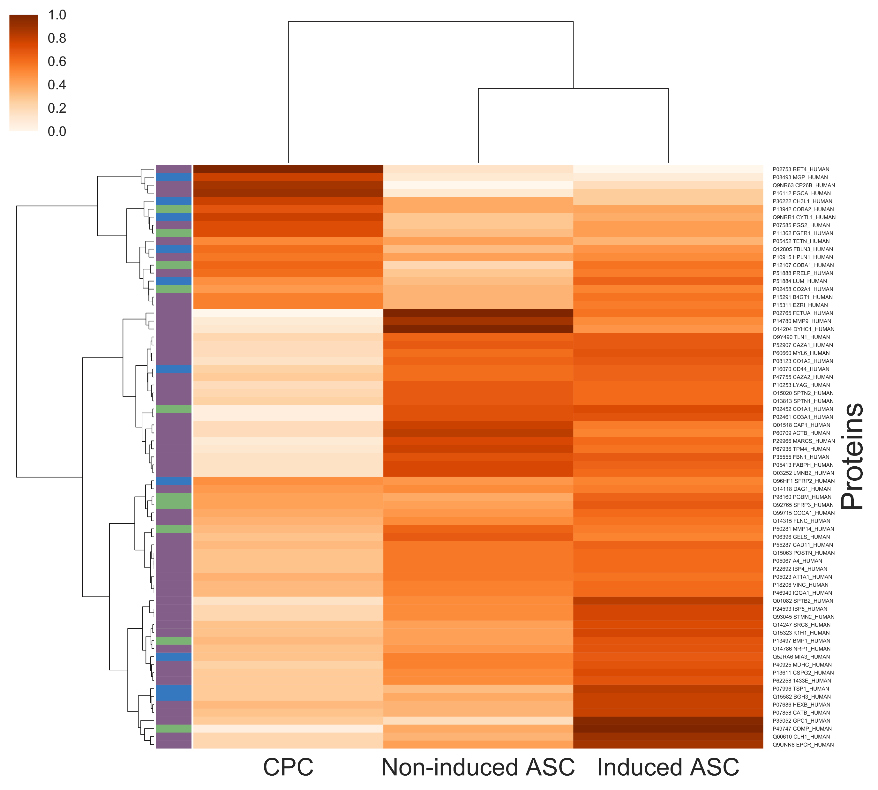

Biological advantages of self-assembly
N-cadherin
Cartilage bioengineering
Spheroid
Embryological development of stable cartilage
Côrtes et al. Tissue Eng Part A. 2019 Feb 8. doi: 10.1089/ten.TEA.2018.0311
Notes:
The self-assembly of adipose stem cells spheroids mimics the condensation stage of cartilage formation during the skeletal embryonic development. Due to this mimicry, we expected to reach not only a mature chondrocyte phenotype, but more importantly, a stabilized phenotype without signs of hypertrophy.

Slide 24
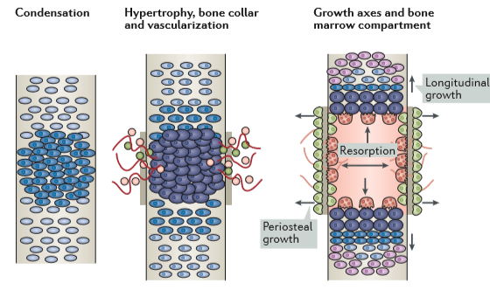
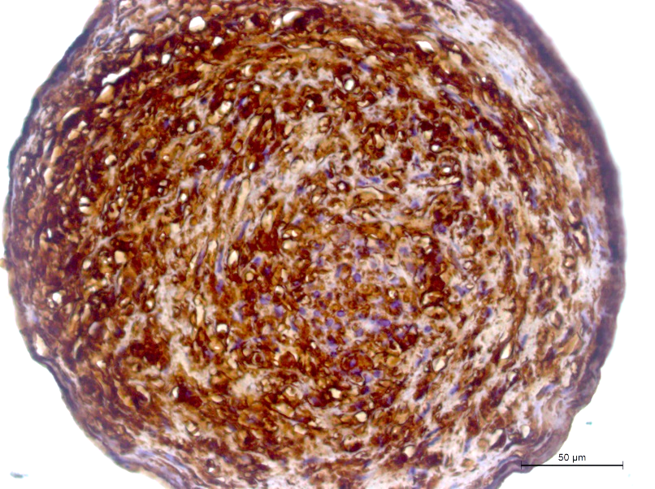
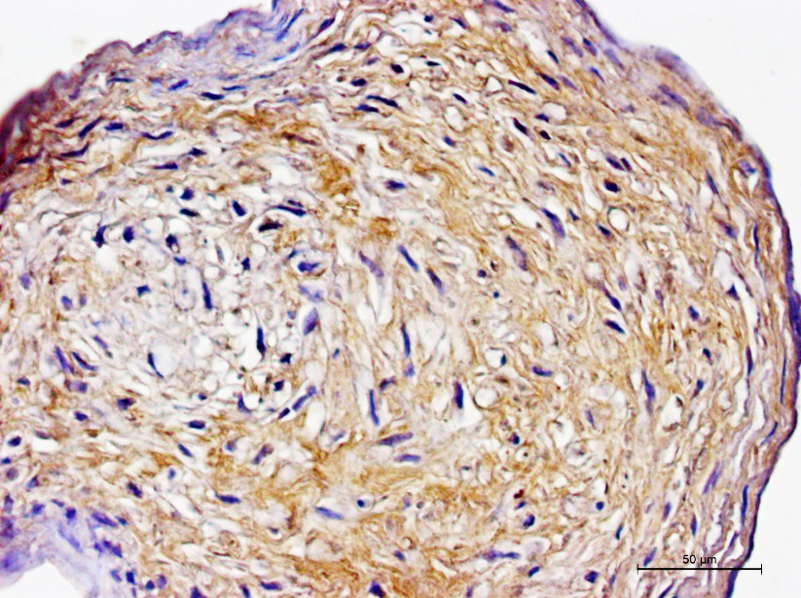
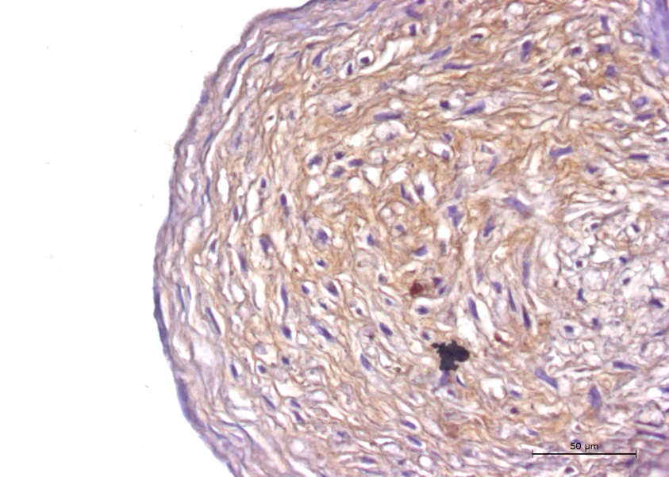
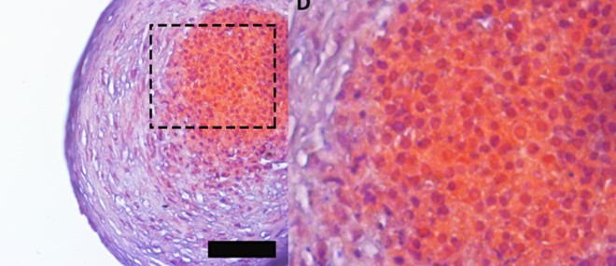
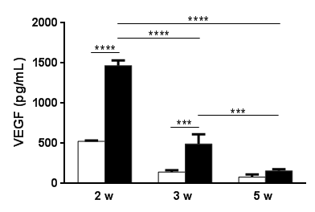
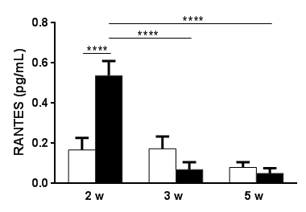
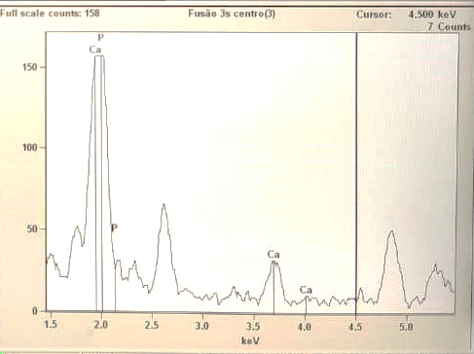


Col X
Col I
Osteocalcin
Bone bioengineering
Embryological development of endochondral ossification
Engineered hypertrophic cartilage
Master Thesis Kronemberger, 2018
Submitted results

Slide 25



Bioprinting

Slide 26

Clinical concept: In Situ RAPID TISSSUE BIOFABRICATION USING SCAFFOLDS
Scheme demonstrating in vivo rapid 3D tissue biofabrication using tissue spheroids

Slide 27

Bottom-up tissue engineering: spheroids
Laschke MW, Menger MD. Trends Biotechnol. 2017 Feb;35(2):133-144. doi: 10.1016/j.tibtech.2016.08.004.

Slide 28

Cartilage and bone bioprinting
Baptista LS et al. Int. J. Mol. Sci. 2018, 19, 1285; doi:10.3390/ijms19051285

Slide 29


Our first bioprinting test with cartilage spheroids

Slide 30



Bone constructs (biomaterial+spheroids) produced in the laboratory (biofabrication)
Rattus norvegicus
Scaffold
CTL
CTL
CTL
Spheroids production
24h
7 days
n = 28 animais (in vivo 1)
n = 1 (Cloth group)
n = 6 (Biomaterial group)
n = 6 (Bomaterial + spheroids group)
Experimental period = 3 months
Paulo A de O, Castro-Silva II, Oliveira DF, Machado ME, Bonetti-Filho I, Granjeiro JM. Repair of critical-size defects with autogenous periosteum-derived cells combined with bovine anorganic apatite/collagen: an experimental study in rat calvaria. Braz Dent J. 2011;22(4):322–328. doi:10.1590/s0103-64402011000400011

Slide 31






3 months after implantation: biocompatibility, no immunological rejection – new bone formed

Slide 32

3D cell culture perpective: Bioprinting using spheroids as building-blocks (bottom-up approach)
Baptista LS et al. Frontiers In Bioscience, Landmark, 23, 1969-1986, June 1, 2018. DOI No:10.2741/4683]
Adaptado de Guven S et al., Trends Biotechnol. 2015, 33:269-279. doi: 10.1016/j.tibtech.2015.02.003.

Slide 33




Bioprinting using spheroids as building-blocks
1.5mm diâmetro por 7mm comprimento
Itoh M et al. PLoS One. 2015 1;10(9):e0136681. doi:10.1371/journal.pone.0136681.

Slide 34

Bioprinting using spheroids as building-blocks: fusion and biomechanical assays
Côrtes et al. Tissue Eng Part A. 2019 Feb 8. doi: 10.1089/ten.TEA.2018.0311

Slide 35







Bioprinting using spheroids as building-blocks: fusion and biomechanical assays
A
B
C
D
E
F
Unsubmitted results

Slide 36



Motivation

Slide 37









Surgical cleft lip repair - cheiloplasty
(3 months)
Surgical cleft palate repair - palatoplasty
(6-12 months)
Bone graft
(8-11 years)
Orthodontic movimentation
(2-15 years)
A
1st Generation
2nd Generation
3rd Generation
B
Donor:
Human cadaveric
bone
Alloplastic
Graft
Allogenous
Graft
Osteconductive Biomaterials/scaffold
(hydroxyapatite, TCP)
Biomaterials/scaffold
Bone Bioengineering
Signaling molecules
Receptor site: palate
Stem Cells
PRP
PRF
Engineered bone graft
Autologous
Graft
Donor site:
iliac crest/hip (most commum)
Growth Factors
BMPs
patient

Slide 38

Biometrology: the new frontier to be explored!
MISSÃO DO INMETRO
A medida certa para
promover confiança à
sociedade e competitividade
ao setor produtivo.

Slide 39


Agradecimentos ; )
https://www.grupoctab.com/
Collaborator:
Anderson Beatrici, Inmetro
PhD students:
Isis Côrtes, Inmetro
Renata Matsui, Inmetro
Gabriela Kronemberger, Unigranrio
Letícia Charelli, COPPE - UFRJ
Master student:
Guilherme Miranda, Inmetro
Undergraduate students:
Bianca Montenegro, UFRJ-Xerém
Marcela Marins, UFRJ-Xerém
Tathiana Proença, UFRJ-Xerém
Úrsula Kopke, UFRJ-Xerém

Slide 40



Inscrições gratuitas:
www.grupoctab.com
/bioimpressao

Slide 41




www.grupoctab.com/cultivocelular3d
Notes:
Taking advantage of my time here, I would to share with you our theorical-pratical course in three dimensional cell culture. The third edition just happened and informations can be obtained using this link or e-mail.

Slide 42


Episkin, L´Oreal, Brazil

Slide 43


Próxima edição – São Paulo, Merck, Barueri ; )
https://www.bioedtech.online/events/imersao-nas-tecnologias-do-futuro-cultivo-celular-em-3d-e-bioimpressao-de-tecidos

Slide 44






Funding

Slide 45

Thanks
More information
  www.inmetro.gov.br
  www.renama.org.br
  José Mauro Granjeiro
    jmgranjeiro@inmetro.gov.br; jmgranjeiro@gmail.com
    Bioengineering Lab., Life Sciences Apllyed Metrology
    021 2145 3221
    021 9 8702 3433
    http://scholar.google.com.br/citations?user=5peGDJgAAAAJ&hl=pt-BR
    http://www.researcherid.com/rid/D-8289-2012

