Slide 1


Interferometry in harsh environments: from a dream to reality
Armando Albertazzi
Universidade Federal de Santa Catarina
Florianópolis, Brazil
Florianópolis, 24 - 27 November 2019

Slide 2
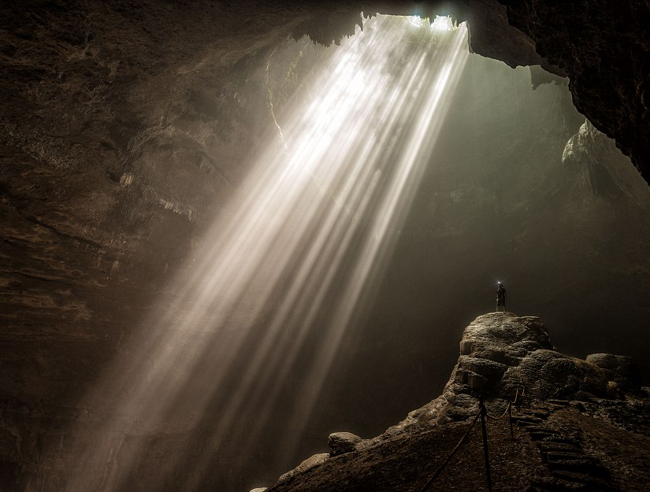
“let there be light” Genesis
bright idea
enlightened life
clear person
interior light
have a bright day
enlightened mind
In the beginning darkness was over the surface of the earth.
photosynthesis
give me a light ...
dar a luz
light and health
the light of your eyes
photovoltaic energy
age of enlightenment
enlightenment (Buddhism)

Slide 3
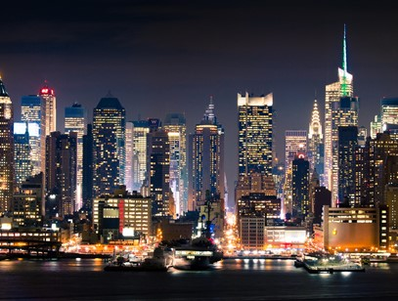
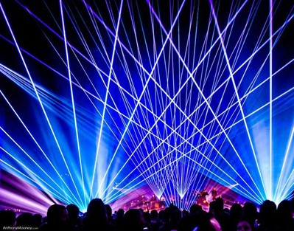

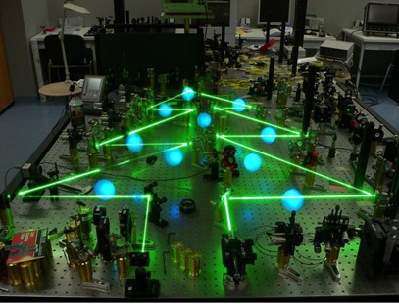
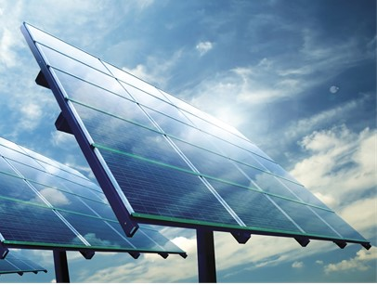
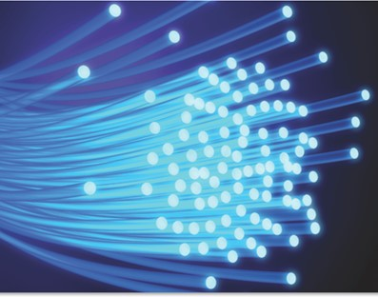
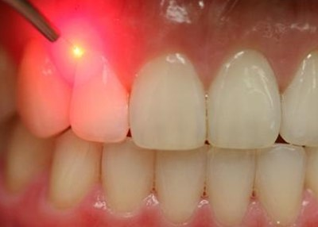
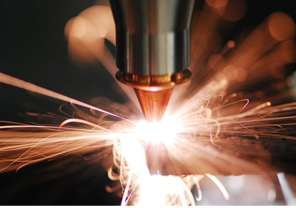
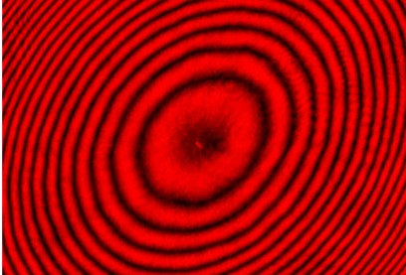
light to support life
light for fun
light to produce food
light to make art
light for energy
light to connect
light to heal
light to manufacture
light to measure

Slide 4
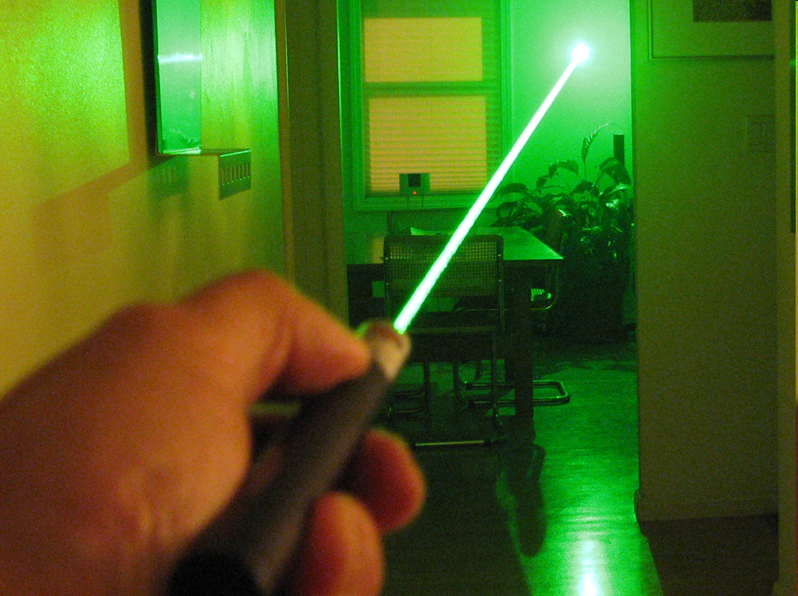
Light properties
Trajectory
Velocity
Intensity
Frequency
Color
Wavelength
Phase
Polarization
All properties can carry information
at light speed.

Slide 5
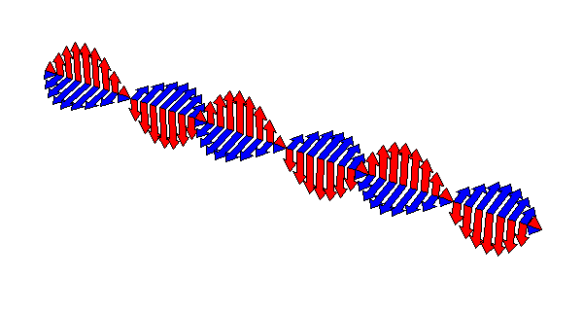
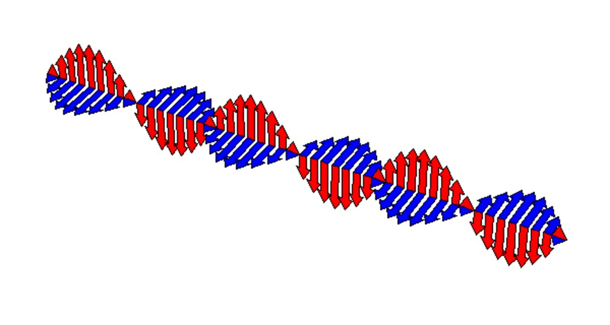
Light as an electromagnetic wave
λ
λ ≈ 0.0006 mm
λ can be used as a scale

Slide 6
The meter definition from 1960 to 1983
Krypton 86 atom => orange light
λ ≈ 602 nm
The meter is the length equal to 1 650 763,73 wavelengths in vacuum of the radiation corresponding to the transition between the levels 2p₁₀ and 5d₅ of the krypton 86 atom.
1 650 763,73 λ

Slide 7
A human hair
48 µm ≈ 80 λ

Slide 8

Practical problem
Light propagates too fast to be “frozen”
  About 300 000 km/s in vacuum (7.5 turns on earth per second)
Light frequency is too fast to be detected
  Almost 10¹⁵ Hz = 1 000 000 000 000 000 Hz
Light wavelength is too small to be seen
  About 600 nm = 0.000 6 mm = 0.000 000 6 m
Light is immaterial and cannot be touched
How to use the wavelength of light to measure something?

Slide 9
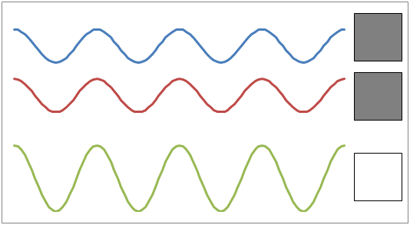
One answer: mixing waves
Interference

Slide 10
Interferometer: single ray
Light source
Mirror 2
Detector
Partial mirror
Mirror 1

Slide 11
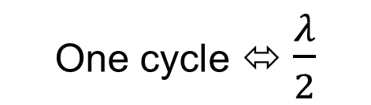
Interferometer: single ray
Light source
Mirror 2
Detector
Partial mirror
$$\frac{λ}{2}$$
One cycle ⬄ $\frac{λ}{2}$
Mirror 1

Slide 12


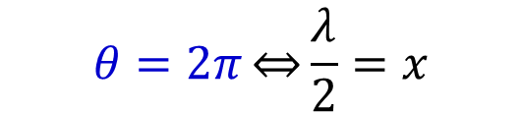
Length – phase relationship
$$I\left(x\right)=A+B cos⁡\left(θ\right)$$
θ = phase angle
x
One cycle ⬄ $\frac{λ}{2}$
$$x=\frac{λ}{4π}θ$$
$$θ=2π\overset{⇔}{}\frac{λ}{2}=x$$

Slide 13
Interferometer: multi rays
Light source
Part
Partial mirror
Mirror 1

Slide 14
Interferometer: multi rays
Light source
Part
Partial mirror
Mirror 1

Slide 15
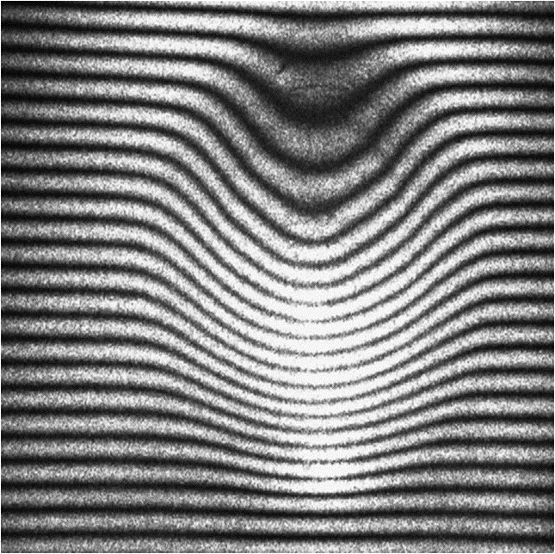
Michelson Interferometer
Interference fringes
interferogram
screen
reference mirror
laser
partial mirror
surface to measure

Slide 16
Michelson Interferometer
Interference fringes
interferogram
screen
reference mirror
laser
partial mirror
surface to measure

Slide 17
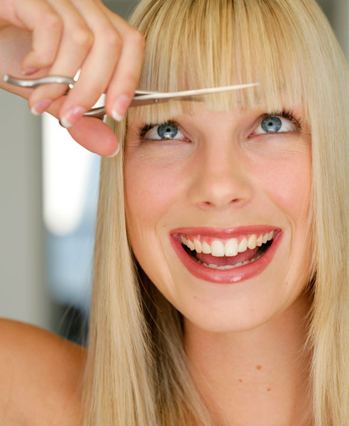
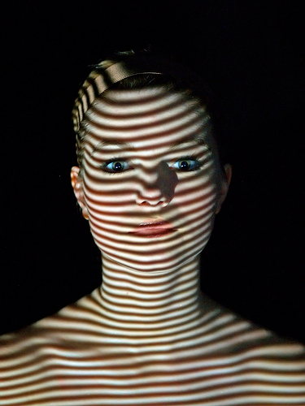
Digital Fringe Processing
Not this fringe
This kind of fringe

Slide 18
Fringes can be like contour lines

Slide 19
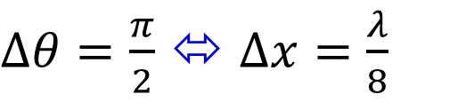
Fringe processing by phase shifting
1
$Δθ=\frac{π}{2}$ ⬄ $Δx=\frac{λ}{8}$

Slide 20
Phase calculation using phase shifting
1

Slide 21
Phase calculation using phase shifting
1

Slide 22





Wrapped phase map
1
$$2π$$
$$\frac{3π}{2}$$
$$π$$
$$\frac{π}{2}$$
$$0$$

Slide 23
Unwrapped phase map
1
A sequence of ≥ 3 images is required

Slide 24
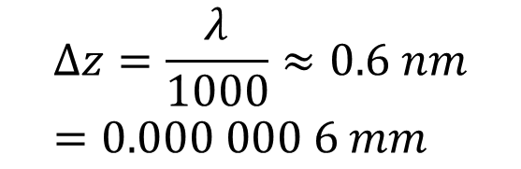
Surface topography
1
Using phase shifting techniques it is possible to reach resolution up to
$$Δz=\frac{λ}{1000}≈0.6 nm=0.000 000 6 mm$$
in a very very stable environment.

Slide 25
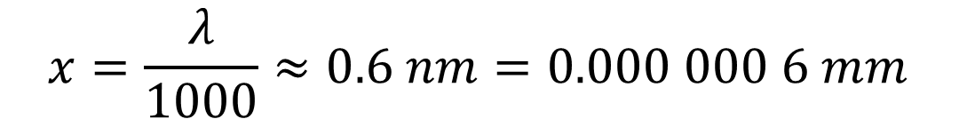
Length – phase relationship
E(x)
x
Using phase shifting techniques it is possible to reach resolution up to
$$x=\frac{λ}{1000}≈0.6 nm=0.000 000 6 mm$$
in a very very stable environment.

Slide 26
Fringe processing by carrier fringes
2

Slide 27
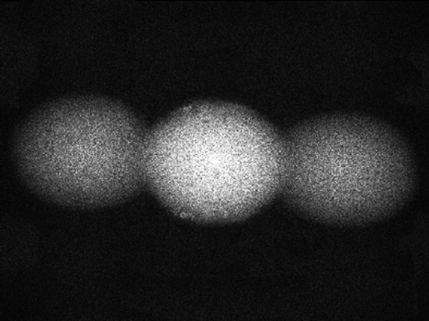

Fringe processing by carrier fringes
2
2D Fourier transform
Just one image is sufficient

Slide 28
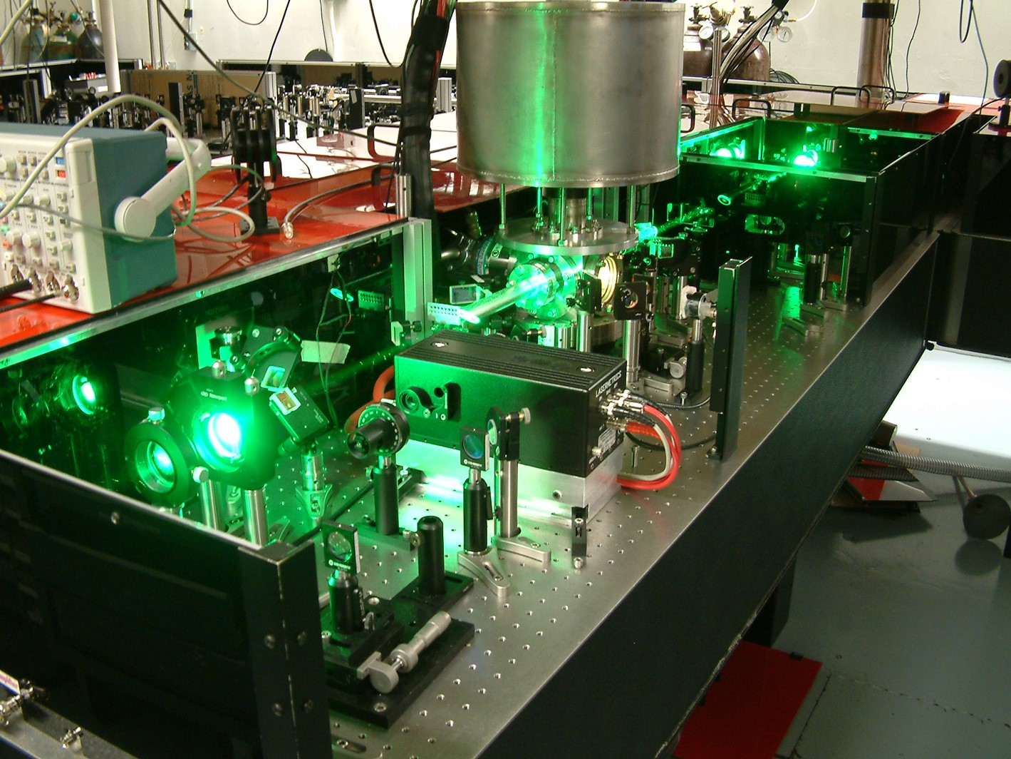
A lab in the paradize…
Moisture control
Temperature control
Light control
Reduced air motion
Dust free atmosphere
Reduced electromagnetic fields
Clean environment
Vibration isolation

Slide 29
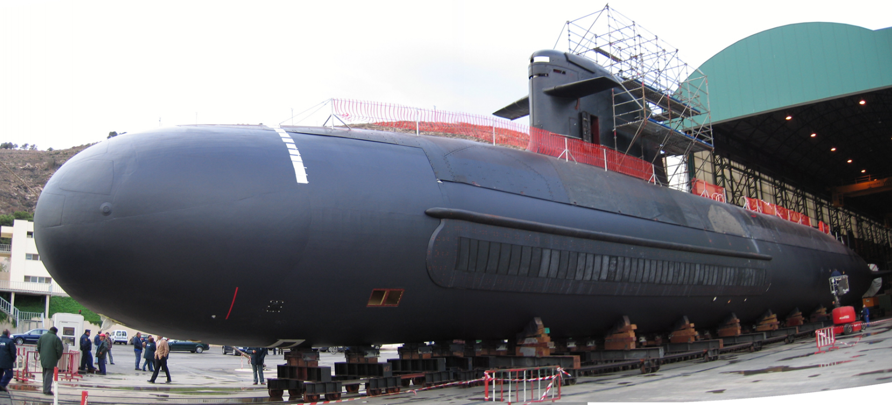
It is not always possible to move the part to be measured to your lab
My LAB

Slide 30
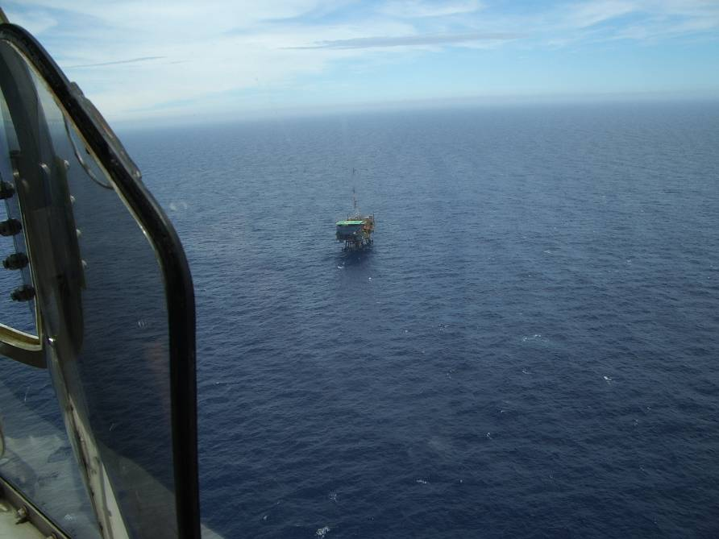

Slide 31
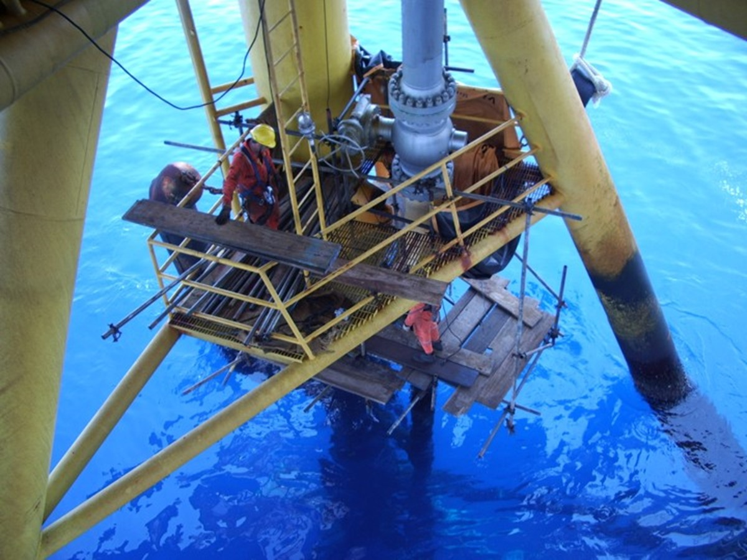

Slide 32
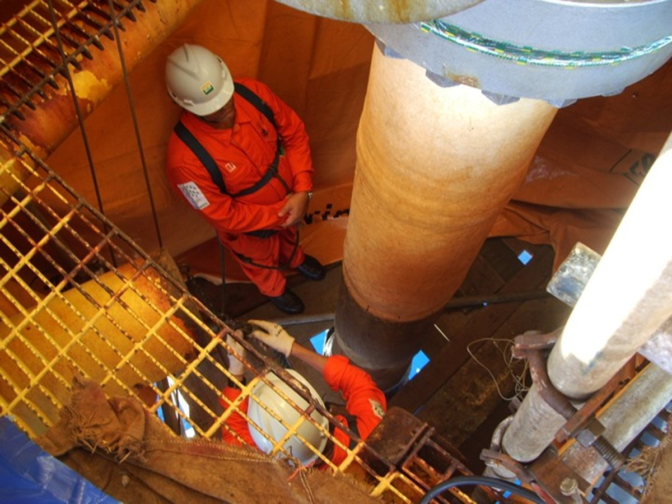
Is there a defect in this pipe coating?
Let’s find out with interferometry

Slide 33
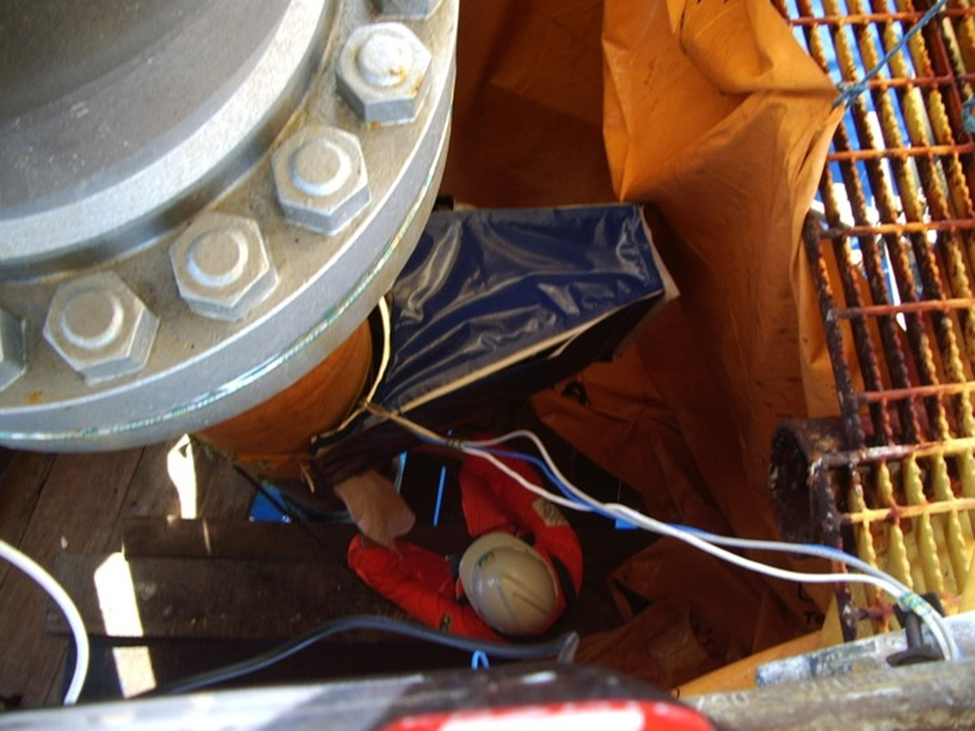
Wind
Moisture
Temperature
Sun light
Vibration

Slide 34
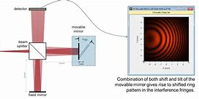
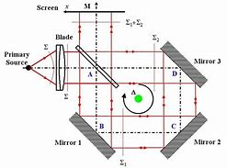
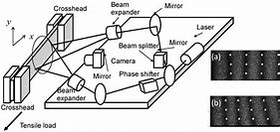
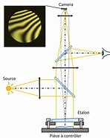
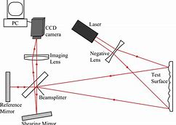
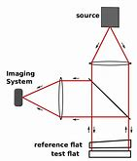
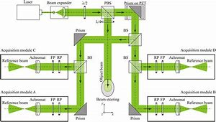
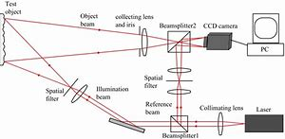
Interferometers
Can measure
  Length
  Shape
  Deformation
  Stress
  Dilatation
  Pressure
  Rotation
  Translation
  Acceleration
  Refraction index
  Thickness
  Vibrations
  …

Slide 35
Interferometry in harsh environments: from a dream to reality
Armando Albertazzi
Universidade Federal de Santa Catarina
Florianópolis, Brazil
Florianópolis, 24 - 27 November 2019

Slide 36
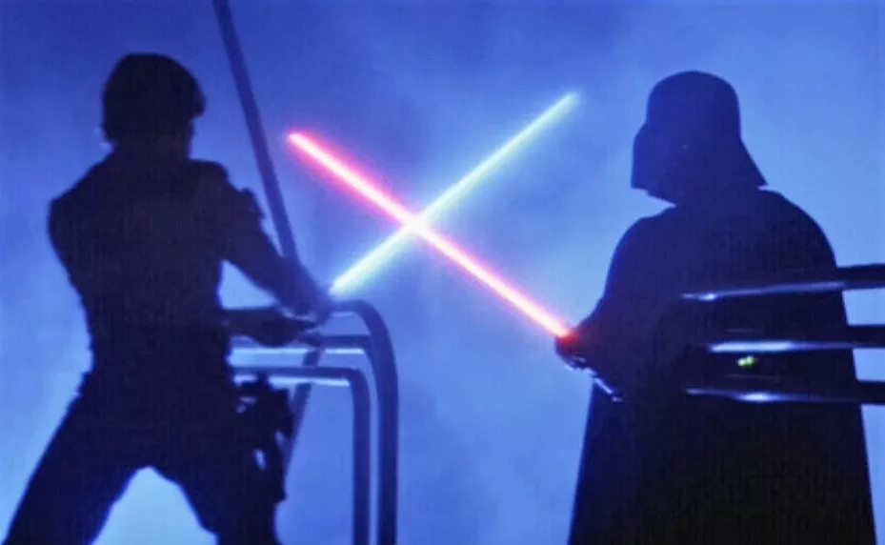
A war approach
Knowing the Enemy
Defense Strategies
Victories Examples

Slide 37
Knowing the Enemy
  Harsh Environments
  Disturbing Agents

Slide 38
What is a harsh environment?
A quick definition:
  Anywhere not “indoors”.

Slide 39
What is a harsh environment?
A more complete definition:
  Any condition of extremes relative to the human condition applies:
    Temperature
    Humidity
    Atmosphere (including pressure)
    Radiation
    Shock and vibration
    Erosive flows
    Corrosive media
  whether indoors or not.

Slide 40

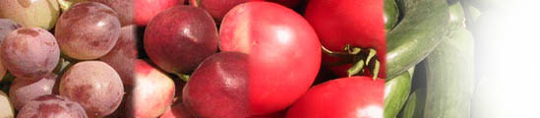




Harsh Environment Examples
Agricultural plants
Farms
Industrial plants
  Food
  Pharmaceutical
  Chemical
  Manufacturing
Explosion areas
Medical
Transport
Oceanography

Slide 41
Knowing the Enemy
  Harsh Environments
  Disturbing Agents

Slide 42
Disturbing agents in interferometry
Temperature
Radiation and background illumination
Humidity
Interferometry
Shock and vibration
Atmosphere and pressure
Skip details

Slide 43
what affects
how affects
components
accelerated aging
malfunction
wavelength change
temperature
measurement performance
sensitivity change
signal drift
electronic noise
thermal deformation
measurand
material properties changes
surface modification

Slide 44
what affects
how affects
components
degradation
malfunction
wavelength change
humidity (moisture condensation)
measurement performance
image blur
decorrelation
measurand
surface reflectivity changes
surface modification

Slide 45
what affects
how affects
components
misalignment
damage
fringe instability
shock & vibration
measurement performance
image blur
resolution degradation
decorrelation
random errors increase
measurand
misalignment
modification

Slide 46
what affects
how affects
components
degradation
malfunction
radiation and background illumination
measurement performance
signal to noise degradation
resolution degradation

Slide 47
what affects
how affects
components
malfunction
damage
wavelength change
atmosphere and pressure
measurement performance
image blur
refraction index changes
decorrelation
thermal currents (convection)
measurand
surface contamination
surface modification

Slide 48
Knowing the Enemy
  Harsh Environments
  Disturbing Agents
Defense Strategies
  Isolation
  Robustness
  Isolation and robustness

Slide 49
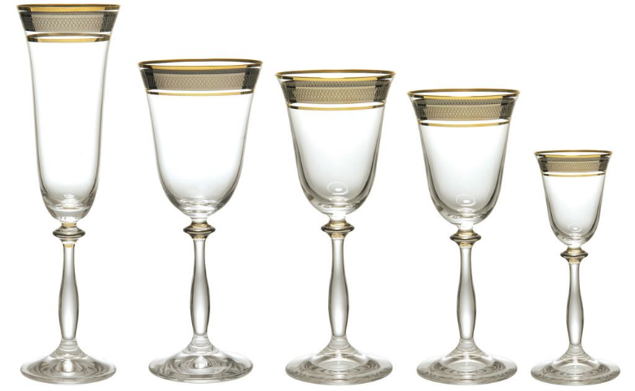
1 - Isolation

Slide 50
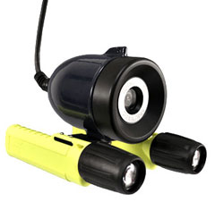
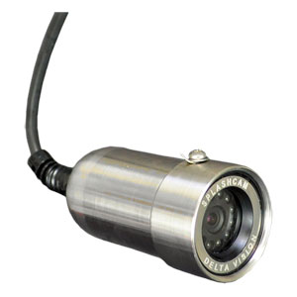
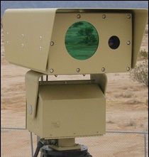
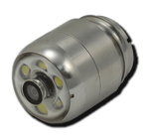
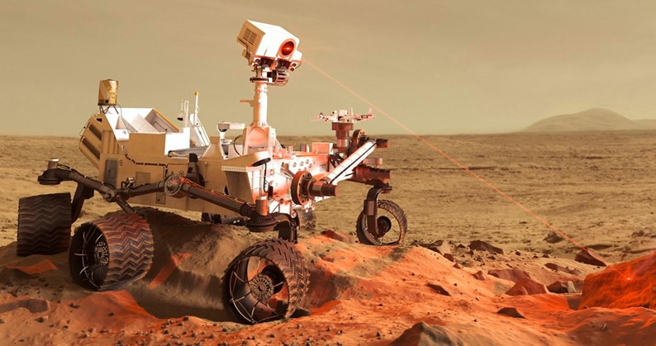
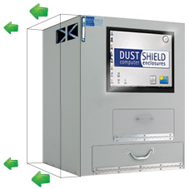
Isolation Solutions
Atmosphere and pressure
  Encapsulation
  Positive pressure
Air blower
Filter

Slide 52
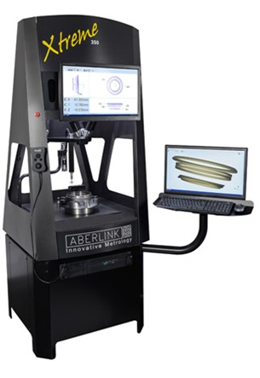
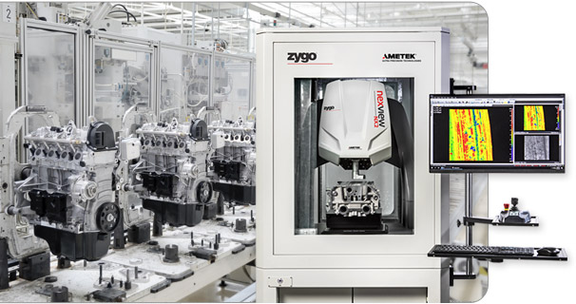
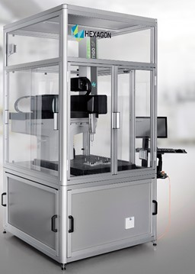
Isolation Solutions
Temperature
  Isolation + cooling

Slide 53
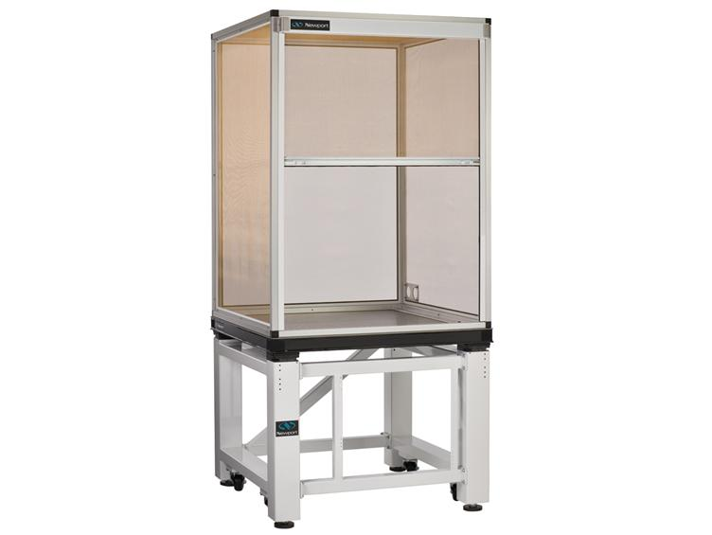
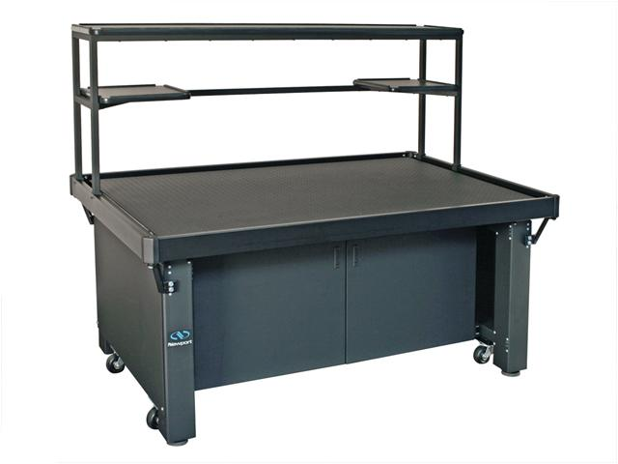

Isolation Solutions
Radiation
  Faraday cage (electromagnetic fields)
  Low reflectivity coating (ambient light)
  Black box
  Filters

Slide 54






Isolation Solutions
Vibration isolation
  Passive dumping elements
  Active dumping elements

Slide 55



Active Stabilization
General concept
Optical system
Sensor
Disturbance
Controller
Actuator
Disturbance cancelation

Slide 56
Knowing the Enemy
  Harsh Environments
  Disturbing Agents
Defense Strategies
  Isolation
  Robustness
  Isolation and robustness

Slide 57

2 - Robustness

Slide 58
Robust
Adjective
  1. strong in constitution; hardy; vigorous
  2. sturdily built (a robust shelter)
  3. requiring or suited to physical strength (a robust sport)

Slide 59
Robust Mechanical Design
what
why
compact and lightweight
easer to clamp and to reduce relative motions
rigid
keep stable positioning and alignment of optical parts
Robust construction
stiff clamping
reduce relative motions: everything vibrates together
no movable parts
easer to keep stable relative positioning

Slide 60
Stopping Relative Motions
Interferometer
Part to be measured

Slide 61

Stopping Relative Motions
Interferometer
Part to be measured

Slide 62
Robust Optical Principles
what
why
quasi-equal path
effective for tolerating mechanical vibrations and thermal currents of air
Robust principle

Slide 63



Quasi-equal path interferometer
Observer
Laser
Beamsplitter
Fizeau interferometer
Critical region (small)

Slide 64
Robust Optical Principles
what
why
quasi-equal path
effective for tolerating mechanical vibrations and thermal currents of air
one-shot
a short exposure time freezes instabilities and allows averaging out random error
Robust principle

Slide 65




Freezing Motion – short expousure

Slide 66
Robust Optical Principles
what
why
quasi-equal path
effective for tolerating mechanical vibrations and thermal currents of air
one-shot
a short exposure time freezes instabilities and allows averaging out random error
Robust principle
achromatic
not sensitive to light wavelength instabilities
robust algorithm
instability tolerating algorithm

Slide 67
Robust Optical Principles
what
why
quasi-equal path
effective for tolerating mechanical vibrations and thermal currents of air
one-shot
a short exposure time freezes instabilities and allows averaging out random error
Robust principle
achromatic
not sensitive to laser wavelength instabilities
robust algorithm
instability tolerating algorithm

Slide 68
Knowing the Enemy
  Harsh Environments
  Disturbing Agents
Defense Strategies
  Isolation
  Robustness
  Isolation and robustness

Slide 69

3 - Robustness and Isolation

Slide 70
Knowing the Enemy
  Harsh Environments
  Disturbing Agents
Defense Strategies
  Isolation
  Robustness
  Isolation and robustness
Some Victories
  A few examples

Slide 71
Robustness features
compact and lightweight
☹
😐
Robust construction
rigid
☺
stiff clamping
no movable parts
quasi-equal path
Robust principle
one-shot
achromatic
robust algorithm

Slide 72

1
PhaseCan

Slide 73



PhaseCam
One shot
No sensitive to vibration neither air turbulences

Slide 74

PhaseCam

Slide 75

Large Optics Measurement

Slide 76
Robustness features
☺
compact and lightweight
☹
2
rigid
😐
Robust construction
stiff clamping
☹
😐
no movable parts
☺
2
quasi-equal path
☹
☹
Robust principle
one-shot
☺
4
achromatic
☹
😐
6
robust algorithm

Slide 77

2
Reflection Digital Holographic Microscope

Slide 78



Lyncée Reflection Digital Holographic Microscope R1001
nanometer resolution
real-time
single full-field acquisition (no scan)
non-invasive 3D observations

Slide 79




Application examples
Live cell measurement
SiO₂ lines
Fresnel lens array
Corner cubes

Slide 80
Robustness features
☺
compact and lightweight
☹
2
rigid
😐
Robust construction
stiff clamping
☹
😐
no movable parts
☺
2
quasi-equal path
☹
☹
Robust principle
one-shot
☺
4
achromatic
☹
😐
6
robust algorithm

Slide 81

2
Speckle interferometer with radial sensitivity

Slide 82

Laser speckle

Slide 83


Speckle interferometer
2
Initial image
-
interference
Final image
=
laser

Slide 84
Double illumination speckle interferometer
laser
camera
Better for
in-plane measurements
Double Illumination

Slide 85
Robust Optical Principle
stop
Diffraction grating
pitch = p
β
β
d_{x}
Does not depend on λ => achromatic

Slide 86
In-plane radial sensitivity
singular point

Slide 87


Slide 88
Stiff clamping
Leveling
Leveling
Hemispheres
Rare earth magnets
Sharp conical tips
Sharp conical tips

Slide 89
Stiff clamping
Sharp conical tips
Sharp conical tips
Both in-plane and out-of-plane clamping stiffness

Slide 90

Conical tip 2
Hemesphere 2
Conical tip 3
Hemesphere 4
Magnet 2
Conical tip 1
Hemesphere 1
Magnet 1

Slide 91






In-field applications

Slide 92
DSPI for in-field residual stress measurement

Slide 93
Robustness features
☺
compact and lightweight
😐
3
rigid
☺
Robust construction
stiff clamping
☺
😐
no movable parts
😐
3
quasi-equal path
☹
☹
Robust principle
one-shot
☹
2
achromatic
☺
😐
9
robust algorithm

Slide 94


3
Shearography interferometry

Slide 95
Single image formation
P
P’
Part to be inspected
Lens
Image plane

Slide 96
Double image formation
Wedge
P₁
P₂
P’₁
= P’₂
Part to be inspected
Lens
Image plane

Slide 97
Shearography
laser
prism
P₁
P₂
sensor
lens
Good for
non-destructive tests
Quasi-equal path configuration

Slide 98






Commercial shearography systems

Slide 99
3.1
Shearography interferometer with diffraction grid

Slide 100


25kg

Slide 101


~ 3170 g
[Merluza – EAS]
SILICCOM
Lighter
More flexible
~ 436 g
More robust
~ 447g
~ 642g
[Lab]
~ 1000g
[P32]
~ 324 g
[Lab]
350g < mass < 550g
[GasBol – Houston]
~ 290g
[TEFRAN]
~ 474g [Lab]
Notes:
Lente zoom + 2 anteriores = 11 protótipos

Slide 102
Shearography using diffractive grating
laser
P₁
P₂
sensor
lens

Slide 103

Shearography device with a diffractive grating

Slide 104










Phase shifting devices
Classical Interferometer
Diffraction Grating
FS Mirror
λ/8
More robust
More compact
Λ >
>λ
Λ/8
PZT
PZT
PZT....
FS Mirror
$${Δφ}_{+}=+π/4$$
$${Δφ}_{−}=−π/4$$
CCD
CCD
$$Δφ=π/2$$
$${Δφ}_{r}=π/2$$
Notes:
The phase shift can be applied by a few different devices. Most of them use the piezoelectric actuator for this procedure as in the Michelson interferometer.
In the case of the Diffraction Grating System, the phase shifting is promoted by the lateral displacement of the grating, in the direction perpendicular to its grooves.
Thus, the phase shifting is relative to the grating period and not the wavelength of the laser as in the Michelson interferometer.
As the value of the grating period is usually much larger than the values ​​of a typical laser wavelengths, this system becoming more robust to external influences.
Additionally, the substitution of the Michelson interferometer for the diffraction grating promotes a more compact system.

Slide 105






Opto-mechanical design
CCD Camera
Imaging lens
Piezoeletric
actuator
Diffraction grating
Notes:
The solution proposed for this system is basically composed of four main elements: CCD camera, imaging lens, piezoelectric actuator and diffraction grating.
Differently of the typical arrangement found on literature, here the optical arrangement was elaborated in order to obtain the lowest possible volume for the system. Like this, the diffraction grating was placed in the space between the C-mount imaging lens and the camera sensor.

Slide 106









Opto-mechanical design
PZT electrical
connector bracket
Diffraction grating
holder
Imaging lens
holder
Camera
housing
Notes:
This is the final concept of the system
The design is divided into four modules, the imaging lens and the diffraction grating holders, the camera housing and the PZT connector bracket.
And here is an image of the actual system, which shows how compact the system is.

Slide 107


Slide 108

Good clamping example

Slide 109
Robustness features
☺
compact and lightweight
☺
4
rigid
☺
Robust construction
stiff clamping
☺
😐
no movable parts
😐
2
quasi-equal path
☺
☹
Robust principle
one-shot
☹
2
achromatic
☹
😐
10
robust algorithm

Slide 110
3.2
Shearography interferometer with multiple apertures

Slide 111
Shearography
laser
lens
P
P`
P`₁ = P`₂
P₂
P₁
sensor
bi-prism
measurand
P`₁ = P`₂

Slide 112
Shearography with carrier fringes
lens
sensor
measurand

Slide 113
Shearography with horizontal carrier fringes
lens
sensor
measurand

Slide 114
Shearography with vertical carrier fringes
lens
sensor
measurand

Slide 115
Shearography with inclined carrier fringes
lens
sensor
measurand

Slide 116
Shearography with three simultaneous carrier fringes
lens
sensor
measurand

Slide 117

Triple image
W₃
Single point
Image plane
W₁
W₂
Object
$$y$$
$$x$$
$$z$$
A₃
Aperture locations define carrier fringes
Wedge angles define lateral displacement amounts and directions
A₁
A₂

Slide 118



















Combinações de aberturas
Franjas portadoras
Deslocamentos laterais
FFT
A₃
$$C_{y}$$
(a)
$$A_{x}$$
A₁
A₂
$$C_{y}^{∗}$$
A₃
$$C_{x}^{∗}$$
$$A_{y}$$
$$C_{x}$$
(b)
A₁
A₂
A₃
$$C_{xy}$$
$$A_{xy}$$
(c)
$$C_{xy}^{∗}$$
A₁
A₂
A₃
$$C_{y}$$
$$C_{xy}$$
(d)
$$C_{x}^{∗}$$
$$A$$
$$C_{x}$$
$$y$$
A₁
A₂
$$C_{xy}^{∗}$$
$$C_{y}^{∗}$$
$$x$$

Slide 119

Thermal loading example

Slide 120



X
Two images and 3 results
24 images and 3 results

Slide 121
Robustness features
☺
compact and lightweight
☺
7
rigid
☺
Robust construction
stiff clamping
☺
😐
no movable parts
☺
0
quasi-equal path
☺
☹
Robust principle
one-shot
☺
1
achromatic
☹
☺
14
robust algorithm

Slide 122




4
Interferometric optical fiber sensors

Slide 123

Bragg grating optical fiber sensor

Slide 124


Bragg grating optical fiber sensor

Slide 125

Fabri-Perot optical fiber pressure sensor

Slide 126


Slide 127

Combined Bragg and Fabri-Perot optical fiber sensor (pressure and temperature)

Slide 128


Slide 129
Robustness features
☺
compact and lightweight
☺
8
rigid
☺
Robust construction
stiff clamping
☺
😐
no movable parts
☺
0
quasi-equal path
☺
☹
Robust principle
one-shot
☺
0
achromatic
☺
☺
16
robust algorithm

Slide 130
Knowing the Enemy
  Harsh Environments
  Disturbing Agents
Defense Strategies
  Isolation
  Robustness
  Isolation and robustness
Conclusions

Slide 131
Conclusions
Interferometers are extremely sensitive measurement systems.
Initially, they seemed restricted to laboratory use.
We dreamed about bringing them out of the lab.
The development of technology and the use of appropriate strategies made it possible.
The few cases we present here are a small samples of what is possible today.
There is so much more to come.
Be prepared.

Slide 132




















Thank you for your kind attention
Thanks to
And the Labmetro team at UFSC
“It is during our darkest moments that we must focus to see the light.” – Aristotle
132

