Slide 1
Metrologia 2019
Exchange of metrological data for the use in machine to machine communication for industry 4.0
“Communication and validation of smart data in IoT-networks”
2019-11-26
Th. Wiedenhöfer, D. Hutzschenreuter, F. Härtig
(with support from all around the world)
contact: smartcom@ptb.de

Slide 2





Short CV Thomas Wiedenhoefer
PTB, Germany
Studied production engineering at University Erlangen-Nuremberg, Germany Focus: Manufacturing metrology, quality management, production automatisation Working student at Siemens research centre in Erlangen; department Corporate Technology „Software and Engineering“ (CT SE 5)
University Erlangen-Nbg., Chair quality management + manufacturing metrol. Head of research group optical and micro-/nano-metrology
Werth Messtechnik GmbH, Germany Director for R&D cooperations Part time lecturer at University of Applied Sciences Schmalkalden
Physikalisch-Technische Bundesanstalt (PTB), Germany, since 2015 Management and support of strategic projects in Div. 1 „Mechanics and Acoustics“ Coordination of EURAMET project SmartCom “Communication and validation of smart data in IoT-networks” as of June 2018. since June 2019: Member of presidential staff supporting European projects and senior specialist for work, health and safety

Slide 3
A closer look at the (sub-)title
Communication and validation of smart data in IoT-networks
Smart-Sensor
Smart-Home/Ind. 4.0
Smart-City
Smart world?
enhanced digital information formatted for
further/advanced data consolidation & analytics
validation Server
in this talk focusing on communication of metrological information
unambiguous, universal
safe (cryptographic secured)
long term (machine)readable/interpretable

Slide 4
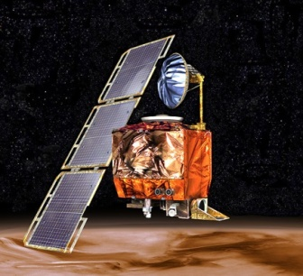
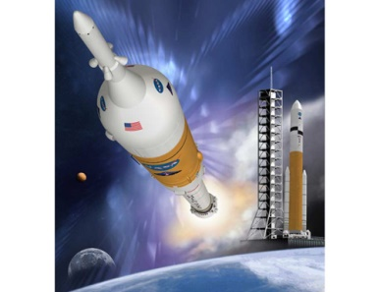

Motivation: Some big issues of the past
Mars Climate Orbiter¹ 1999
mix up of metric and imperial units
destroyed at landing approach (125 Mio US$)
Quelle NASA
2005 NASA-“Constellation-Program“
[landing on the moon] rejected!
harmonisation of units would cost
370 Millionen US$².
Quelle NASA
1983 Air Canada Flight 143 „Gimli-Glider”:³
Fuelling crew mixed up pound/litre and kg/litre
for calculation => tanks less than half filled.
Quelle Wikipedia
¹NASA; Mars Climate Orbiter Mishap Investigation Board Phase I Report. ftp://ftp.hq.nasa.gov/pub/pao/reports/1999/MCO_report.pdf; Zugriff April 2016
²https://www.newscientist.com/article/dn17350-nasa-criticised-for-sticking-to-imperial-units/; Zugriff April 2016
³ https://en.wikipedia.org/wiki/Gimli_Glider; Zugriff April 2016

Slide 5
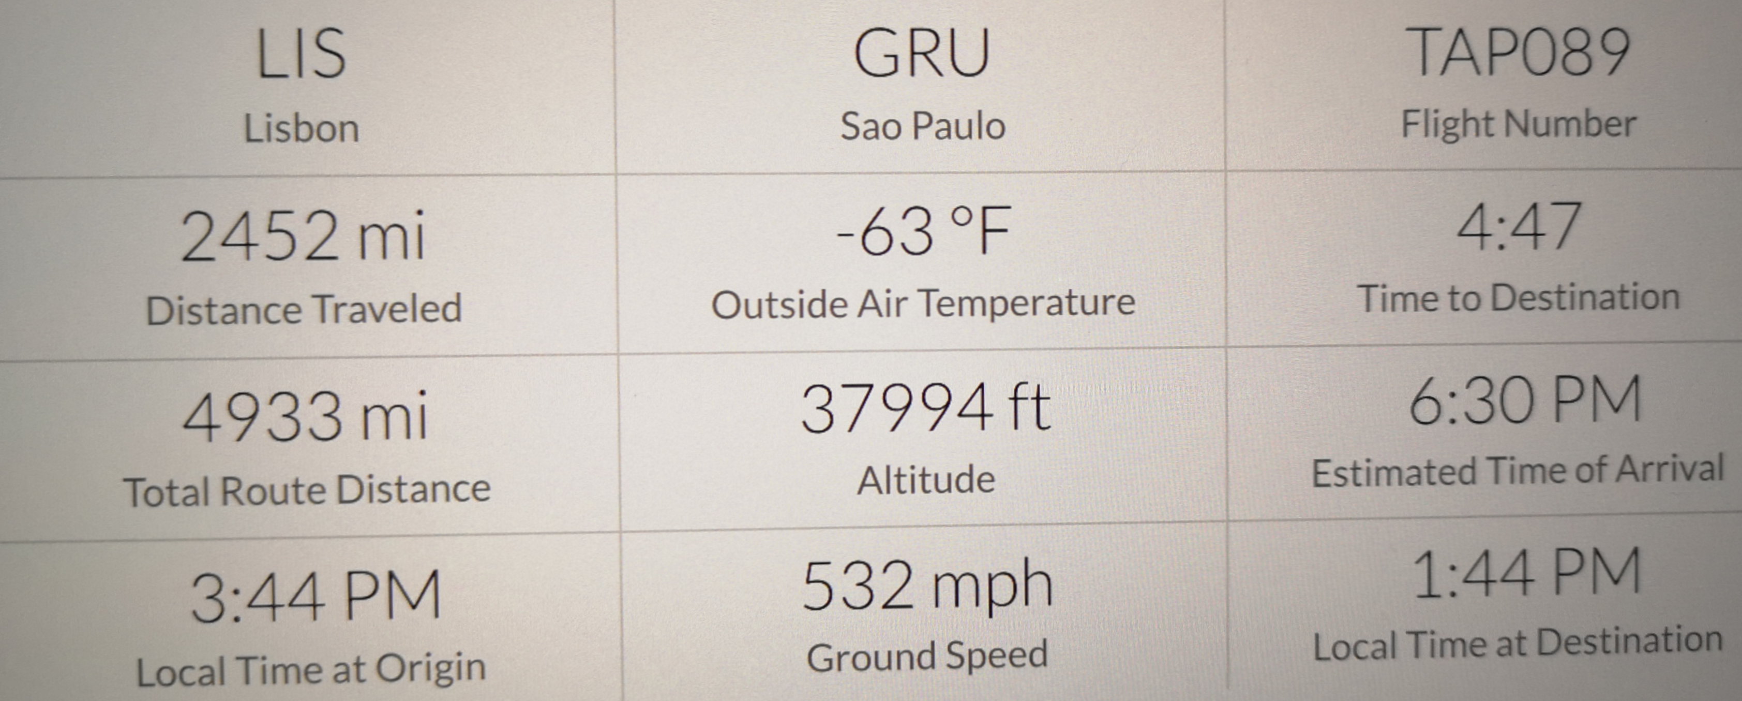
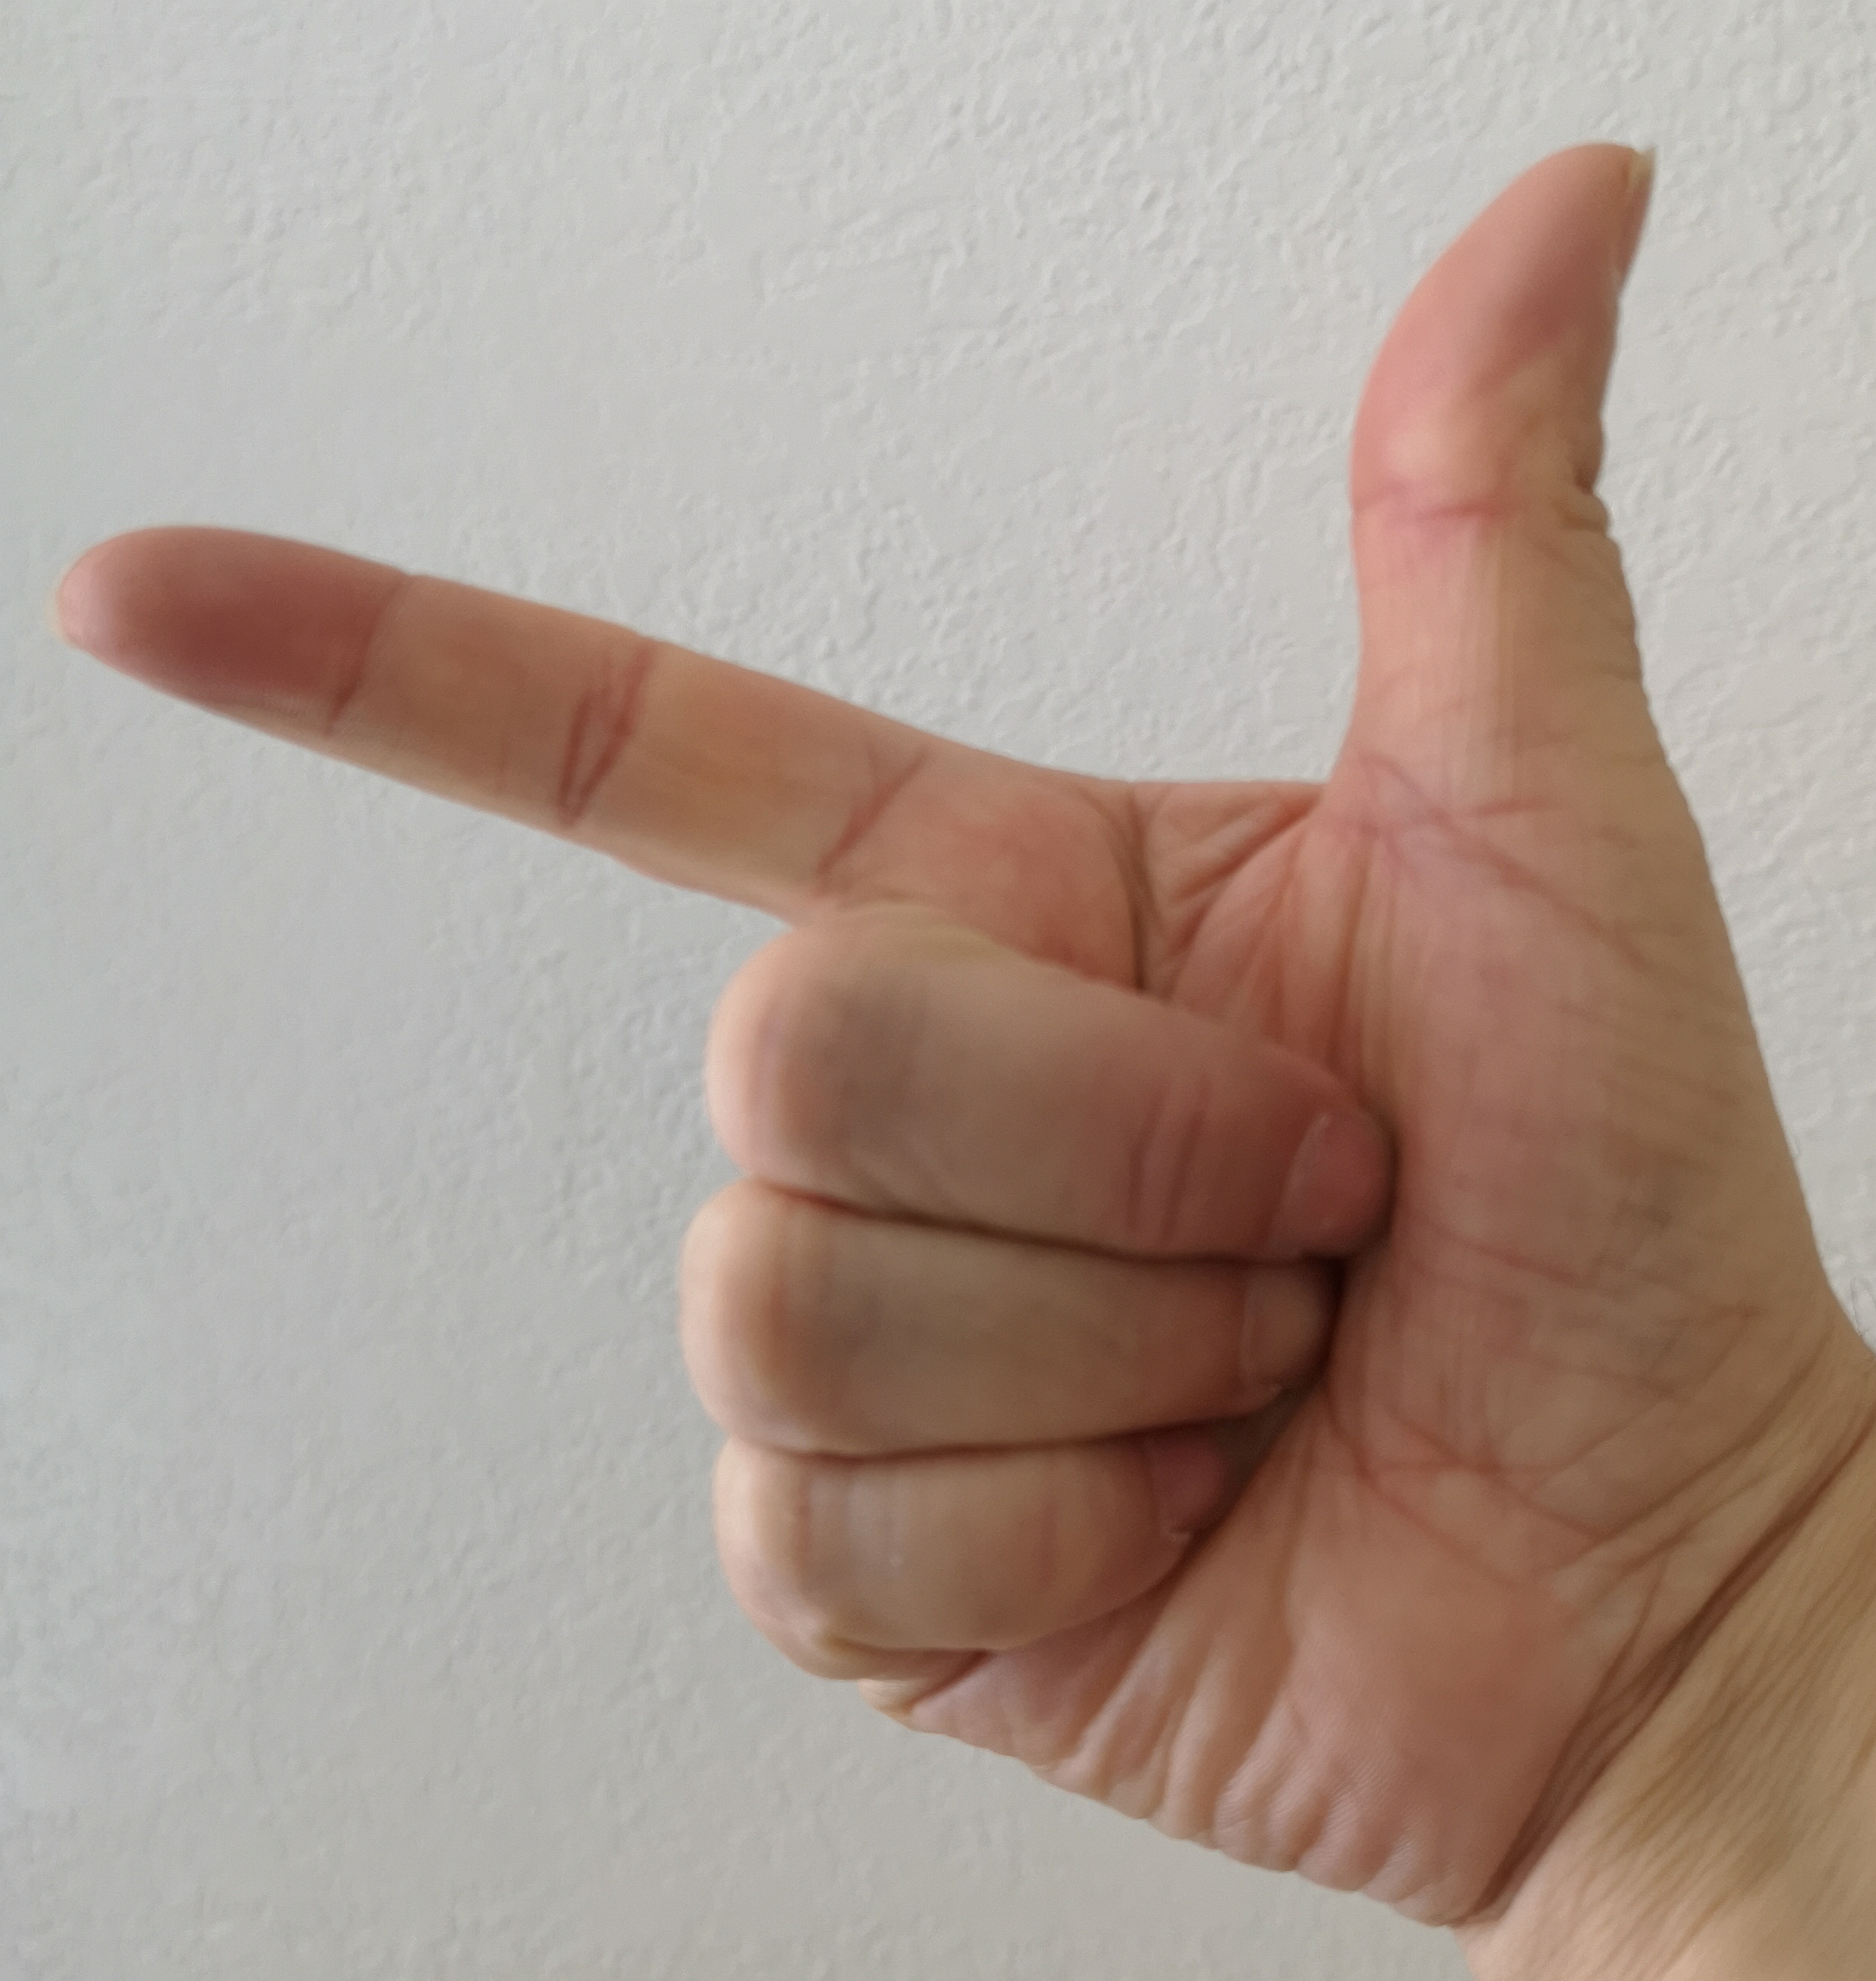


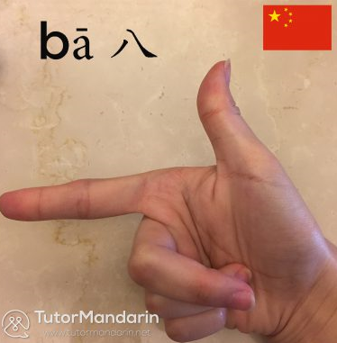
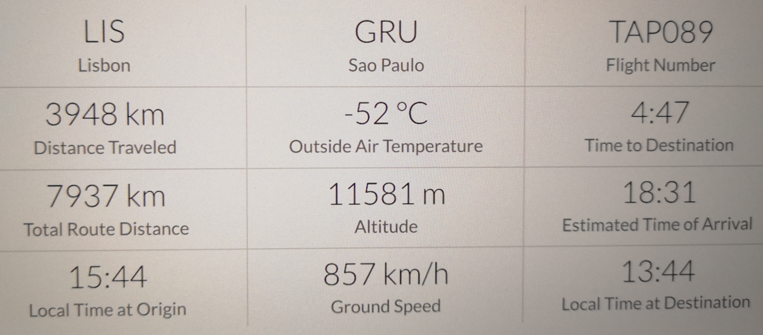
on my flight to Florianopolis
How many children?
2
Imperial
uncertainty?
metric
8

Slide 6


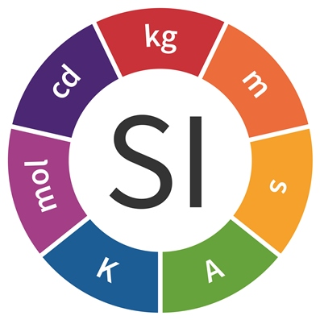
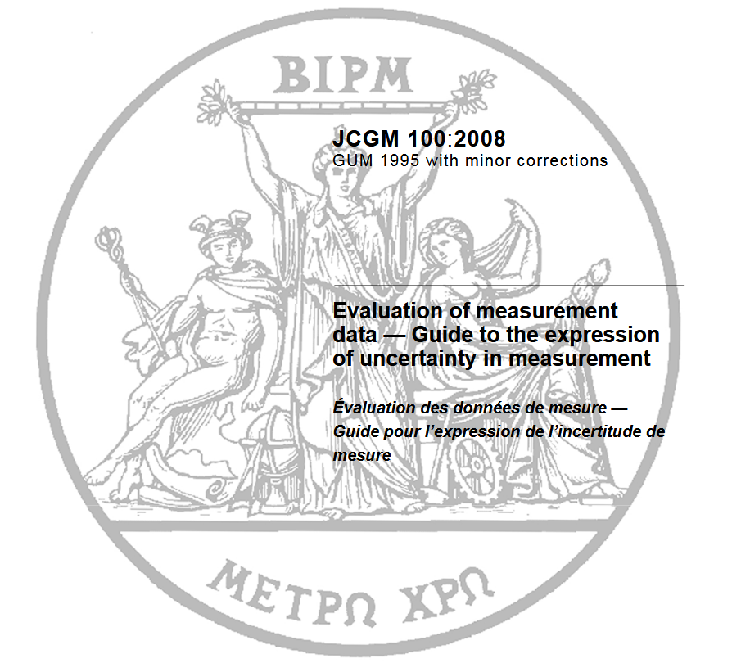
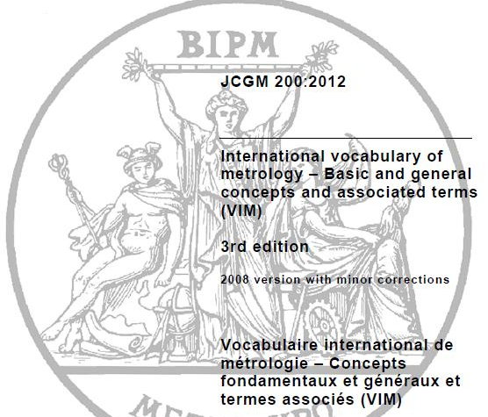



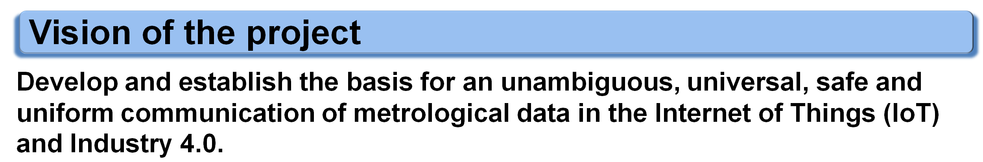
EMPIR-project SmartCom
Communication and validation of smart data in IoT-networks
…
GUM
VIM

Slide 7




What we do not want
Software allows seemingly everything ...
However, what we need to avoid in automated (machine to machine) communication
Units such as: Inch, Gallon, Feet, Miles, …
Characters such as: ÄÖÜ, , , , ……
Numeral systems such as: binary, hexadecimal, ...
Numerical digits such as: Roman numerals (MMMCLXXXIIIV), …
Braunschweiger Ell ,…
… but some countries will introduce or maintain their own variants.
… even if there is a increasing risk of diversity and missunderstanding.
Economic disaster: complexity rise in the order of n*(n-1)/2
(N: number of redundant information e.g. mm to inch: n=2)
Notes:
Characters: ÄÖÜ, arabisch: Meter, chinesisch: Meter; russisch: Meter

Slide 8





What does my introduction has to do with this presentation?
German intro
authentication
!
something considered by me to be a correct Portuguese intro
Portuguese
intro
App
?
?
!
English intro
German intro
with agreed vocabulary
rules
validation
+ integrity (information has not been changed -> cryptography)
We all have to learn German!

Slide 9
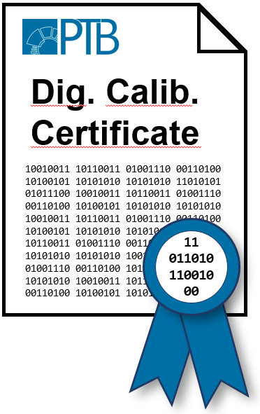
SmartCom: key objectives
Digital System of Units (D-SI)
  SI based data model for digital communication of metrological data
  considers uncertainty of measured quantities
  SI units of BIPM SI brochure & non-SI units
…
GUM
VIM
Digital Calibration Certificate (DCC)
  minimum requirements
  structure (administrative and measurement data)
  relevant standards like ISO 17025
  secure transfer, cryptography, withdrawal
Dig. Calib.
Certificate
Dig. Calib.
Certificate

Slide 10
SmartCom: Content
D-SI
…
DCC
GUM
VIM
Validation

Slide 11
SmartCom: Challenges
Consensus:
  uniform structure/hierarchy
  uniform exchange format (XML)
Technical solutions:
  cryptographic signatures/seals
  data security, encryption
  authentication (identification of interaction)
Legal requirements:
  legal validity/ documentation of validity period
  Withdrawal of calibration certificates
Fundamental NMI specification in SmartCom
Transfer of
“NMI specification”
to end users & standardization

Slide 12
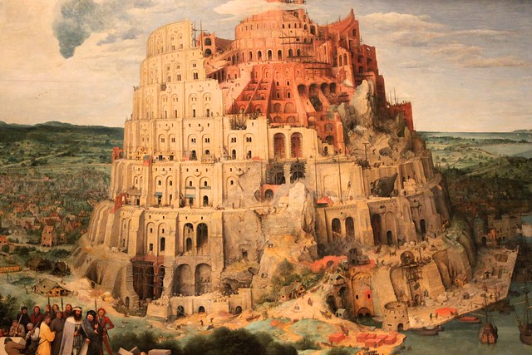

Already existing and on the way
siunitx
GemiMeG
internat. projects
and cooperations
eCl@ass
SI-syntax
European Metrology Cloud
identifier, data format
VDI/VDE 2623
…
…
Euramet TC-IM 1448
GUM
VIM
2623 + calibration data
MII / FLUKE
Units, dimensions, types
identifier, classes
…
NIST/OASIS
Allotrope
Foundation
codes for units for trade
UN/ECE
Common Data Dictionary
Ontologie
Ontology for RDM@ PTB
OPC-UA
interfaces
Ontologie, IEC/TS 62720
machinereadable
data exchange

Slide 13
Production Cycle
production
measure-
ment
€
1
7
QM
6
start of
calibration
2
Industry
Calibration
5
T
ransfer
time for re-
calibration
report
8
9
4
3
Optimi-
sation
data analysis
Industry 4.0;
Digital Twin
10

Slide 14
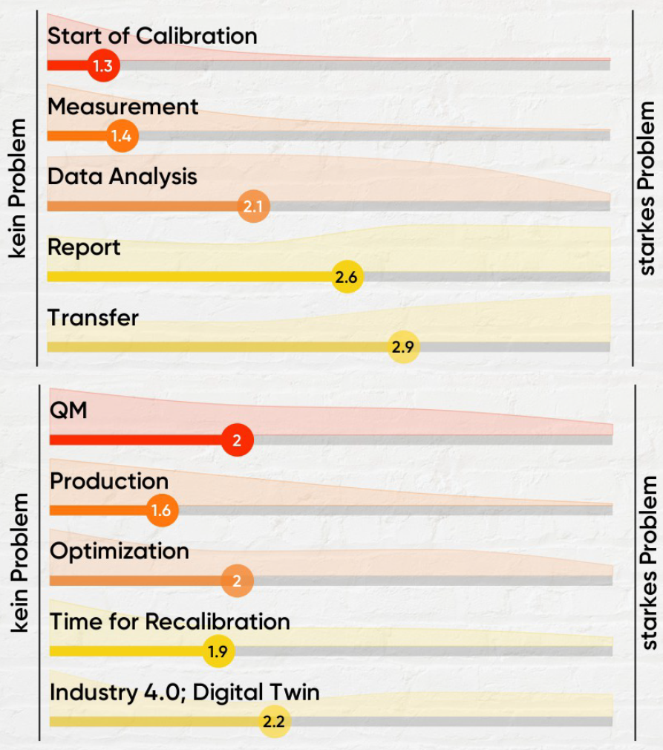
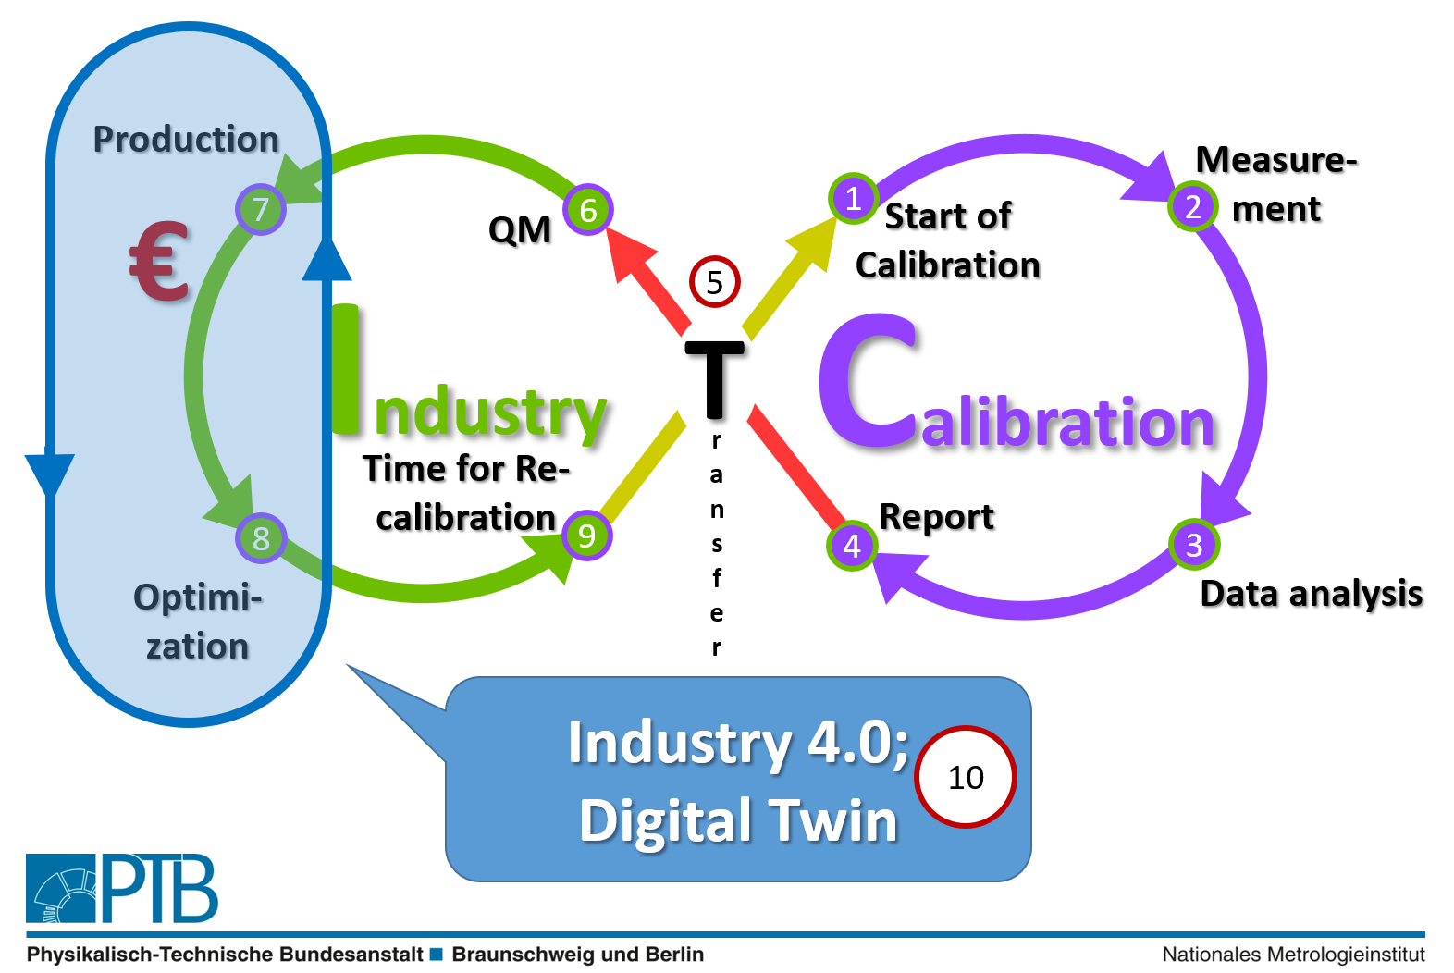
Results of DCC-2019 workshop
Production-Cycle

Slide 15
DCC workshop for industry
3./4. June 2019
snippets of dialogues
fear: „external will
program my machine!!!“
„sound regulation“
„Data find- and read- and understandable for machines“
„based on 17025“
„useable with excel“
„economically efficient“
„efficient“
„automated“
„standards needed“

Slide 16

BMWi/PTB-Workshop 10.April 2018
Metrology as basis for digitalisation.
Notes:
Unterste Stufe: Millionen von Messungen
Die Kalibrierpyramide macht die große wirtschaftliche Bedeutung sehr deutlich.
➔ Ein Digitaler Kalibrierschein mit Mehrwert verspricht hohe Gewinne.

Slide 17
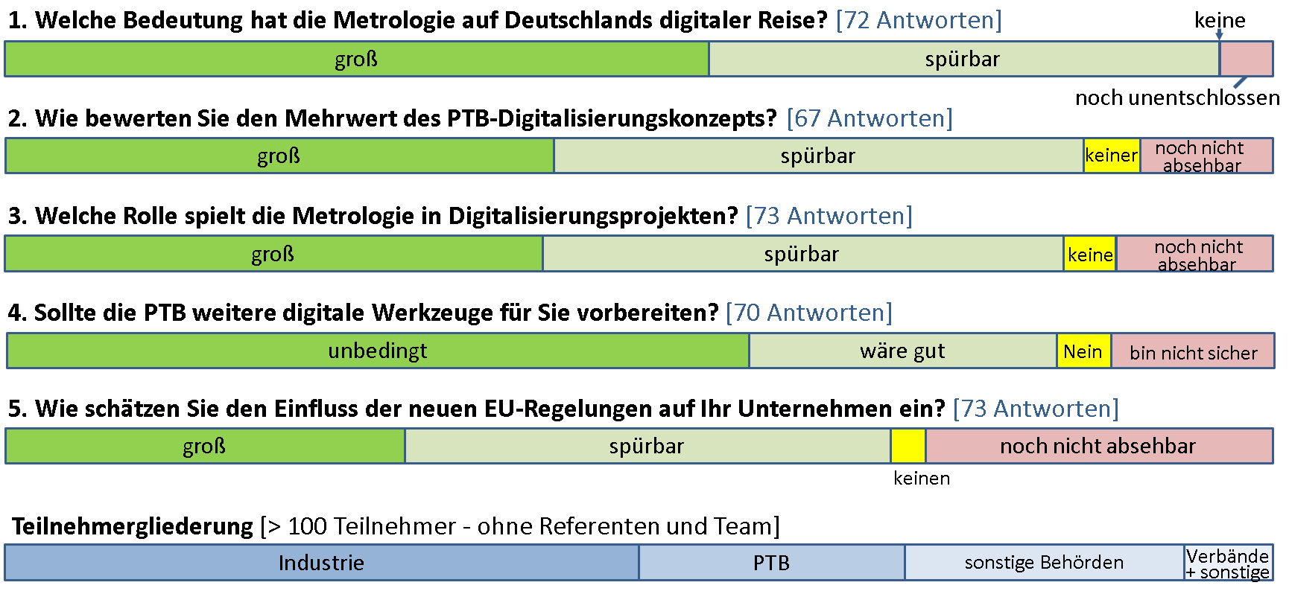
Live feedback from industry and calibration labs

Slide 18
SmartCom: D-SI
Validation
DCC
D-SI
…
GUM
VIM

Slide 19

Success story: international units
1799, french parliament layed the foundation for
unity in metrology
Success story:
- Reduction of trade barriers
- Increase in security
- Growth in economy
World wide uniform communication
Notes:
have not adopted the International System of Units (SI, or metric system) as their official system of weights and measures

Slide 20
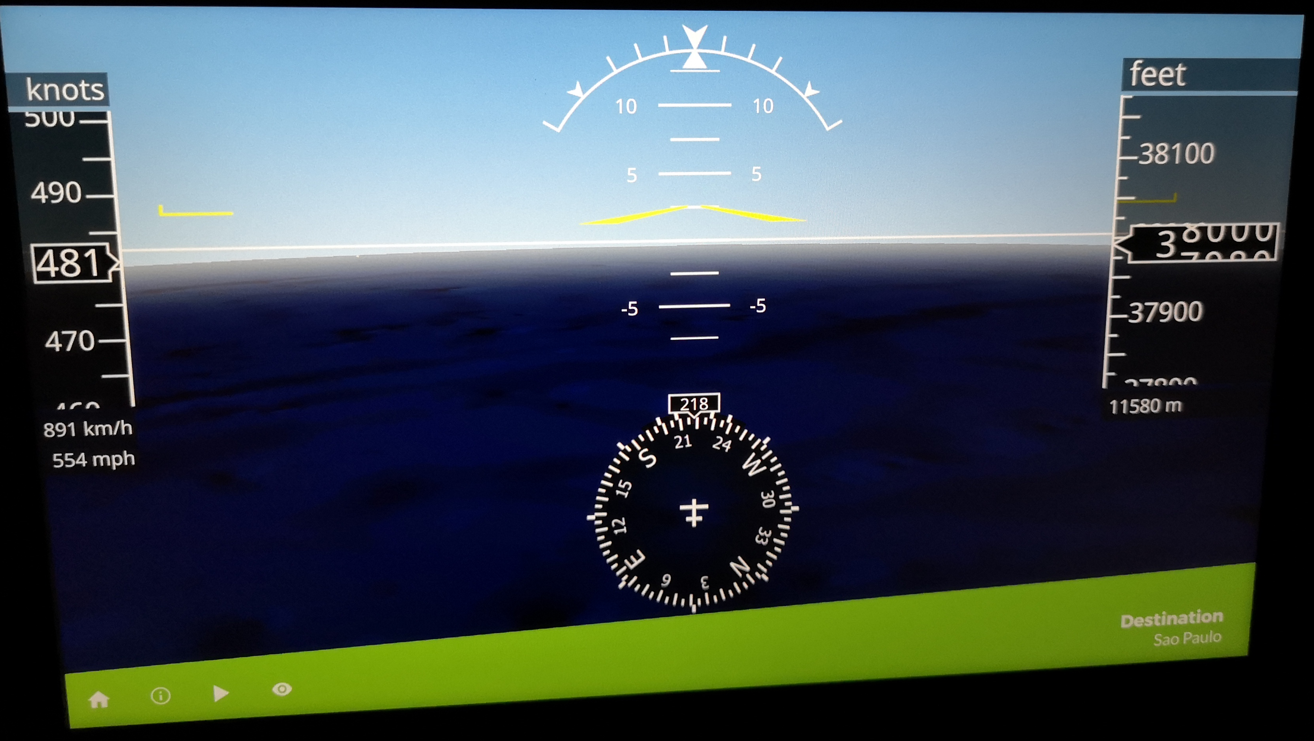
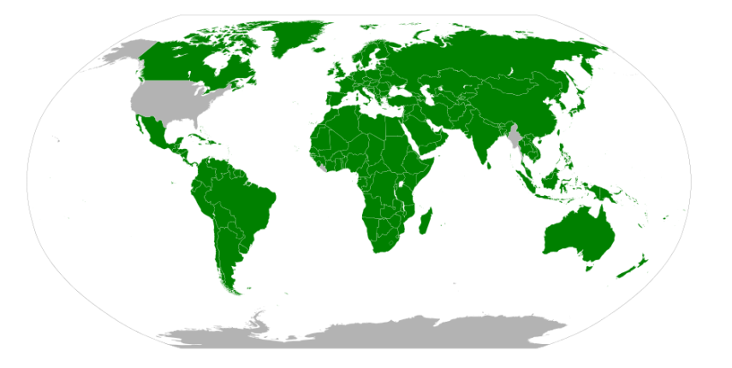



Metrological data exchange
machine interface
SI only
JSON
XML
…
unambiguous,
efficient,
easy to understand,
exchangeable
User Interface
metre, °C, bar
decimal
Ä, Ö, Ü,
User Interface
feet, °F, Pa
binary
but this is o. k. as it is only the user interface

Slide 21

Digtal System of units D-SI
SI brochure
RFC 362 (UTF-8)
VIM
universal
data model
ISO 8601
GUM
IEEE 754
D-SI
Data Model
CODATA
siunitx syntax
IEC/TS 62720
ISO 80000
Data model must be
unambiguous
universal
safe
uniform
IEC 61360
…
vision: no (measurement) result without a (SI) unit

Slide 22
Digital SI – universal data model
Minimum requirement
Minimum requirement + additional information
SI Broschüre
Y = y [SI]
± U₉₅(k) distribution UTC
VIM
universal
data model
GUM
Coordinated
Universal Time
CODATA
type of distribution
(normal, uniform, … )
vision: no (measurement) result without a (SI) unit!
coverage factor
measurement uncertainty
& coverage interval
+ container for non SI
SI-unit
measurement value

Slide 23
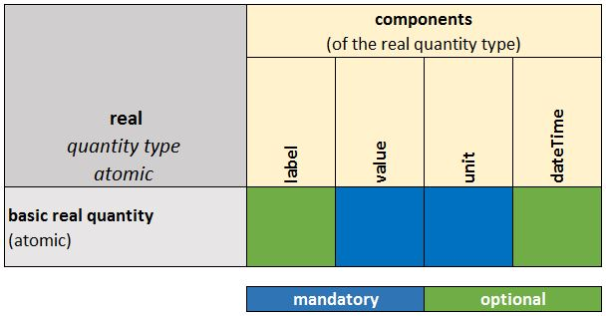
Data model for real quantities
similar structure for fundamental physical and mathematical constants

Slide 24
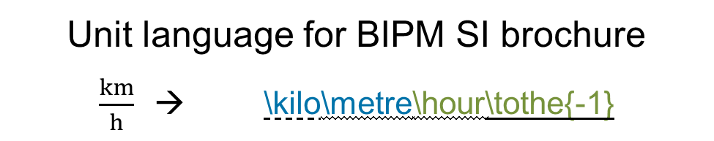
SI units
Unit language for BIPM SI brochure
$\frac{km}{h}$ → \kilo\metre\hour\tothe{-1}
optional
optional
Start
End
SI prefix
BIPM SI
unit
exponent
multiplication
Has to be maintained. Today’s basis: 9th SI brochure

Slide 25
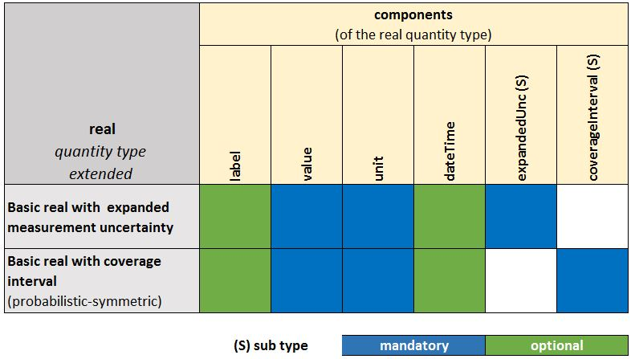
Data model with additional information
Y = y [SI] U₉₅(k) distribution UTC
uncertainty information encapsulated by the elements
„expandedUnc“
„coverageInterval“

Slide 26
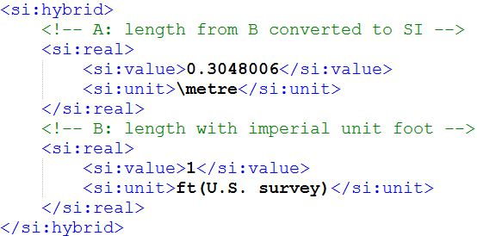
Non-SI: hybrid
Equivalent quantities
machine-readable SI quantity
non-SI quantity
To be used for all units not listed in the latest SI brochure

Slide 27
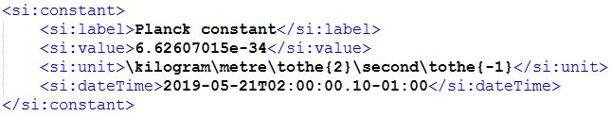
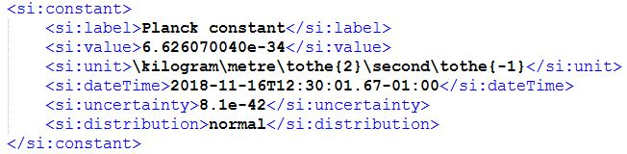
CODATA - constants
Universal machine-readable CODATA constants on basis of
D-SI in addition to original CODATA listings
CODATA
2018
CODATA
2014

Slide 28
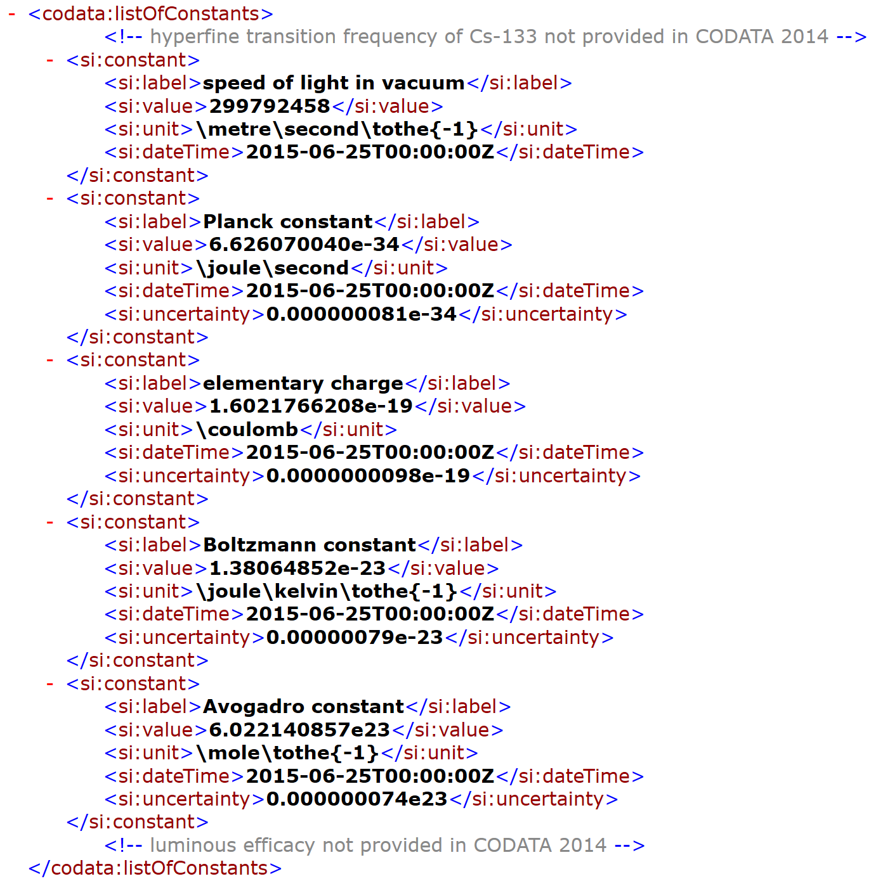
Machine readable defining constants
https://www.ptb.de/si/codata/codata.xsd
https://www.ptb.de/si/codata/CODATA_2014_SI_defining_constants.xml
https://www.ptb.de/si/codata/CODATA_2018_SI_defining_constants.xml

Slide 29
D-SI format development
Y=y±U (k=2)
coverage interval
Format must be
universal
easy & safe
uniform & unambiguous
univariate uncertainty
real quantity
Metrology Standards
IT Standards
num. value
& SI unit

Slide 30
D-SI further development
Y=y±U (k=2)
coverage interval
cartesian or polar coordinate form
coverage region: ellipsoid
…
univariate uncertainty
complex quantity
multivariate uncertainty
aim: data model
real quantity
vector quantity
real & complex vectors, recursion
num. value
& SI unit

Slide 31
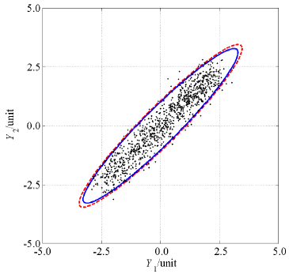
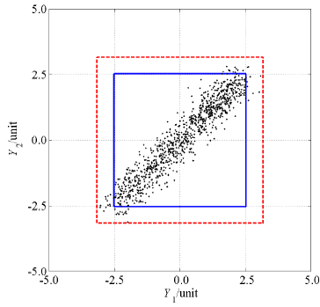
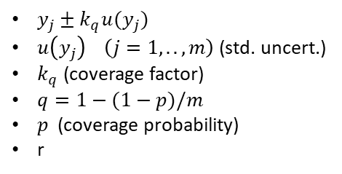

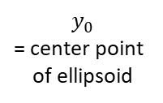
GUM S2 requirements
Hyper-ellipsoidal region
Hyper-rectangular region
${\left(y−y_{0}\right)}^{T}U_{y}^{−1}(y−y_{0})=k_{p}$
$U_{y}$ (covariance matrix)
$p$ (coverage probability)
$k_{p}$ (coverage factor / ellipsoid size scale factor)
$y_{j}±k_{q}u(y_{j})$
$u\left(y_{j}\right) \left(j=1,..,m\right)$ (std. uncert.)
$k_{q}$ (coverage factor)
$q=1−(1−p)/m$
$p$ (coverage probability)
r
$$y_{0}$$
= center point
of ellipsoid

Slide 32


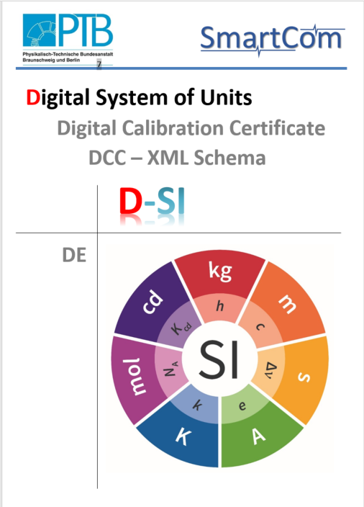
Digital-SI
Universal, easy to understand, safe und unambiguous data model for the digital exchange of metrological data on the basis of the SI
https://tinyurl.com/smartcom-D1
https://tinyurl.com/smartcom-D1-short

Slide 33








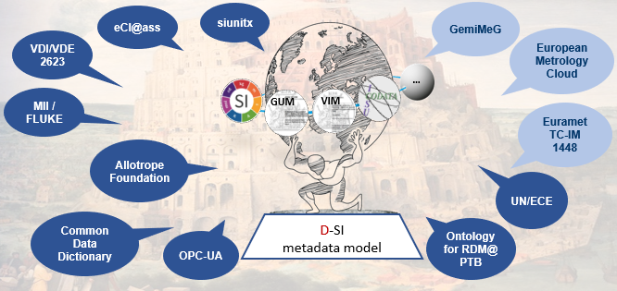
Support Interoperability
Indispensable many different formats
MC
DCC
One universal metadata model (D-SI)!

Slide 34
SmartCom: DCC
Validation
DCC
D-SI
…
GUM
VIM

Slide 35
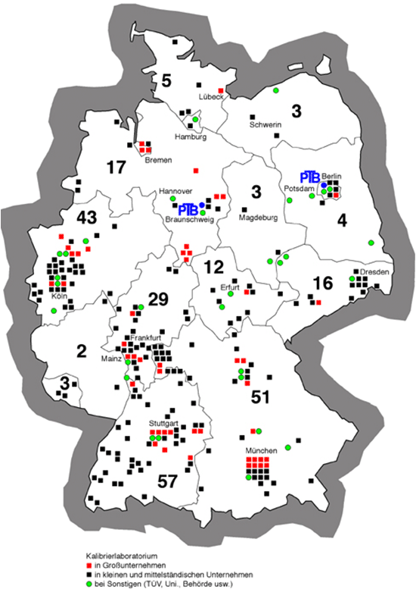

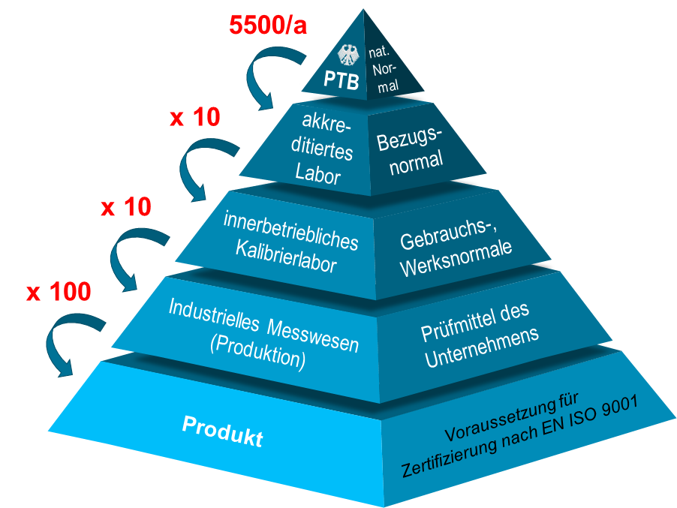
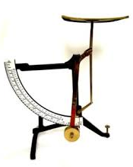
Calibration in Germany
Machine-readable, legally accepted und electronical signed certificate for a digital exchange of calibration data on the basis of the SI
traceability
DAkkS
laboratories

Slide 36
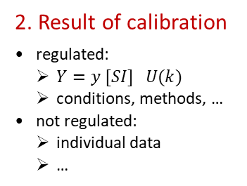
Digital Calibration Certificate (DCC)
1. Administrative data
  regulated
standards & norms
SI
VIM
2. Result of calibration
  regulated:
    $Y=y [SI] U(k)$
    conditions, methods, …
  not regulated:
    individual data
    …
GUM
tree structure
CODATA
17025
XML as exchange format
international accepted & recognized
cryptographic signature
3. Comments
  not regulated
4. analogue document
  human-readable

Slide 37
DCC: universal requirements
…

Slide 38
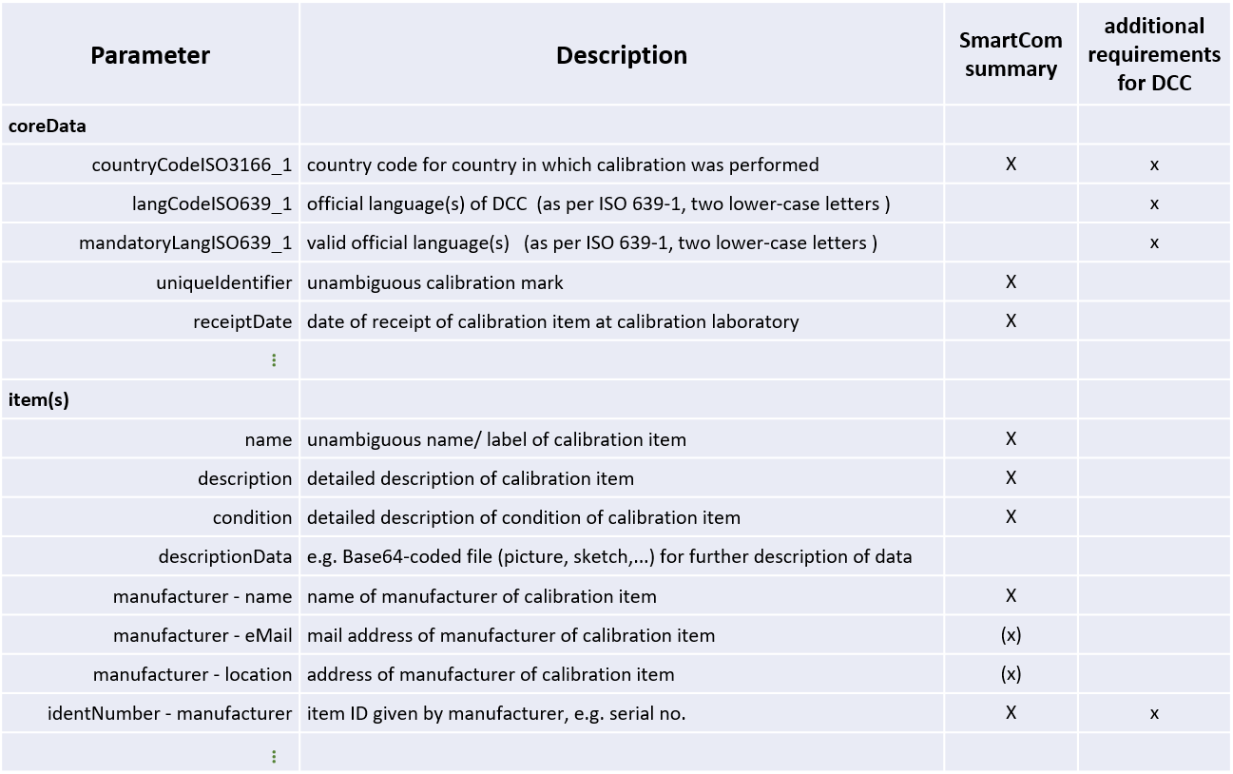
DCC: summary of universal requirements
…

Slide 39

DCC: Framework conditions
Framework conditions for secure transfer
(long-term ) preservation of readability, integrity and authenticity
stable data format
digital signatures
Interoperability
preservation of controllability of data
understanding of risks and liabilities
compliance with security and privacy policies – key management
verification/ validation of data
withdrawal/revocation
… and many more …
Notes:
*noch nicht fertig*

Slide 40
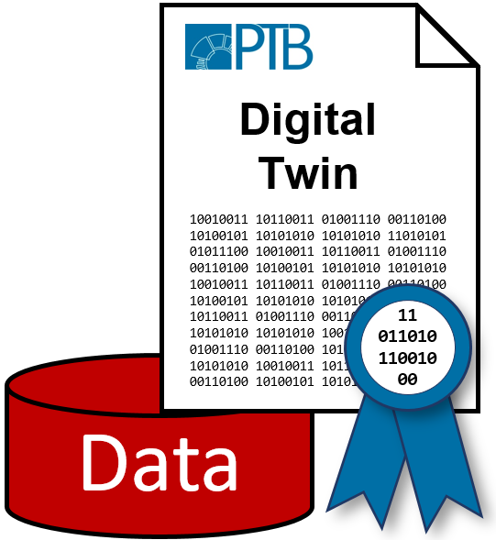
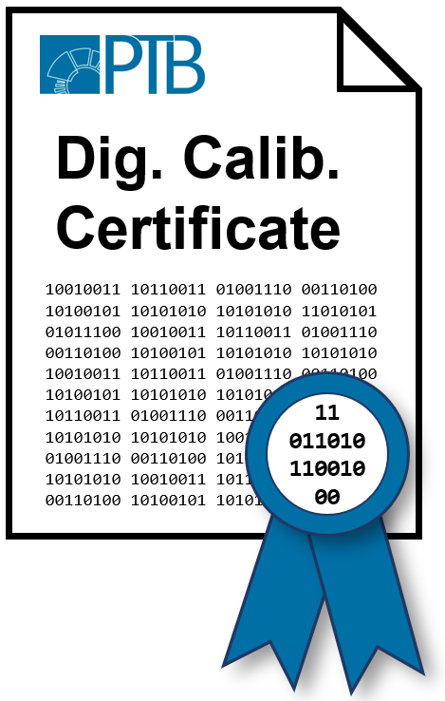

Validity of digital certificates in Germany, the EU and the world
§§
Signature semantics
Registry
Withdrawal/revocation
Validity
Liabilities

Slide 41
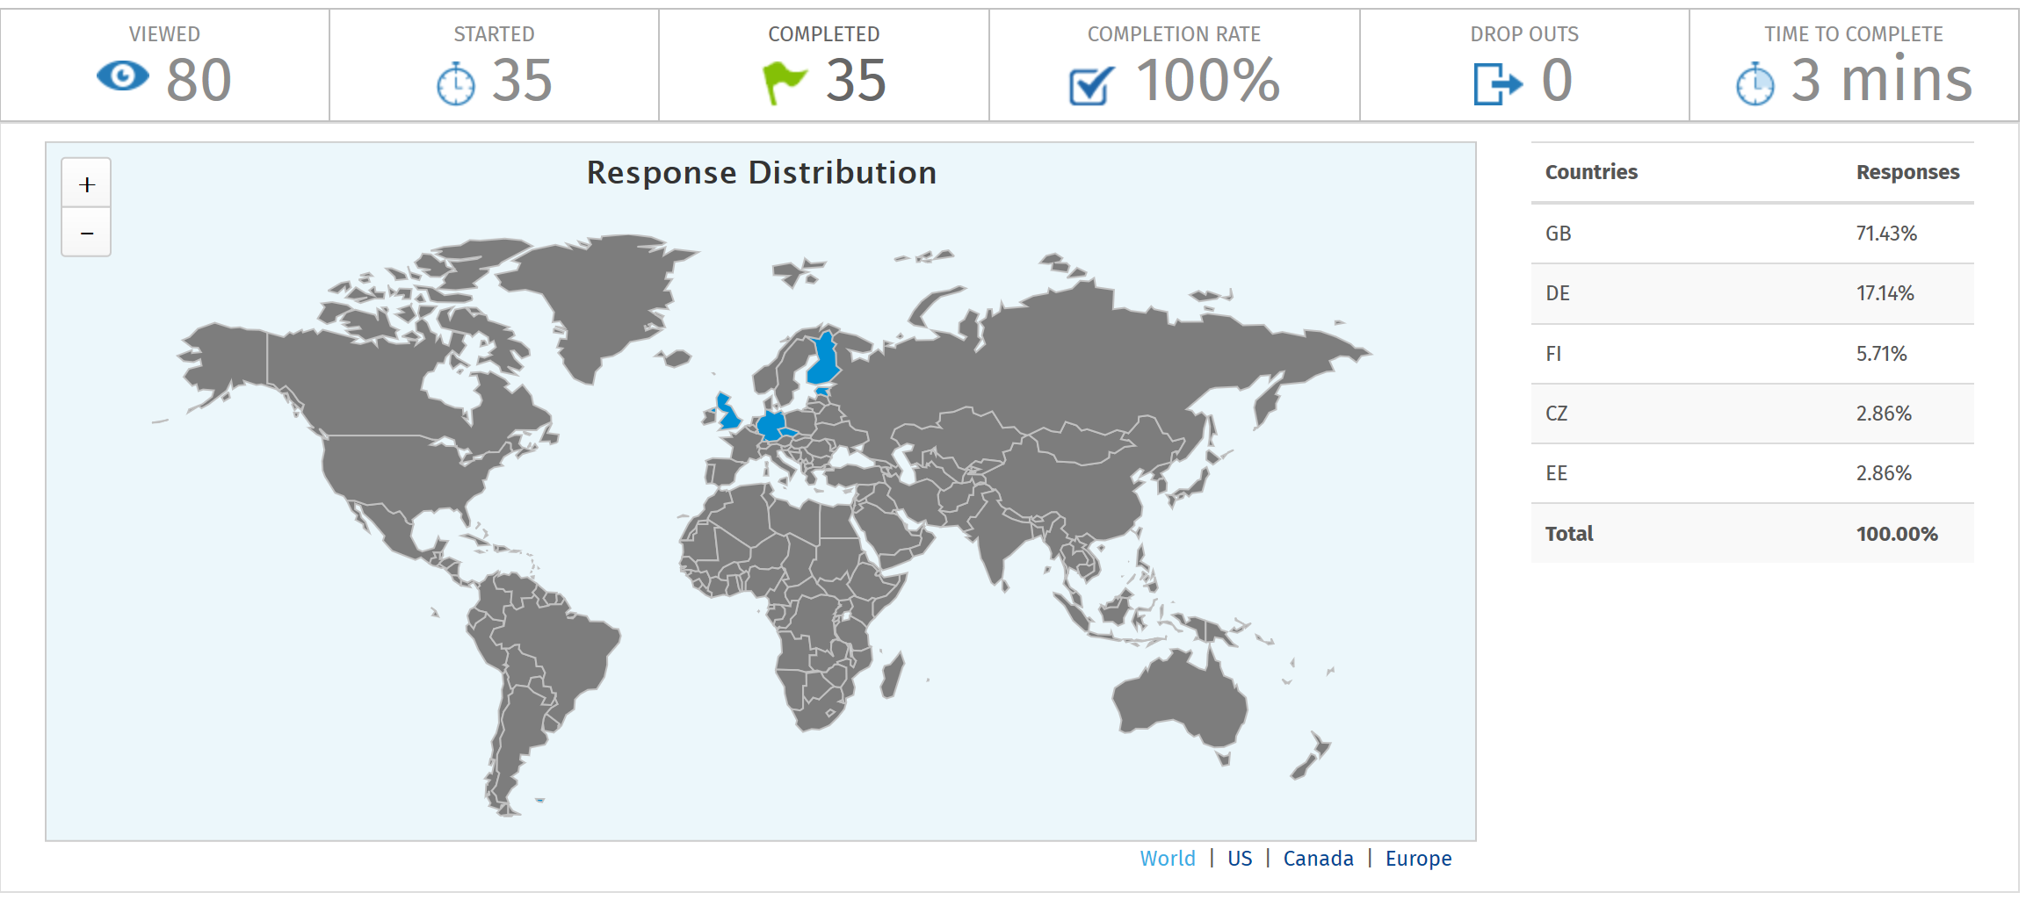
Stakeholder workshop, Nov. 2019

Slide 42
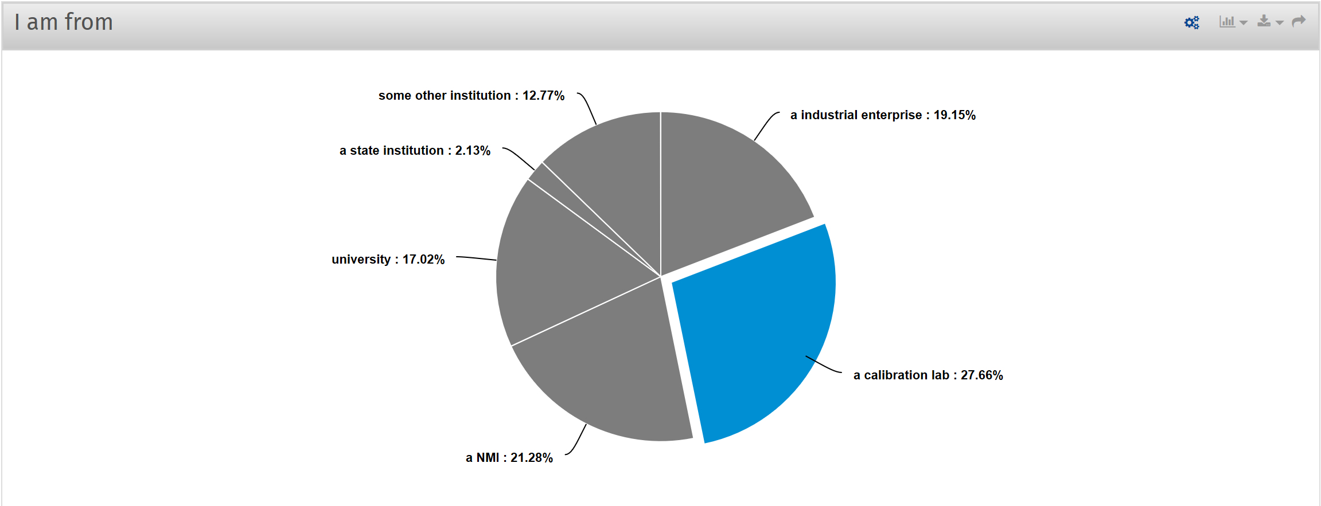
Stakeholder workshop, Nov. 2019

Slide 43
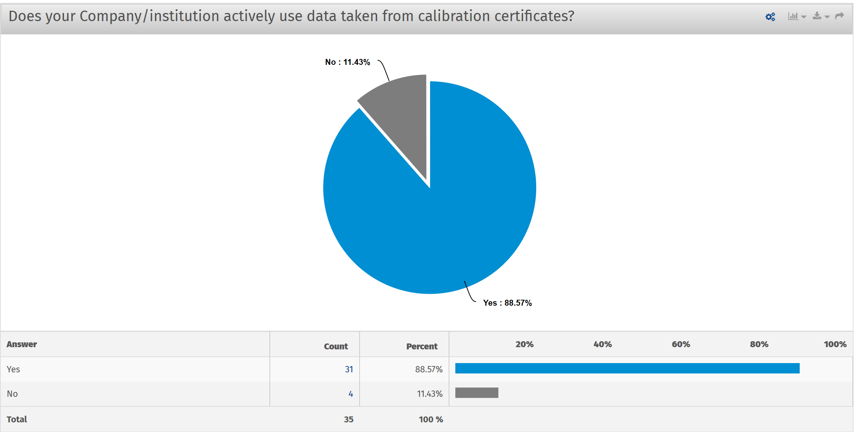
Stakeholder workshop, Nov. 2019

Slide 44
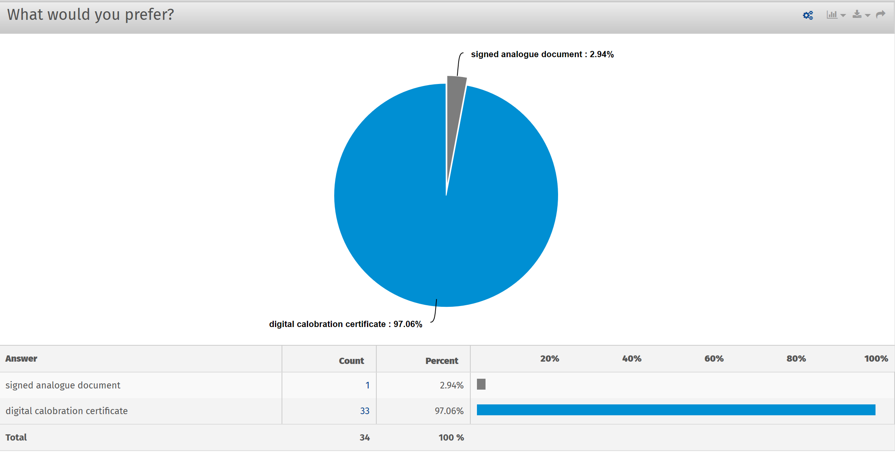
Stakeholder workshop, Nov. 2019

Slide 45
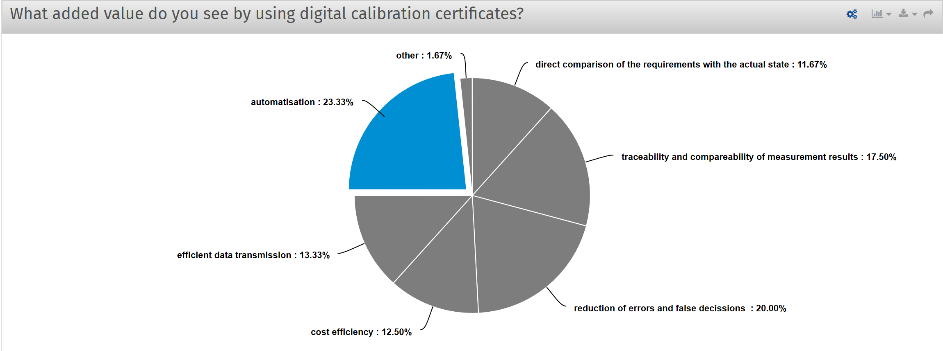
Stakeholder workshop, Nov. 2019

Slide 46
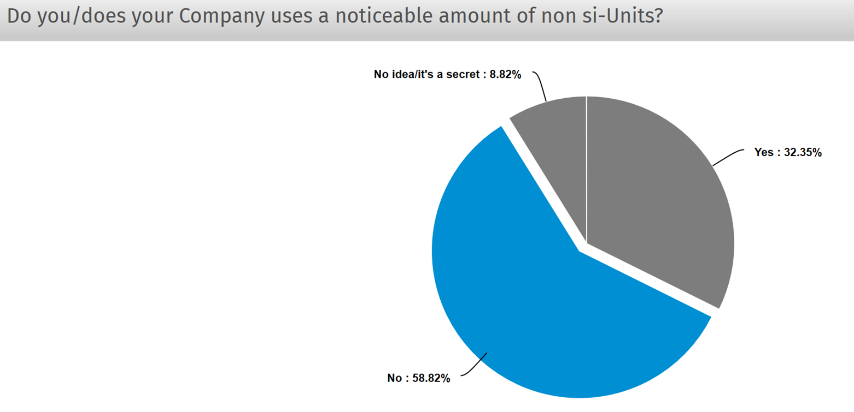
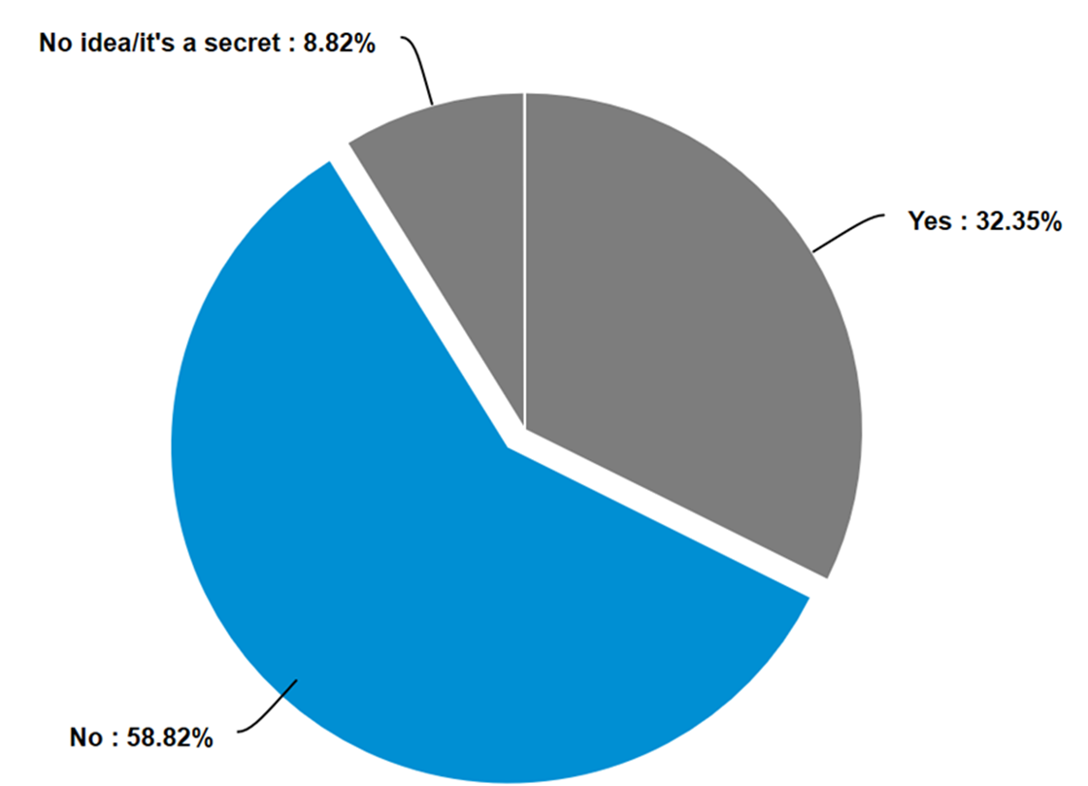
Stakeholder workshop, Nov. 2019

Slide 47
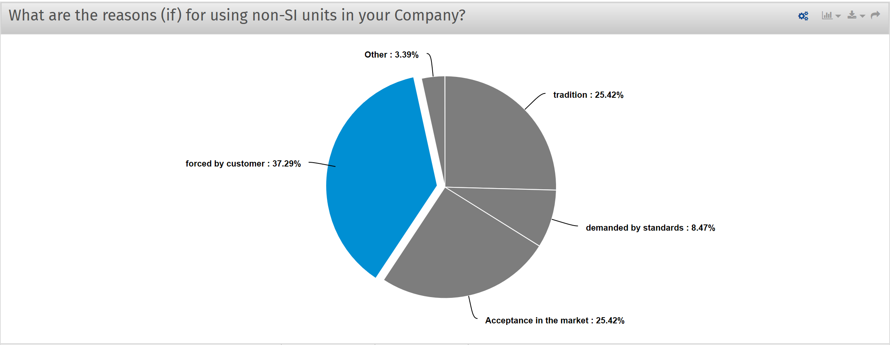
Stakeholder workshop, Nov. 2019

Slide 48
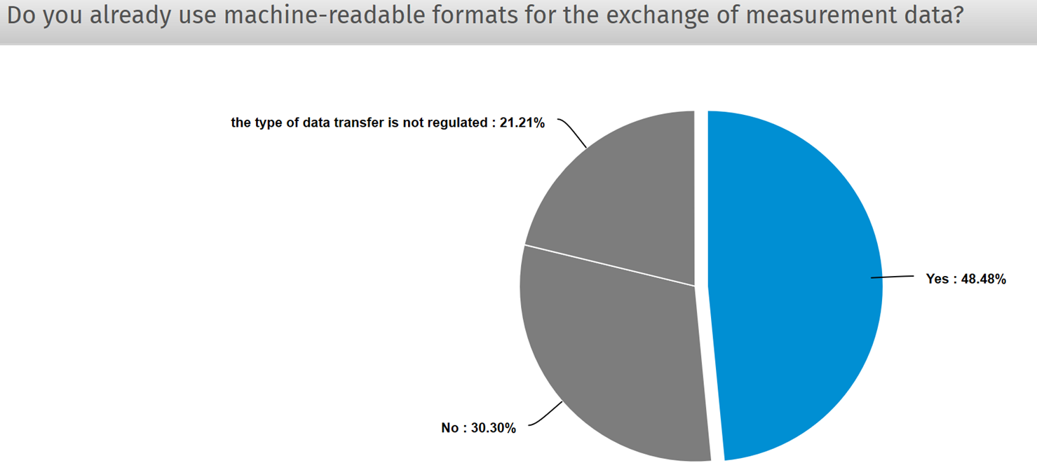
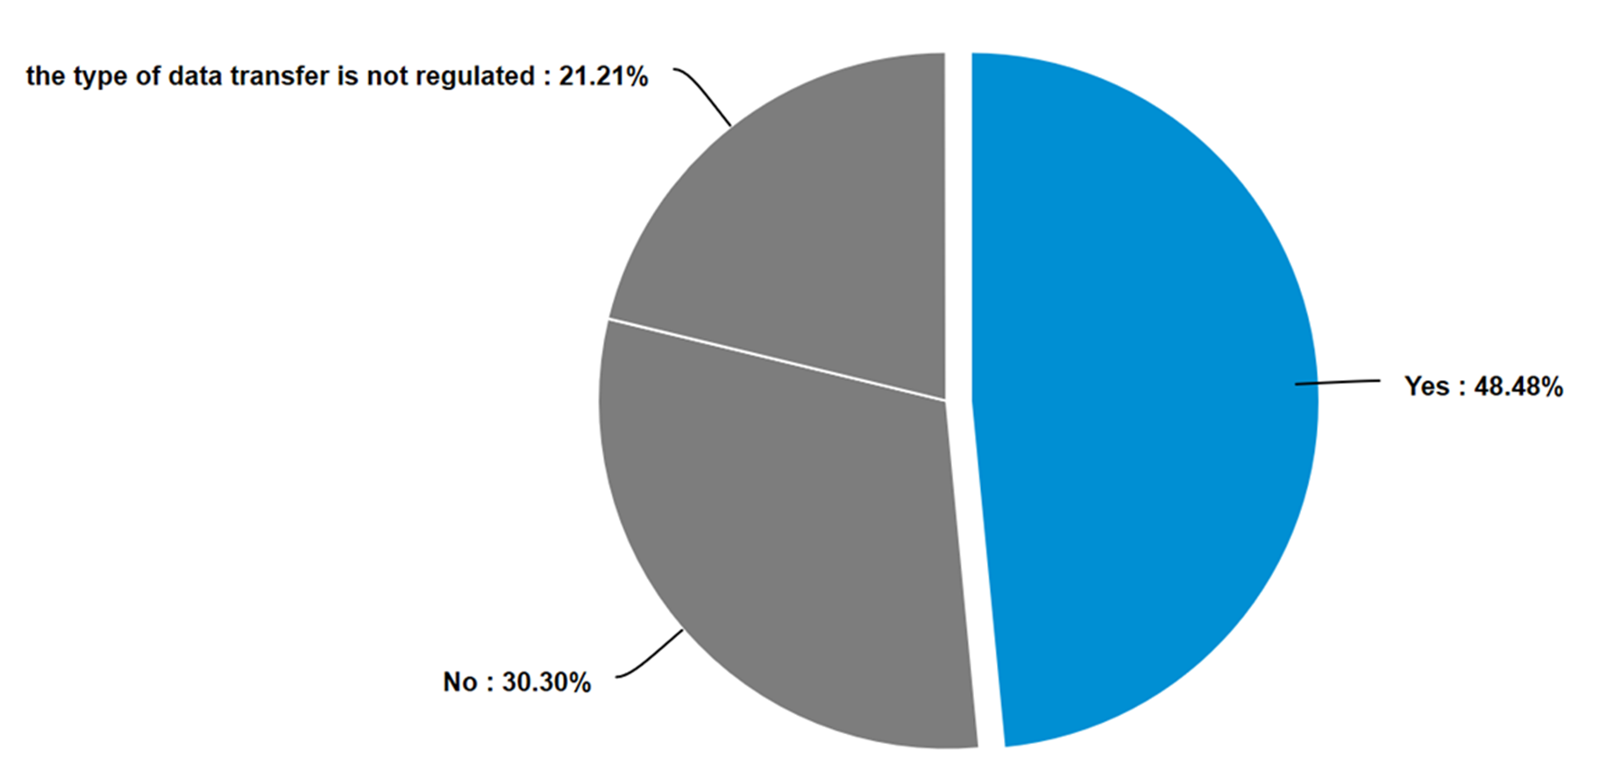
Stakeholder workshop, Nov. 2019

Slide 49
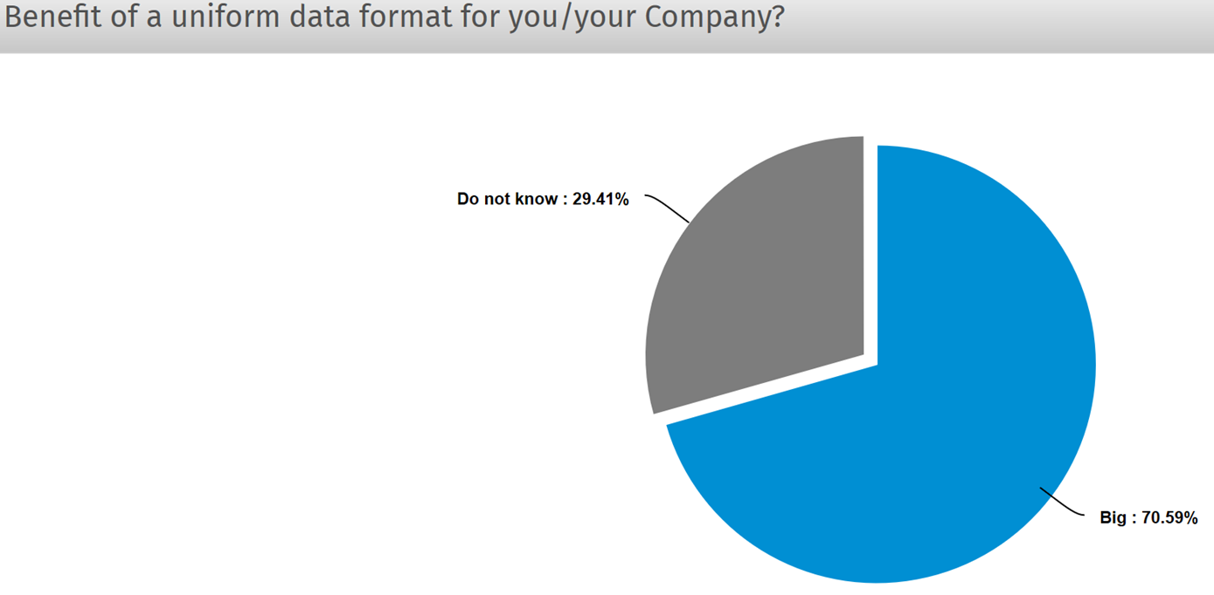
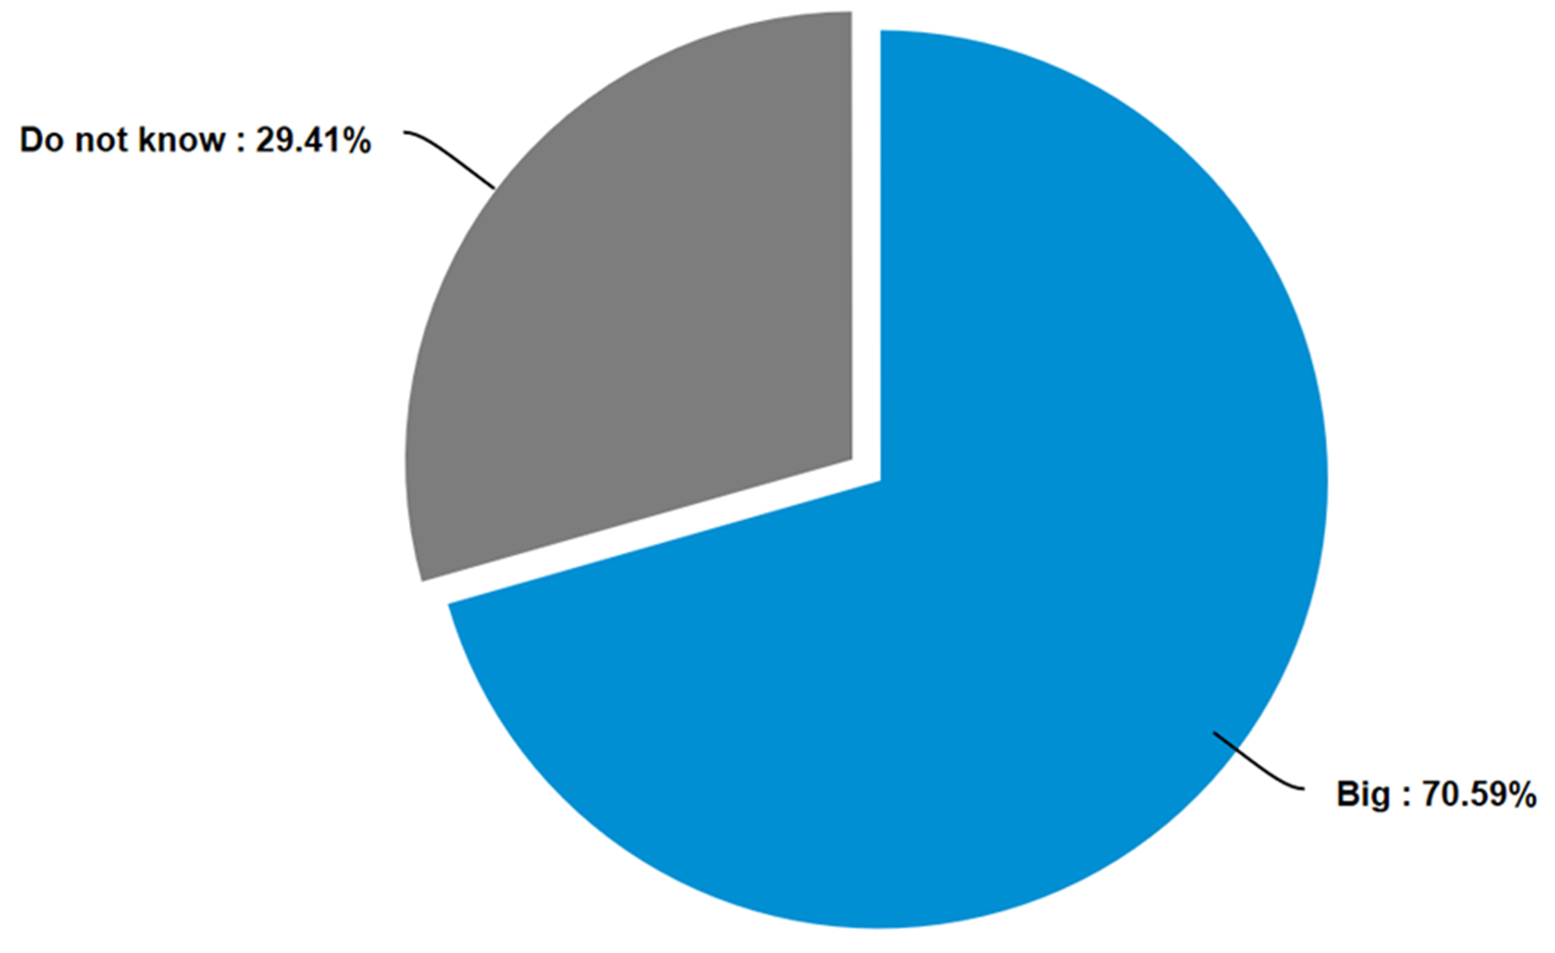
Stakeholder workshop, Nov. 2019

Slide 50

Industrial needs - survey
(Stakeholder workshop, Nov. 2019)
your field of activity
greatest need for development/support

Slide 51
SmartCom: Validation
Validation
DCC
D-SI
…
GUM
VIM

Slide 52




TraCIM service
Traceable Computational Intensive Metrology
industry
TraCIM
machine to machine
machine to machine
CAL_{i}
calibration
laboratories
CAL₁
Validation of algorithms, data/metadata, Digital Calibration Certificates
Consortium of National Metrology Institutes
NMI_{i}
metrology-
institutes
NMI₁
Service provider
Internet based test service
Service users

Slide 53



TraCIM network
TraCIM e.V.
manufacturers
PTB
request
UM
(fully automated)
NPL
request
machines + sensors
request
…
NMIs
request
users
NMI

Slide 54
TraCIM e.V.
TraCIM e.V.
Consortium of National Metrology Institutes
Promoting scientific cooperation concerning traceability of mathematical algorithms for metrology
Accompany upcoming developments of new test in different metrological domains, e.g. length, electricity, chemistry …
Define unique quality standards for software tests

Slide 55

TraCIM-based online validation

Slide 56


Slide 57
SmartCom: Content
Validation
DCC
D-SI
…
GUM
VIM
security
aspects

Slide 58
Security aspects: some terms
Authentication: Identity (of data origin) is known and verified.
Integrity: Data is not modified by unauthorized parties.
Confidentiality: Data is not disclosed to unauthorized parties.
Non-repudiation: The origin and integrity of data cannot be denied.
Availability: Data is accessible whenever needed.

Slide 59

SmartCom Interim Meeting security aspects.pdf - Adobe Acrobat Reader DC

Slide 60

SmartCom Interim Meeting security aspects.pdf - Adobe Acrobat Reader DC

Slide 61


Slide 62

SmartCom Interim Meeting security aspects.pdf - Adobe Acrobat Reader DC

Slide 63

SmartCom Interim Meeting security aspects.pdf - Adobe Acrobat Reader DC

Slide 64

Notes:
A certificate authority can issue multiple certificates in the form of a tree structure. A root certificate is the top-most certificate of the tree, the private key of which is used to "sign" other certificates. All certificates signed by the root certificate, with the "CA" field set to true, inherit the trustworthiness of the root certificate—a signature by a root certificate is somewhat analogous to "notarizing" identity in the physical world. Such a certificate is called an intermediate certificate or subordinate CA certificate. Certificates further down the tree also depend on the trustworthiness of the intermediates.

Slide 65

SmartCom Interim Meeting security aspects.pdf - Adobe Acrobat Reader DC

Slide 66
SmartCom: Content
Validation
DCC
D-SI
…
GUM
VIM
impact and
cooperations

Slide 67


Documentation
WIKI
…

Slide 68

Digitalization is global …
SmartCom
04/2018
06/2018
11/2018
09/2019
03/2018

Slide 69

Worldwide relevance and cooperation

Slide 70

Liaisons

Slide 71
Aims of TC IM 1448: Development of digital calibration certificates
  Definition of minimum requirements for DCC regarding content and interfaces
  Development and publication of case studies, guidelines and software
  Organisation of workshops to provide a forum for the presentation and discussion of novel approaches
  Organisation of training courses, both, web-based and in person
  Active collaboration with all EURAMET TCs
  Active collaboration with the CIPM and its CCs
create DCC
use DCC
validate DCC

Slide 72
Global opportunity
Transfer the successful International
System of Units into the
digitalised world
(October 2019)
Industry
Research
Society
NMIs &
Standar-disation
CIPM Task Group
Digital-SI
Driving Force
Distribution
Benefit

Slide 73
be part of it
Getting in contact via E-Mail: smartcom@ptb.de
Register for the newsletter: https://www.ptb.de/empir2018/smartcom/project/
Be part of the stakeholder network: smartcom@ptb.de
Join the project as collaborator: smartcom@ptb.de
Visit our homepage https://www.ptb.de/empir2018/smartcom/home
International Workshop “Digital Calibration Certificate”
Where: PTB; Brunswick
When: Autumn 2020
Participants: NMI’s, AI’s, Companies, Calibration Lab’s, …

Slide 74




You are invited – your needs do count
Thank you for your attention
Obrigado pela atenção
Take part (short survey):
…
GUM
VIM
https://tinyurl.com/sosu2y5
smartcom@ptb.de

Slide 75
project
start June 2018
duration 3 Year
partners NPL, CMI, Aalto, UM, Unicas, NIM, ITRI, KRISS, Zeiss, Ostfalia, Hexagon, Mitutoyo, Sartorius, Mettler-Toledo.
Contact smartcom@ptb.de
…
GUM
VIM
Thank you for your attention
Obrigado pela atenção

Slide 76

Stakeholder workshop, Nov. 2019

Slide 77

Stakeholder workshop, Nov. 2019

Slide 78


Applications & Connections
Standardization bodies
data security
SI units
data model
glossary
Virtual Metrology
DCC PTB,
GEMIMEG
Research data management
CODATA
data base
SmartCom provides the basis for all metrological communication

Slide 79

Key Example: Met4FoF
Aim: A metrological framework for the evaluation of measurement uncertainties for the complete lifecycle of measured data in industrial IoT networks.
This contains
calibration of sensors with digital, pre-
processed output
incorporation of quality information like
calibration data in industrial sensor networks
incorporation of data quality information in machine learning algorithms
Early impact:
- Improved NMI calibration facilities for sensors with digital-only output
- Proof-of-principle “Smart Traceability” sensor communicating data quality in real-time
- Methods for the evaluation of uncertainty in machine learning for industrial IoT
- Selected industrial IoT test beds improved by a consistent metrology infrastructure

