Slide 1



CHALLENGES IN HEALTH CARE:
THE USE OF OPTICS
V.S. BAGNATO
IFSC- UNIVERSIDADE DE SÃO PAULO
http://cepof.ifsc.usp.br

Slide 2
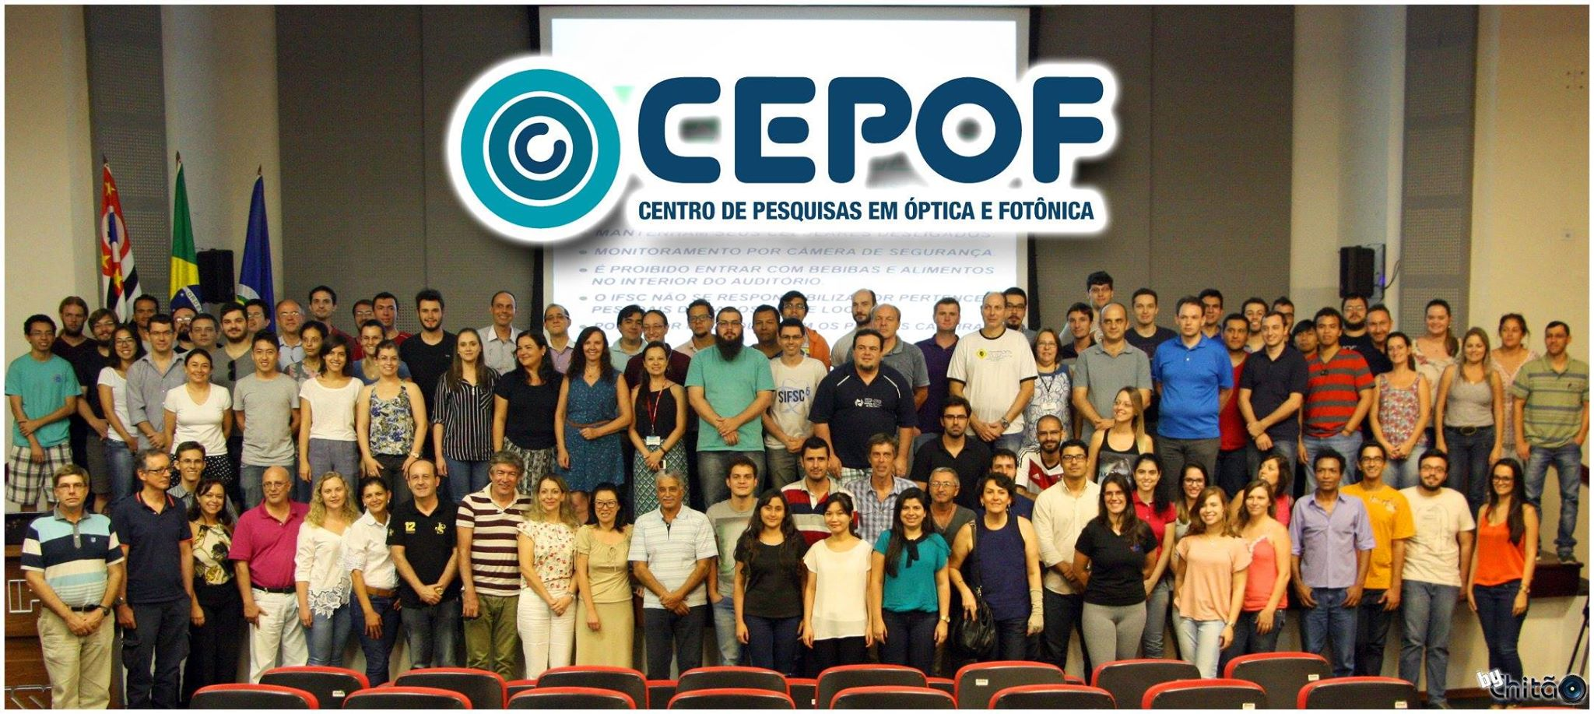
Center for Research in Optics and Photonics
POSITIONS FOR STUDENTS ( MS AND DR) AND PD
http://cepof.ifsc.usp.br

Slide 3





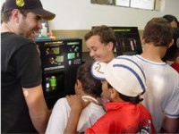
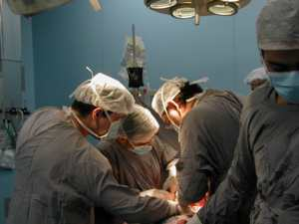
Science Diffusion
Innovation with Social responsibility
Innovation
http://cepof.ifsc.usp.br

Slide 4



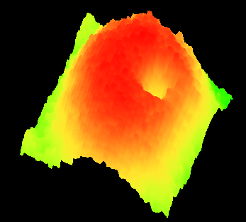
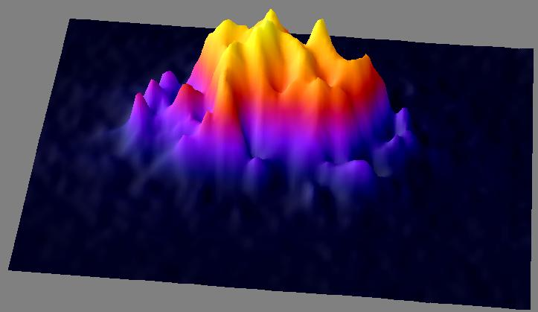
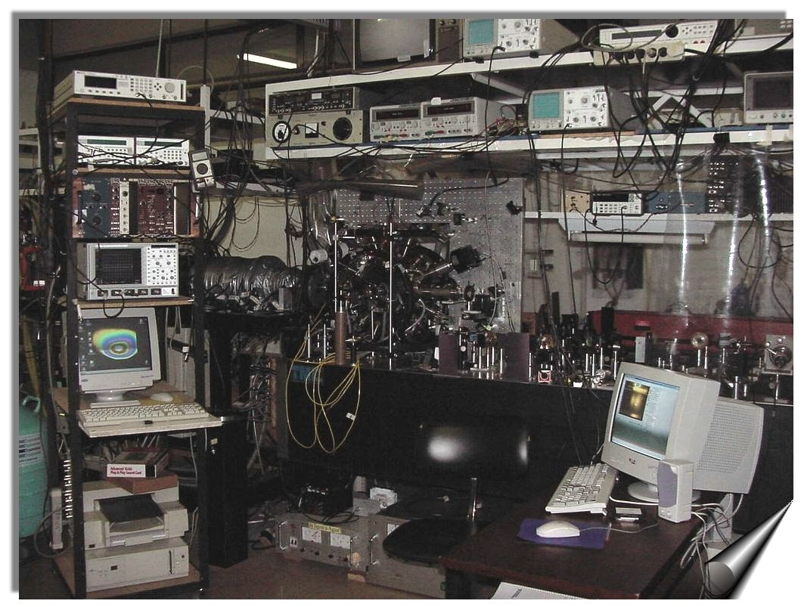
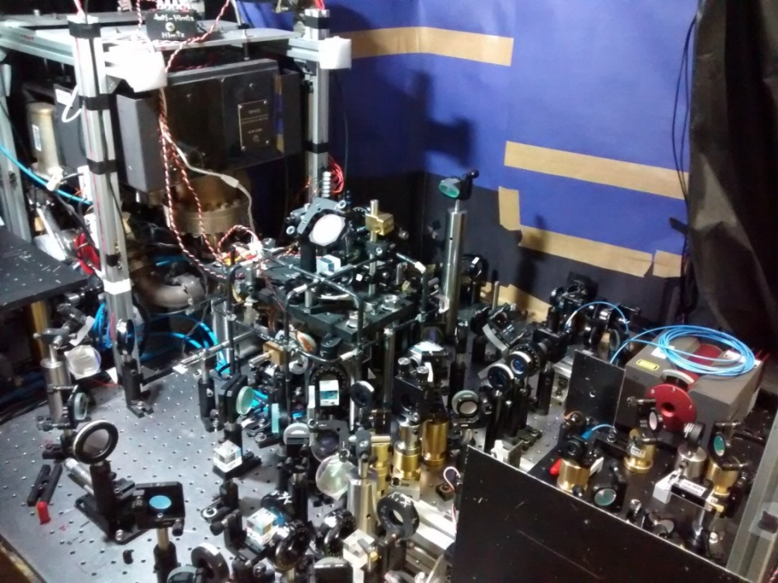
Rb – 87, about 3 10⁵ atoms
Quantum turbulence in superfluids

Slide 5

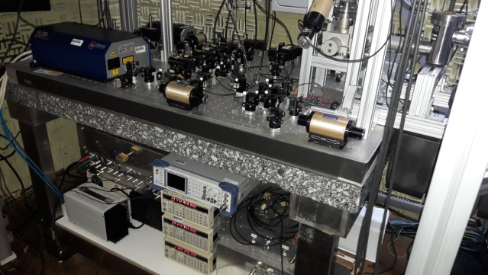
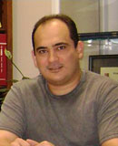
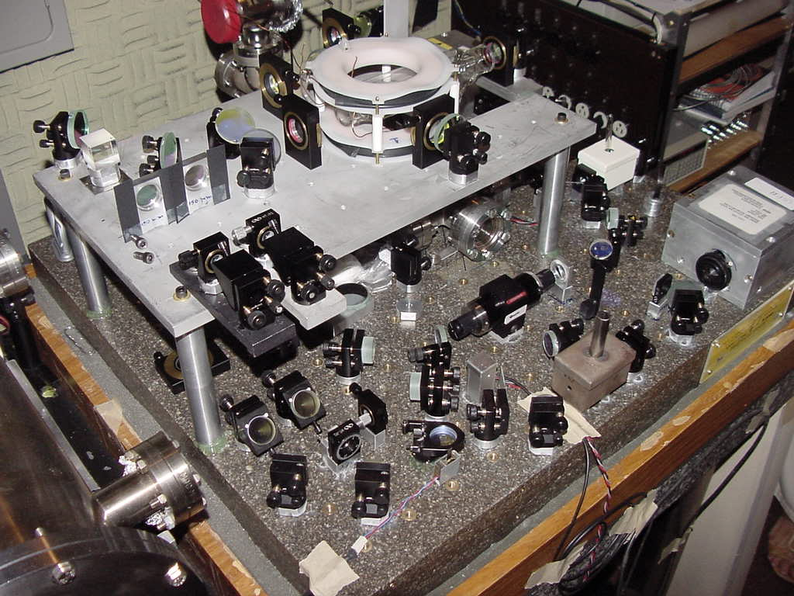
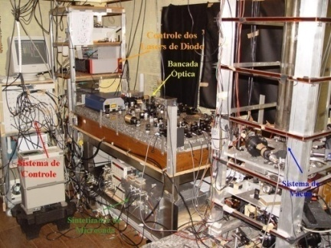
ATOMIC CLOCK

Slide 6
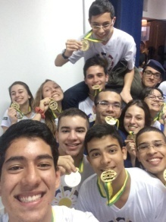
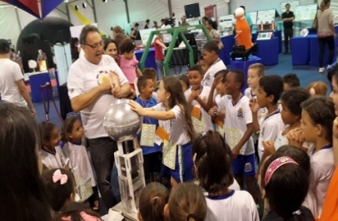
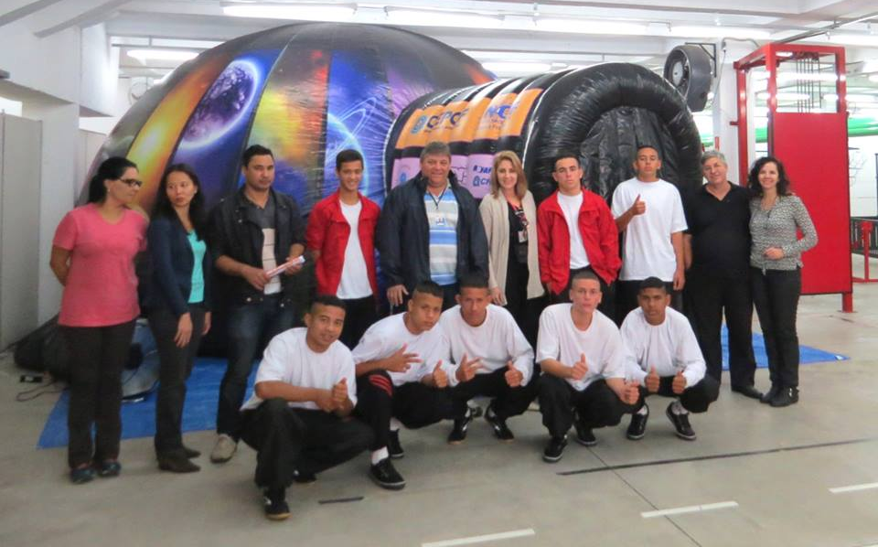
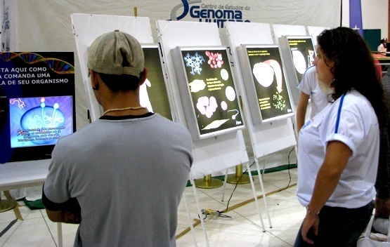
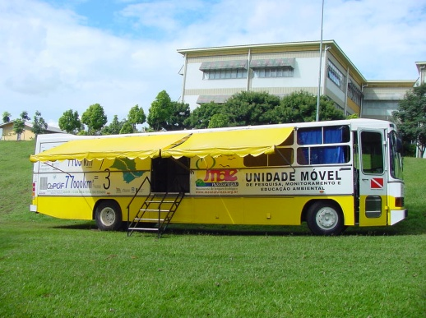
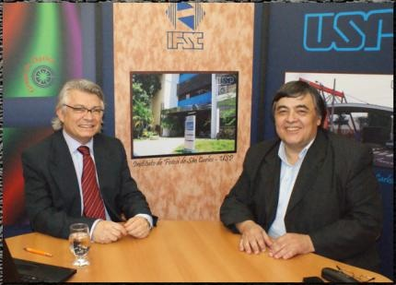
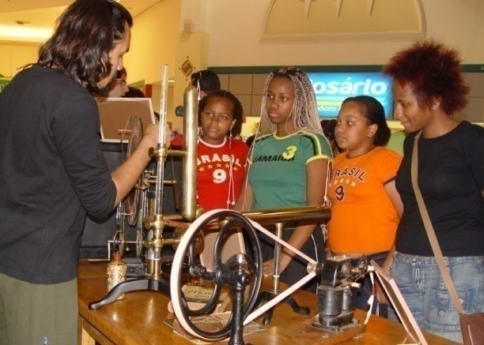
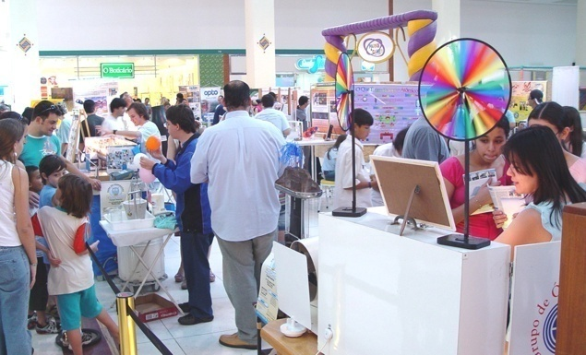
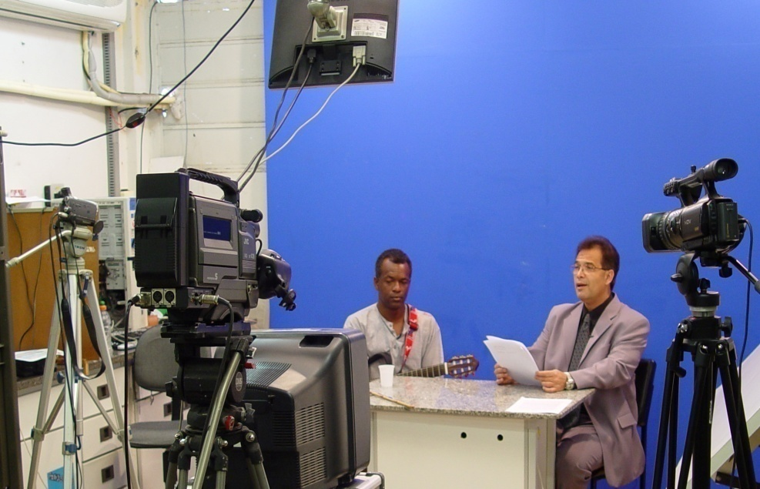
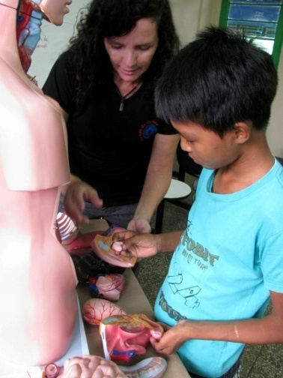
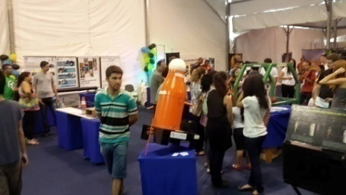
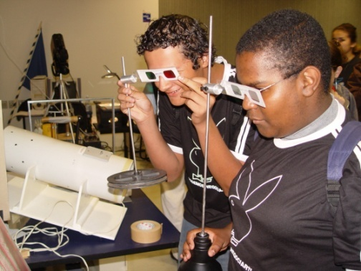
Diffusion os science

Slide 7
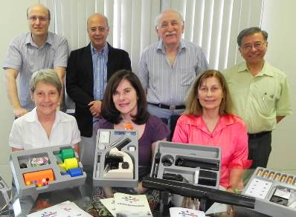
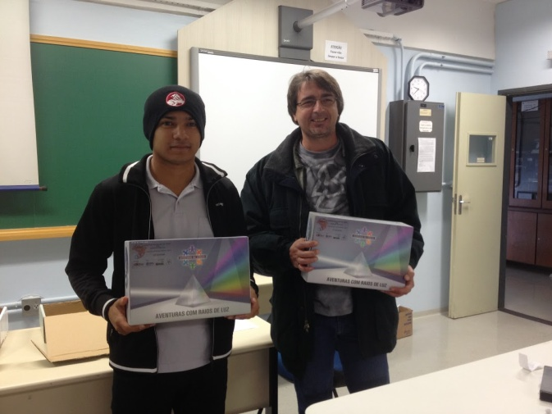
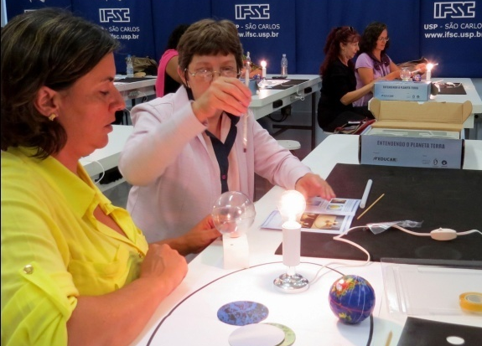
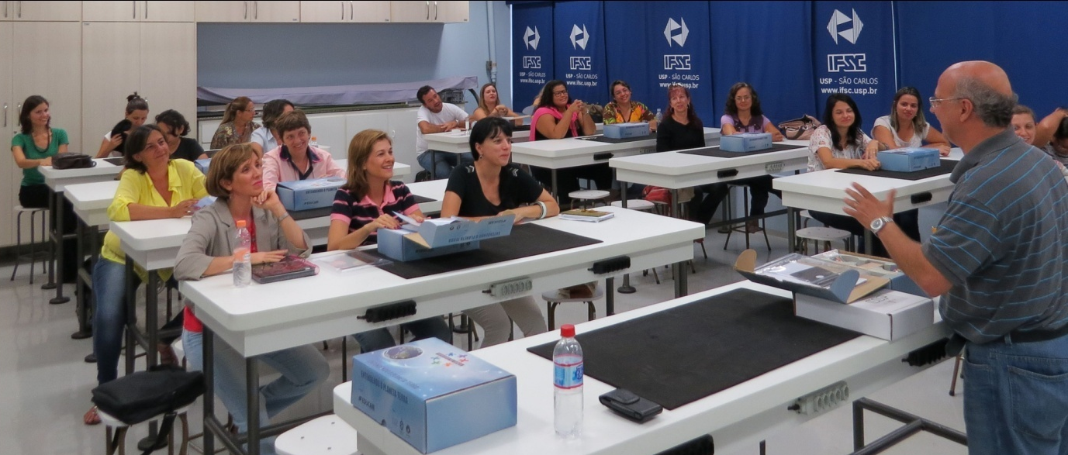
Educational Kits “Science Adventures”
Teachers training

Slide 8


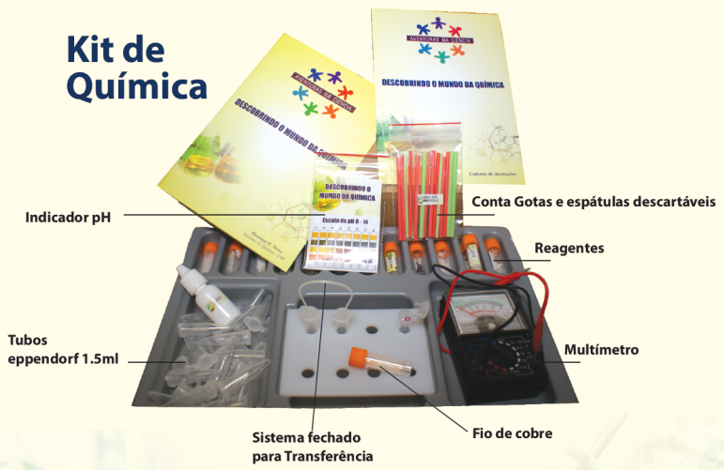
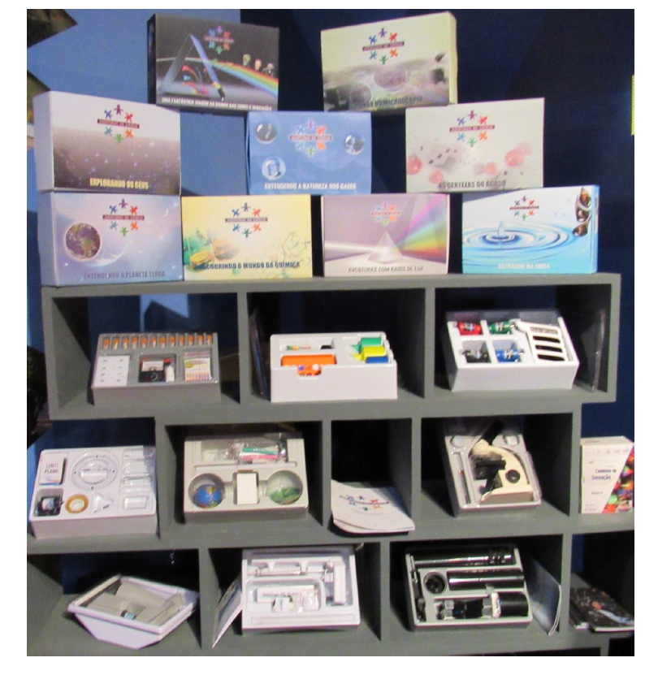
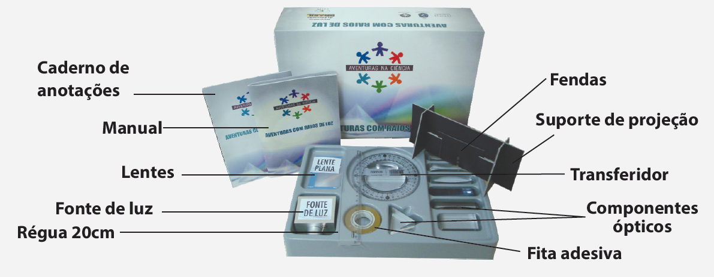
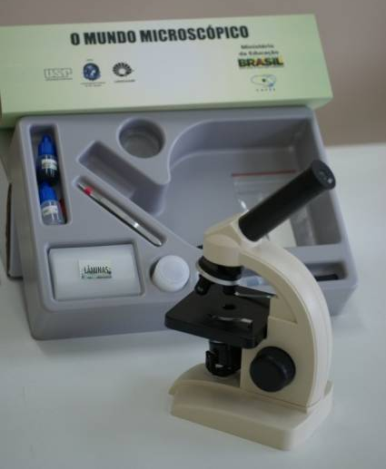
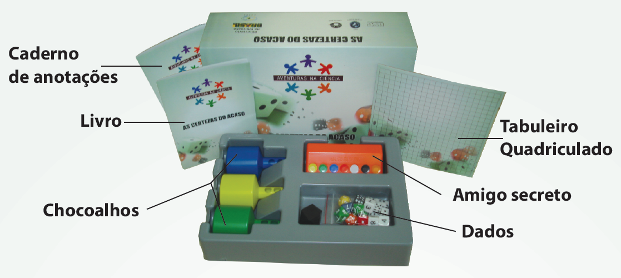
Kits Educacionais
Kit de Probabilidade
Kit de Biologia

Slide 9
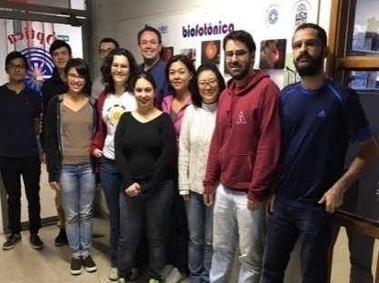
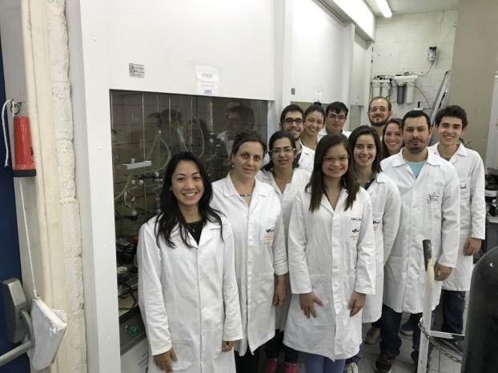
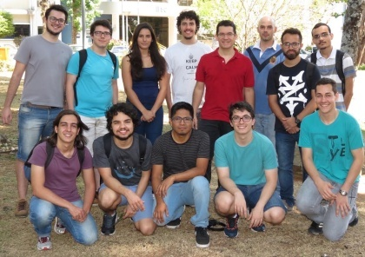
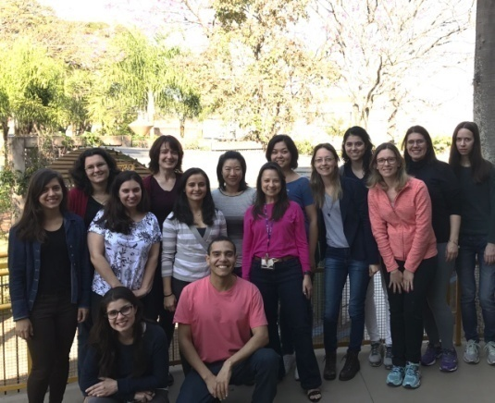
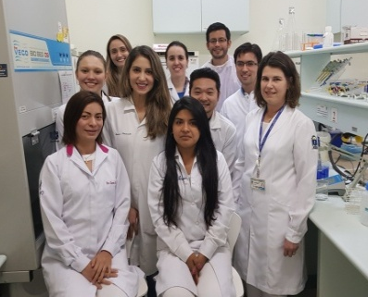
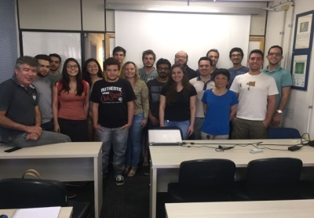
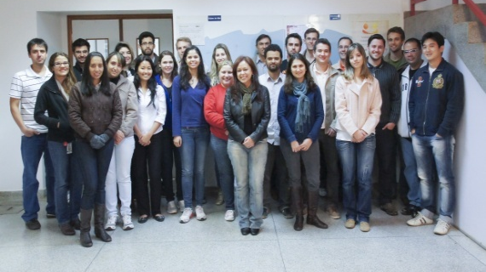
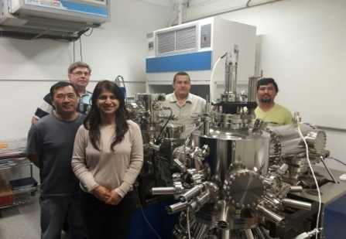
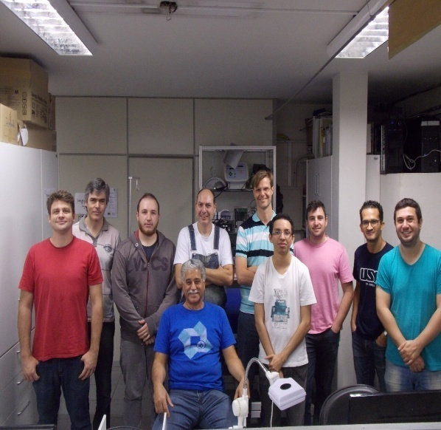
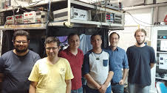
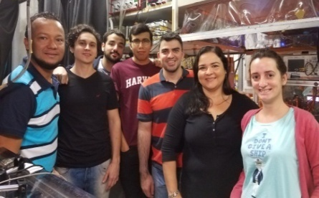
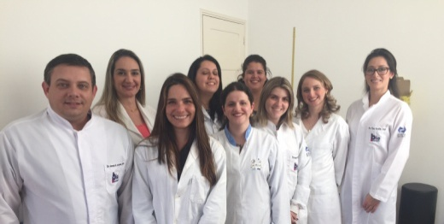
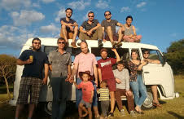
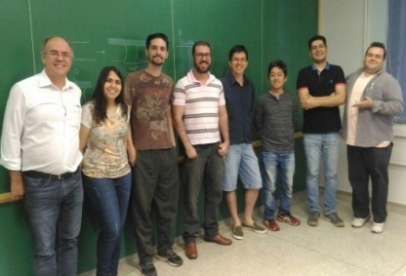
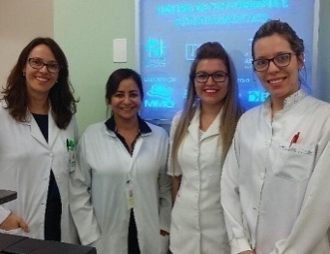
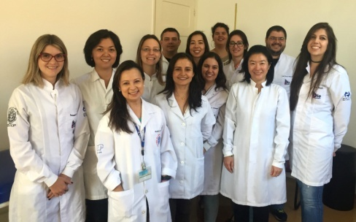
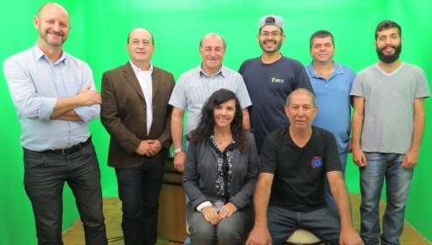
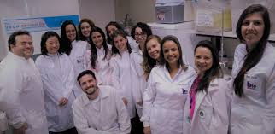


Slide 10


EMBRAPII
INNOVATION IN MEDICAL INSTRUMENTATION AND BIOTECHNOLOGY
Contato: embrapii-saocarlos@ifsc.usp.br

Slide 11




Cells → Experimental models → Clinics
Strong basic sicence part ---- clinical application

Slide 12


Nobel 1903 - Niels Ryberg Finsen
Pelo emprego da luz no tratamento do lupus vulgaris
Lupus vulgaris ou Tuberculose luposa é a forma mais comum de tuberculose cutânea e afeta normalmente pessoas que tiveram contato prévio com o Mycobacterium tuberculosis.^{[1]} Constitui-se de lesões dolorosas na pele com aparência nodular, mais frequentemente na face em torno do nariz, pálpebra, lábios, bochechas e ouvidos.^{[2]:335} As lesões podem resultar em úlceras cutâneas desfigurantes quando não tratadas.

Slide 13

For animals the light may well be a solution for many problems

Slide 14


Agriculture
Enviroment
Treatment
Diagnostics
Medicine
Dentistry
Physical therapy
Physical Education
Basic Science
In vitro
In vivo
Instrumentation

Slide 15
Phototherapy
Treatment
Photodynamic Therapy
Spectroscopy
Frequency and time
Diagnostics
Fluorescence
Imaging

Slide 16
Pulmonary diseases
Condyloma by HPV
Onichomycosis
Oral cavity microbial control
Pitiosis
Infectious
Diseases
Pre-cancer
Actinic keratosis
Actinic cheilitis
Cervical Intraepithelial Neoplasia
Cancer
Oral Cancer
Skin Cancer
Liver transplantation
Physical Therapy
Physical Education
Etc.
Others

Slide 17


LIGHT DISTRIBUTION IN BIO TISSUE
ILLUMINATION
DETECTION
I
POS.

Slide 18
THRESHOLD CONCEPT
TRANSPORT- PHARMACOKINETIC

Slide 19


Threshold dose model:

Slide 20

PREDICTING THE DEPTH OF. NECROSIS
β = 0.00058 J⁻¹.mg⁻¹.cm⁵
σ = 1.5 mg⁻¹.cm²
= 0.163 cm⁻¹
= 0.65 ± 0.32 (mm)

Slide 21





EXPERIMENTS

Slide 22





CHALLENGES
PAIN RELATED TO CHRONIC
CANCER
MICROBIAL CONTROL
3.8% of Global Economy will be lost because of resistant bacteria
FOOD SECURITY

Slide 23
Incidência de câncer no Brasil pode aumentar em 78% nos próximos 20 anos
Dados foram publicados nesta quarta-feira (12) pela Agência para a Pesquisa do Câncer, entidade ligada à Organização Mundial da Saúde (OMS)

Slide 24
GENERAL PANORAMIC OF BIOPHOTONIC IN SÃO CARLOS
PHOTOTHERAPY
PHOTO THERAPY
Or photo control
PHOTO-CHEMICAL
PHOTODYNAMIC

Slide 25







Photodynamic action
Ultra-violet
Ozone
LIGHT+ MOLECULE+ O₂
SEVERE OXIDATION
Cells or MICROORGANISMS

Slide 26
PDT

Slide 27










aumenta produção de ATP

Slide 28





Slide 29





Slide 30




Slide 31



Slide 32



Slide 33



Slide 34



Slide 35


ANGIOGENESE
Inducing cell mitoses

Slide 36







Slide 37






PERFORMANCE: 1-6 meses
AUMENTO DA POTÊNCIA MUSCULAR
REDUÇÃO DA FADIGA
MULHERES NA PÓS-MENOPAUSA
AUMENTO DA TOLERÂNCIA AO EXERCÍCIO
Paolillo et al. 2011
Photomedicine and Laser Surgery
Paolillo et al. 2012
Lasers in Medical Science

Slide 38



Parkinson syndrome
Notes:
P.S. = smadzeņu pataloģija, kad SN šūnas atmirst un vairs neražo dopamīnu, kas ir vajadzīgs, lai smadzenes liktu veikt kustības.

Slide 39




Slide 40





Slide 41



Slide 42



Slide 43




Slide 44



Photobiomodulation and Radiotherapy
Photobiomodulation to sensitize cells to radiotherapy
  Study the effect of light/radiation alone in vitro and in vivo
  Investigate the combination and determining a protocol
Control
5Gy
Cell cycle analysis

Slide 45
ULCERS
Apoio:

Slide 46


APLICAÇÃO PROTOCOLO
⬅ LASERTERAPIA
BIOMEMBRANA ➔

Slide 47


PHOTODINAMIC THERAPY, LASERTHERAPY and BIOMEMBRANE in TREATMENT of VENOUS ULCER
Photodynamic therapy
Biomembrane
Lasertherapy

Slide 48

Evolução do tratamento de ulceras venosas . A) Úlcera venosa no ínicio do tratamento. B) Durante o tratamento 3ª sessão. C) Durante o tratamento 6ªsessão. D) após a 8ªsessão
Tempo de úlcera: 12anos

Slide 49


Evolução do tratamento de ulceras venosas . A) Úlcera venosa no ínicio do tratamento. B) após a 4ªsessão
Tempo de úlcera: 6meses

Slide 50



ULCERS

Slide 51
Apoio:

Slide 52
Apoio:

Slide 53

MICROORGANISMO CONTROL
Picture : M. Hamblin and collab.

Slide 54






Condiloma HPV
ALA – 20%
LED 630 nm 150 mW/cm²
Systemic Porphyrin – 1mg/Kg

Slide 55

Detection of HPV/Condyloma
Fig. 1 – White Light
Fig. 2 – Induced Fluorescence w/ ALA
Real-time detection using PDT induced fluorescence

Slide 56

Effect of in vitro PDT on the Staphylococcus aureus viability

Slide 57








ONYCHOMYCOSIS

Slide 58



Clinical Protocol
20 minutes
120 Joules/cm²

Slide 59

E na podologia?

Slide 60




Photodynamic Therapy and blood cleaning
UV
circulator
Physical separation
Cells
Plasma

Slide 61

New device in test

Slide 62


DECONTAMINATION OF ORGANS FOR TRANSPLANTATION
( LUNG - COLLABORATION U.TORONTO)
Presently doing experiments with liver and kidney ( animal models) in Brazil

Slide 63


Slide 64










Treatment
Phase II (adult)
Phase II (children)
98 cases were treated
After 24 h
Phase III - APPROVED FOR A MULTICENTER TRIAL
Before treatment
After 48 h

Slide 65


PDI on Pneumonia infection using extra-body illumination
Animal model
  Instillation of 10⁸ S. pneumoniae cells
780 nm diode laser device
  60 mW/cm² of irradiance
  120 J/cm² of fluence
Indocyanine green - ICG
  100 µM – Instillation method
Notes:
So, the objective of this study is to propose PDI as an alternative to the treatment of pneumonia, or as an auxiliary technique.

Slide 66









Notes:
For the survival rate the animals were monitored for 50 days; and during that period, 60% of the control group died. In the PDI group, however, no death was observed. During this experiment the animals weight was monitored, and we observed that in the PDI group the animals weight remained the same. However, for the control group the animals weight decreased continuously until death.

Slide 67





Next step in progress
( about 10 mW/cm2
in average reaching the target)
BIOFILM INACTIVATION USING IN ENDOTRACHEAL TUBE
S. aureus Biofilm
formation curve
Notes:
Here we have the CFU recovery results. For control, light and ICG groups, CFU recovery ranged between 10 to the third and 10 to the fourth, on average. For the PDI group, however, only 1 animal allowed enough recovery of CFU to be counted; because there was no bacterial growth in other animals. Therefore, there was a reduction of CFU of about three logs in the PDI group compared to the other groups.

Slide 68


NEGATIVE-POSITIVE PRESSURE WITH O₂

Slide 69
Intra-oral Application
Mostly SCC
Good necrosis level ( good vessel supply)
Fast recover of mucous

Slide 70

The technique is simple, involving in most part of the cases direct illumination taking from 20 to 60 min.
\

Slide 71

IF NECESSARY USE INTERSTITIAL FIBER WITH DIFFUSIORS FOR AFECTING THE TUMOR FROM INNER TO OUT PARTS
This procedure depends on size and Shape of lesion.

Slide 73



Slide 74





SCC

Slide 75




Larynx Treatment Response
2 weeks post PDT
6 weeks post PDT

Slide 76
Intestine

Slide 77
Breast cancer cutaneous recurrency
Initial
after
Droga Sistêmica

Slide 78




ESOPHAGUS
BETTER CONFORT FOR
THE PATIENT

Slide 79


Eye inner cantus – 28 cases: 100% cure

Slide 80


Slide 81
PDT -LIVER

Slide 82




No deadly but costly
Dra. Natalia -→ Skin Cancer and PDT - BRAZIL

Slide 83



PRICE WITHIN THE NATIONAL REALITY
Aprovado pela ANVISA

Slide 84








PROJETO “TERAPIA FOTODINÂMICA BRASIL – Tratamento do Câncer de Pele”
Visuafluorescence guided treatment

Slide 85


PROJETO “TERAPIA FOTODINÂMICA BRASIL – Tratamento do Câncer de Pele”

Slide 86


PROJETO “TERAPIA FOTODINÂMICA BRASIL – Tratamento do Câncer de Pele”
Real time visualization

Slide 87





Centers in Brazil
100 localities in Brazil
Mexico, Cuba, Venezuela, Colombia, Equador, Chile
Argentina, Bolivia

Slide 88
















Campinas-SP
Pres. Prudente-SP
Maceió-AL
Teresina-PI
Macau-RN
Salvador-BA
Guarapuava-PR
Votorantim-SP
Rondonópolis-MT
Cuiabá-MT
Brasília-DF
Curitiba-PR
Matão-SP

Slide 89




Rio de Janeiro - RJ
Niterói- RJ

Slide 90









PROJETO “TERAPIA FOTODINÂMICA BRASIL – Tratamento do Câncer de Pele”
Before and 30 days after

Slide 91




PROJETO “TERAPIA FOTODINÂMICA BRASIL – Tratamento do Câncer de Pele”

Slide 92


PROJETO “TERAPIA FOTODINÂMICA BRASIL – Tratamento do Câncer de Pele”

Slide 93
At the present
Situation | Number of lesions | type | RESULTE
BEFORE THE PROGRAM | 2300 | BC, SC | 83% (AFTER 3 YEARS)
IN THE PROGRAM | 7200 | BC | 95%( STILL UNDER EVALUATION)
NEW TARGET → 97%

Slide 94



Slide 95


CERVICAL CANCER
Dra. Cynthia and Dra. Renata → Cervical Cancer Program

Slide 96









CerCa 150 System®: cervical intraepithelial neoplasia
1 hr
100 J/cm²
Approved by ANVISA and COFEPRIS

Slide 97



Awards
2013
2016

Slide 98













orange
Beef - E.Coli, Salmonela, etc
Transport and distribution
Losses: 30%

Slide 99
WE ARE USING THREE MAJOR TECHNIQUES FOR FOOD SAFE
ULTRA –VIOLET RADIATION
OZONE REACTION
PHOTODYNAMIC ACTION
LIGHT+ MOLECULE+ O₂
SEVERE OXIDATION OF MICROORGANISMS
NO RESISTENCE

Slide 100









